Slide 1
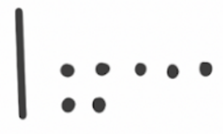
Think Addition Blocks
Directions: Take four cards to create 2 two-digit numbers. Write a subtraction problem. Write a related Think Addition problem. Draw base-10 blocks to help you count up to the sum.
Subtraction Problem | Think Addition Problem | Base-10 Drawing
56 – 39 = | 39 + ____ = 56 | 39 +

