Slide 1
Directions
Print and cut the triangle cards.
Use the blank cards on the last slide to make your own sets.
Please see PDF in case the formatting of this file changes.

Slide 2

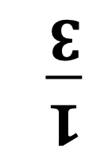
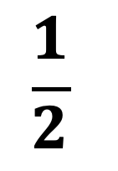
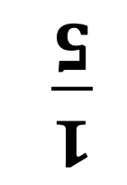
$$\frac{1}{5}$$
3
4
$$\frac{1}{4}$$
15
16
6
18
18
$$\frac{1}{3}$$
$$\frac{1}{2}$$
9

Slide 3
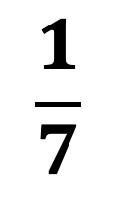
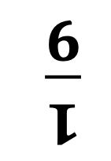
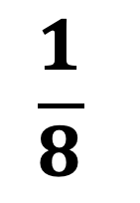
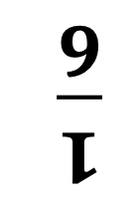
$$\frac{1}{7}$$
$$\frac{1}{6}$$
4
24
21
3
$$\frac{1}{9}$$
4
5
$$\frac{1}{8}$$
36
40

Slide 4


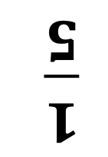

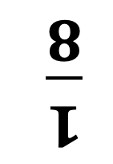
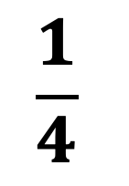

11
$$2\frac{1}{5}$$
14
$$\frac{1}{5}$$
$$3\frac{1}{2}$$
$$\frac{1}{4}$$
$$\frac{1}{8}$$
18
9
$$2\frac{1}{4}$$
$$\frac{1}{2}$$
$$4\frac{1}{2}$$

Slide 5
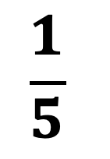


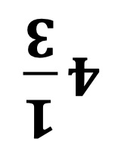
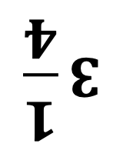

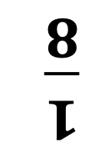
$$\frac{1}{6}$$
$$4\frac{1}{3}$$
14
$$\frac{1}{3}$$
$$4\frac{2}{3}$$
26
$$3\frac{1}{4}$$
26
$$3\frac{2}{5}$$
$$\frac{1}{8}$$
$$\frac{1}{5}$$
17

Slide 6
????
????
????
????
????
????
????
????
????
????
????
????

Slide 7
????
????
????
????
????
????
????
????
????
????
????
????

