Slide 1
2.6 + 8.3 | 3.9 + 1.5
9.2 + 2.3 | 6.8 + 6.7
5.5 + 8.8 | 8.7 + 1.3
0.59 + 0.25 | 0.26 + 0.25
0.22 + 0.48 | 0.37 + 0.44

Slide 2
9.9 – 8.4 | 3.1 – 1.6
2.1 – 1.6 | 6.0 – 2.7
2.9 – 1.7 | 5.9 – 2.8
0.64 – 0.49 | 0.62 – 0.27
0.64 – 0.38 | 0.34 – 0.29

Slide 3
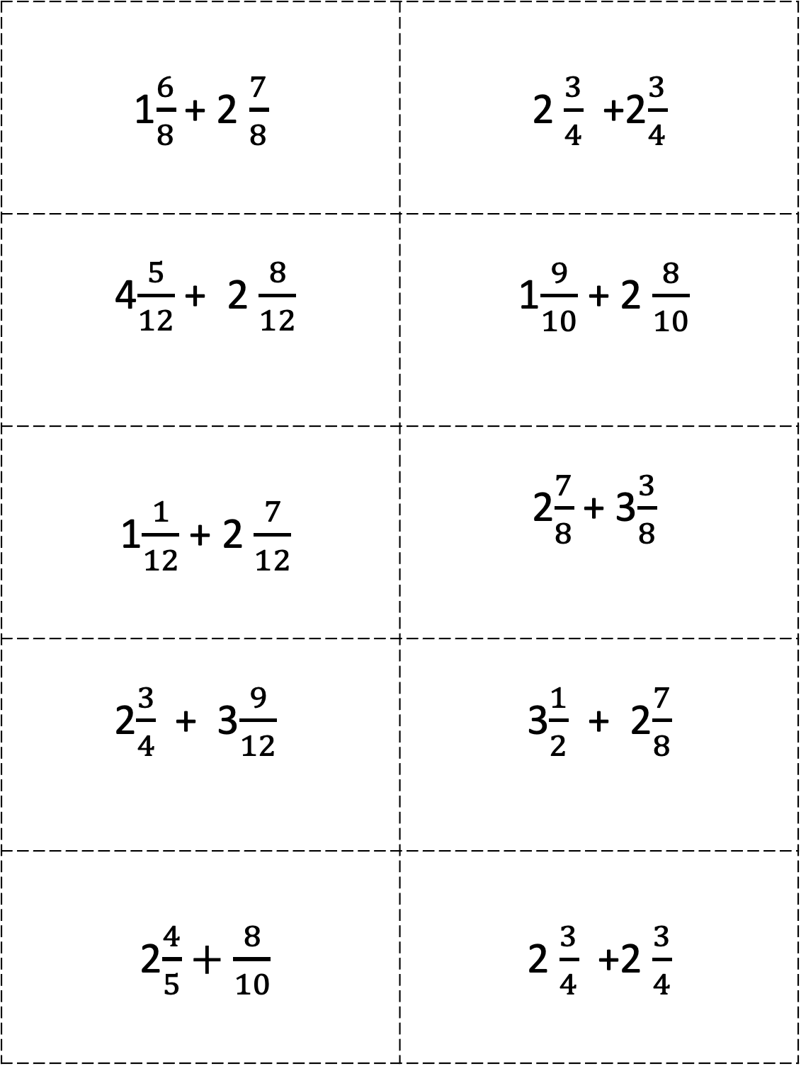
1$\frac{6}{8}$ + 2 $\frac{7}{8}$ | 2 $\frac{3}{4}$ +2$\frac{3}{4}$
4 $\frac{5}{12}$ + 2 $\frac{8}{12}$ | 1 $\frac{9}{10}$ + 2 $\frac{8}{10}$
1 $\frac{1}{12}$ + 2$\frac{7}{12}$ | 2 $\frac{7}{8}$ + 3$\frac{3}{8}$
2 $\frac{3}{4}$ + 3 $\frac{9}{12}$ | 3 $\frac{1}{2}$ + 2$\frac{7}{8}$
2 $\frac{4}{5}+\frac{8}{10}$ | 2 $\frac{3}{4}$ +2 $\frac{3}{4}$

Slide 4
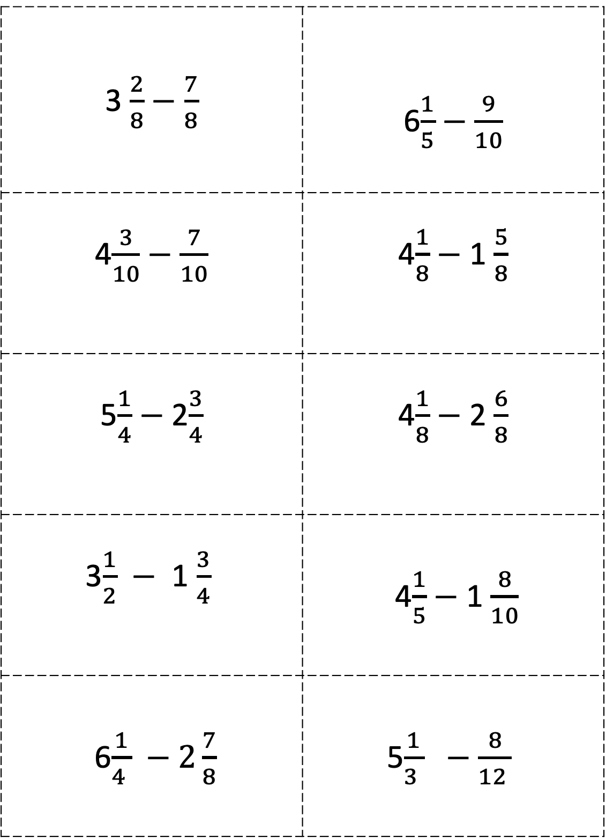
3 $\frac{2}{8}$ $−$ $\frac{7}{8}$ | 6 $\frac{1}{5}$ $−$ $\frac{9}{10}$
4 $\frac{3}{10}−\frac{7}{10}$ | 4 $\frac{1}{8}$ $−$ 1 $\frac{5}{8}$
5 $\frac{1}{4}$ $−$2 $\frac{3}{4}$ | 4 $\frac{1}{8}$ $−$ 2$\frac{6}{8}$
3 $\frac{1}{2}$ $−$ 1 $\frac{3}{4}$ | 4 $\frac{1}{5}$ $−$ 1$\frac{8}{10}$
6 $\frac{1}{4 } −2\frac{7}{8}$ | 5$\frac{1}{3 }$ $−$ $\frac{8}{12 }$

