Slide 1
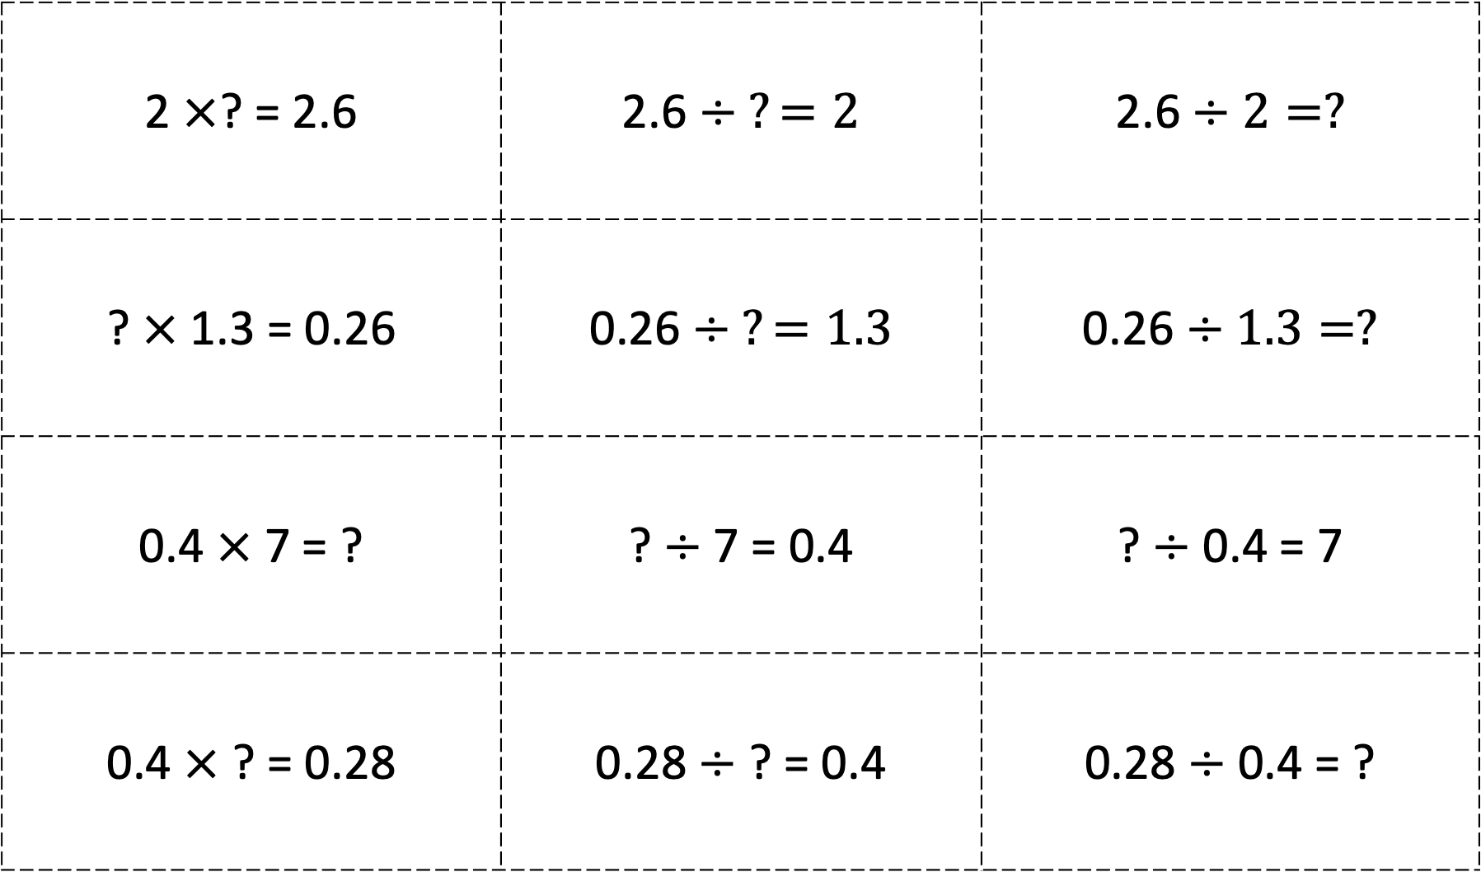
SPOON SCRAMBLE SET 1
2 $×$? = 2.6 | 2.6 $÷ ?=2$ | 2.6 $÷2=?$
? $×$ 1.3 = 0.26 | 0.26 $÷ ?=1.3$ | 0.26 $÷1.3=?$
0.4 $×$ 7 = ? | ? $÷$ 7 = 0.4 | ? $÷$ 0.4 = 7
0.4 $×$ ? = 0.28 | 0.28 $÷$ ? = 0.4 | 0.28 $÷$ 0.4 = ?
Please see PDF in case the formatting of this file changes.

Slide 2
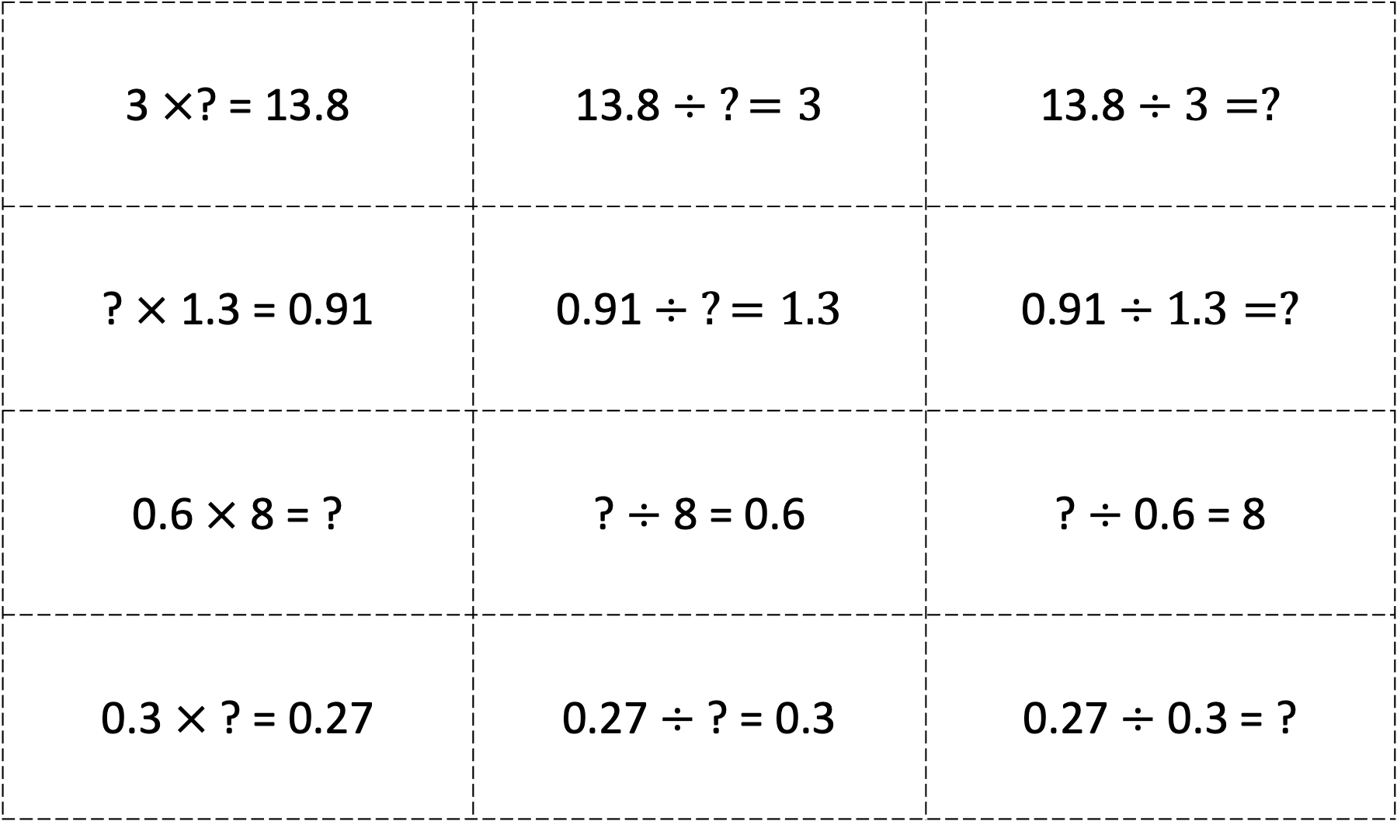
3 $×$? = 13.8 | 13.8 $÷ ?=3$ | 13.8 $÷3=?$
? $×$ 1.3 = 0.91 | 0.91 $÷ ?=1.3$ | 0.91 $÷1.3=?$
0.6 $×$ 8 = ? | ? $÷$ 8 = 0.6 | ? $÷$ 0.6 = 8
0.3 $×$ ? = 0.27 | 0.27 $÷$ ? = 0.3 | 0.27 $÷$ 0.3 = ?
SPOON SCRAMBLE SET 2

Slide 3
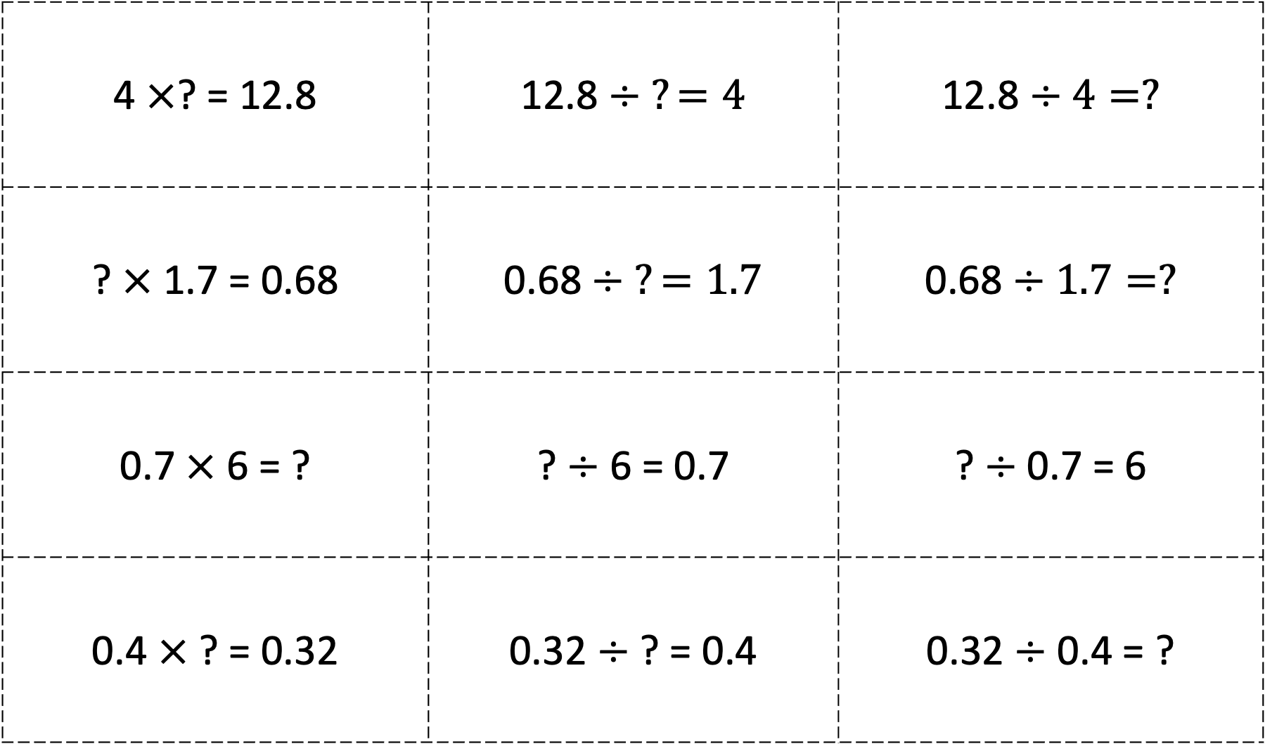
4 $×$? = 12.8 | 12.8 $÷ ?=4$ | 12.8 $÷4=?$
? $×$ 1.7 = 0.68 | 0.68 $÷ ?=1.7$ | 0.68 $÷1.7=?$
0.7 $×$ 6 = ? | ? $÷$ 6 = 0.7 | ? $÷$ 0.7 = 6
0.4 $×$ ? = 0.32 | 0.32 $÷$ ? = 0.4 | 0.32 $÷$ 0.4 = ?
SPOON SCRAMBLE SET 3

Slide 4
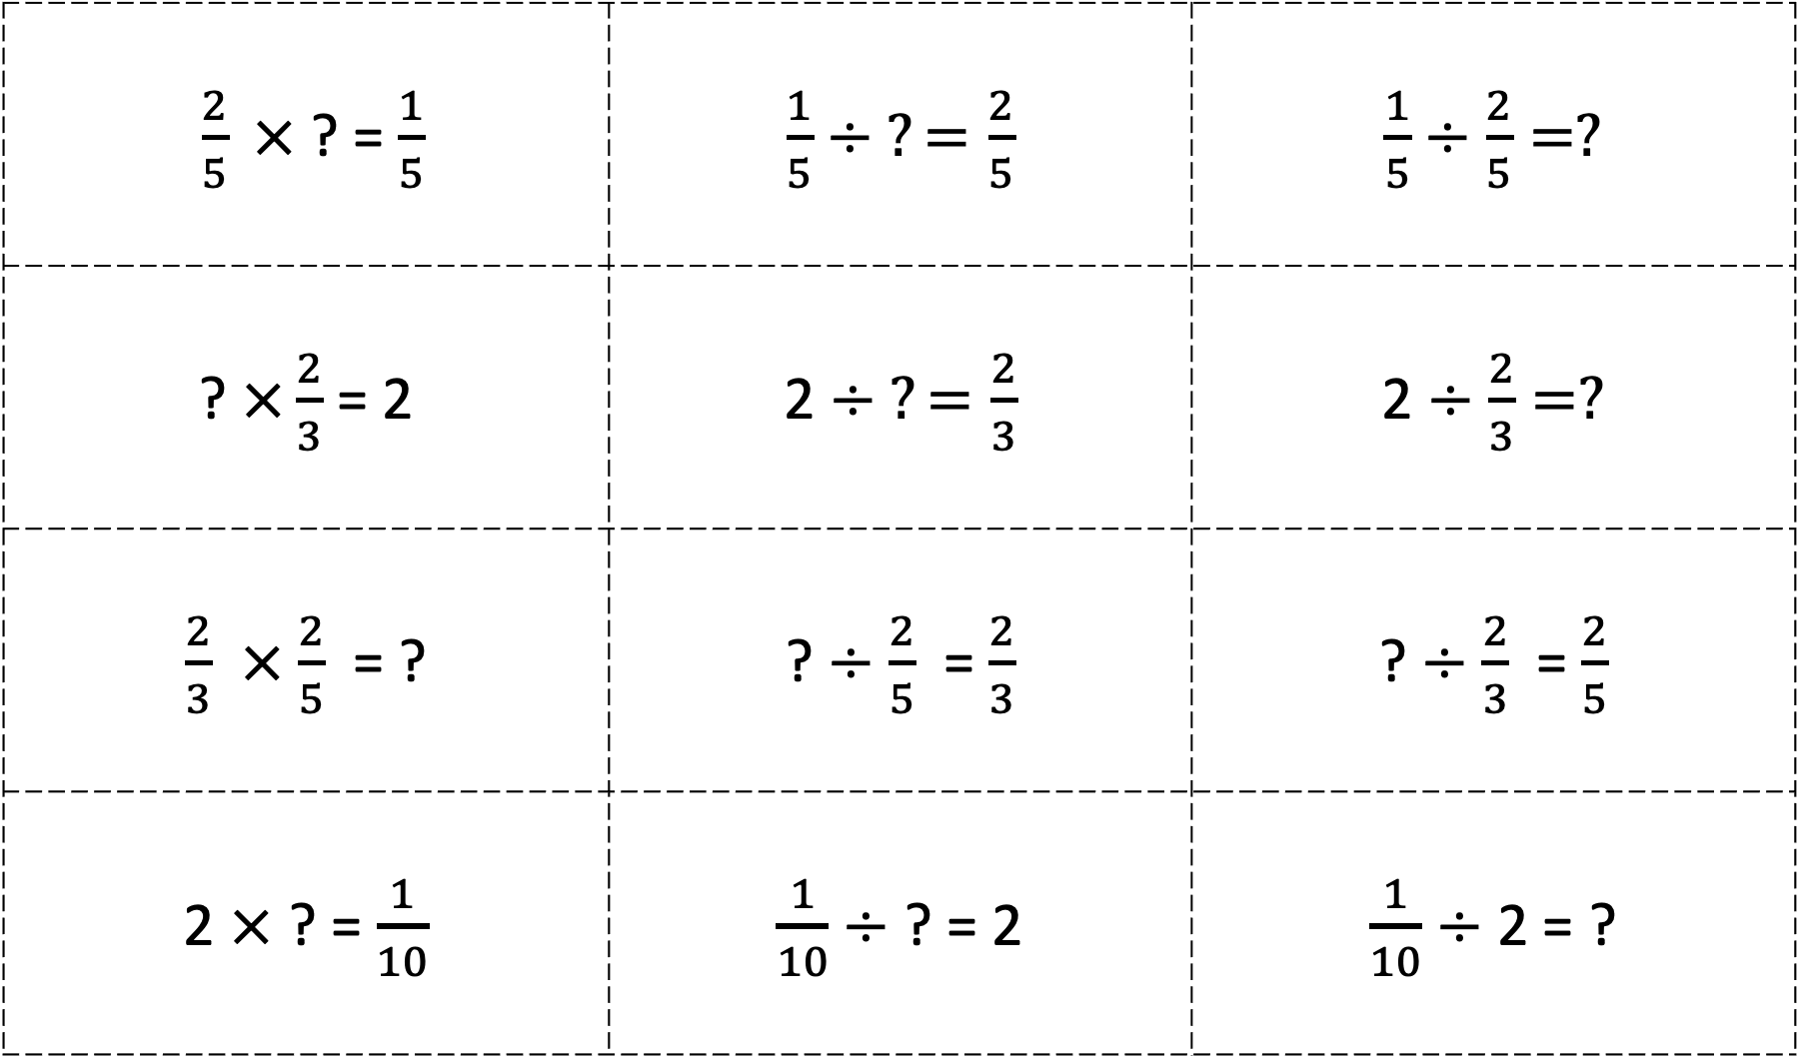
$\frac{2}{5} ×$? = $\frac{1}{5}$ | $\frac{1}{5}$ $÷ ?=\frac{2}{5}$ | $\frac{1}{5}$ $÷\frac{2}{5}=?$
? $×\frac{2}{3}$ = 2 | 2 $÷ ?=\frac{2}{3}$ | 2 $÷\frac{2}{3}=?$
$\frac{2}{3}$ $×$ $\frac{2}{5}$ = ? | ? $÷$ $\frac{2}{5}$ = $\frac{2}{3}$ | ? $÷$ $\frac{2}{3}$ = $\frac{2}{5}$
2 $×$ ? = $\frac{1}{10}$ | $\frac{1}{10}$ $÷$ ? = 2 | $\frac{1}{10}$ $÷$ 2 = ?
SPOON SCRAMBLE SET 4

Slide 5
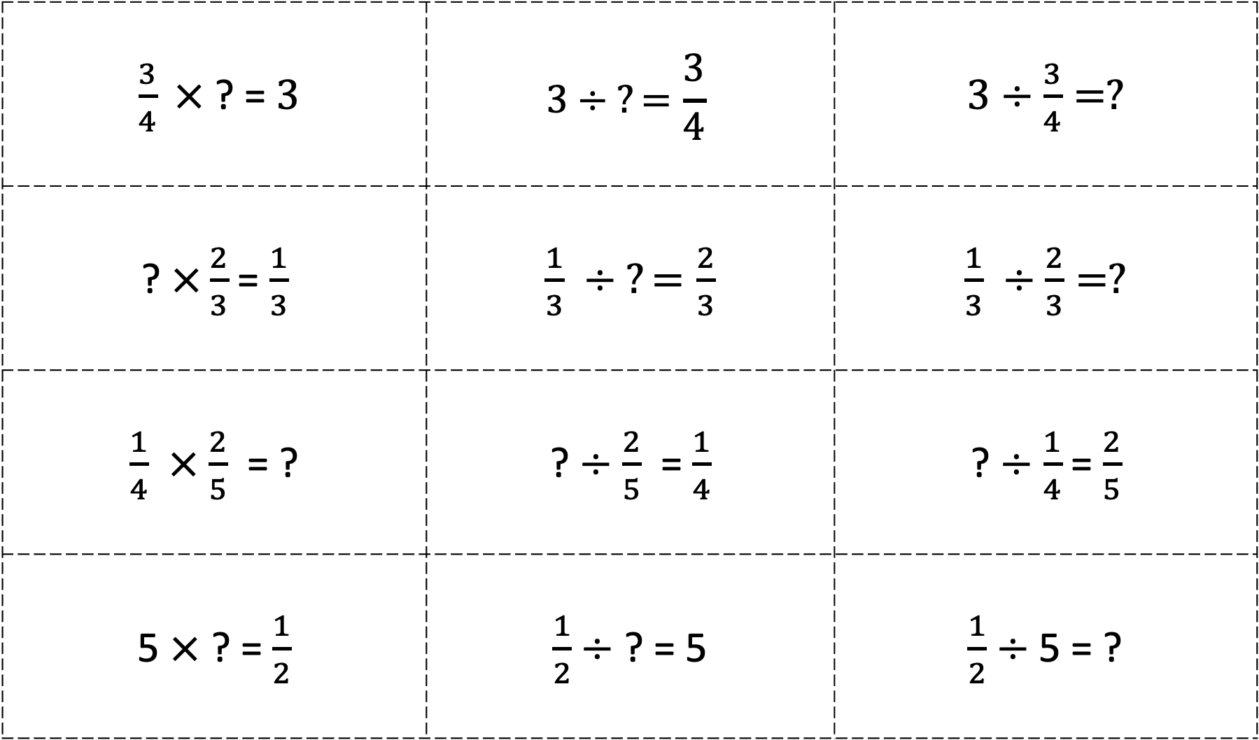
$\frac{3}{4} ×$? = $3$ | $$3÷ ?=\frac{3}{4}$$ | $3÷\frac{3}{4}=?$
? $×\frac{2}{3}$ = $\frac{1}{3}$ | $\frac{1}{3}$ $÷ ?=\frac{2}{3}$ | $\frac{1}{3}$ $÷\frac{2}{3}=?$
$\frac{1}{4}$ $×$ $\frac{2}{5}$ = ? | ? $÷$ $\frac{2}{5}$ = $\frac{1}{4}$ | ? $÷$ $\frac{1}{4}$ = $\frac{2}{5}$
5 $×$ ? = $\frac{1}{2}$ | $\frac{1}{2}÷$ ? = 5 | $\frac{1}{2}÷$ 5 = ?
SPOON SCRAMBLE SET 5

Slide 6
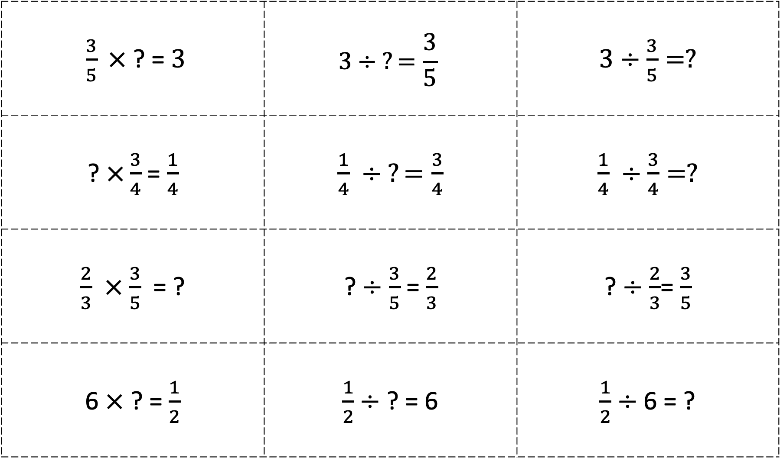
$\frac{3}{5} ×$? = $3$ | $$3÷ ?=\frac{3}{5}$$ | $3÷\frac{3}{5}=?$
? $×\frac{3}{4}$ = $\frac{1}{4}$ | $\frac{1}{4}$ $÷ ?=\frac{3}{4}$ | $\frac{1}{4}$ $÷\frac{3}{4}=?$
$\frac{2}{3}$ $×$ $\frac{3}{5}$ = ? | ? $÷$ $\frac{3}{5}$ = $\frac{2}{3}$ | ? $÷$ $\frac{2}{3}$= $\frac{3}{5}$
6 $×$ ? = $\frac{1}{2}$ | $\frac{1}{2}÷$ ? = 6 | $\frac{1}{2}÷$ 6 = ?
SPOON SCRAMBLE SET 6

