Slide 1
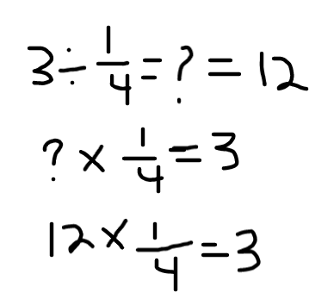
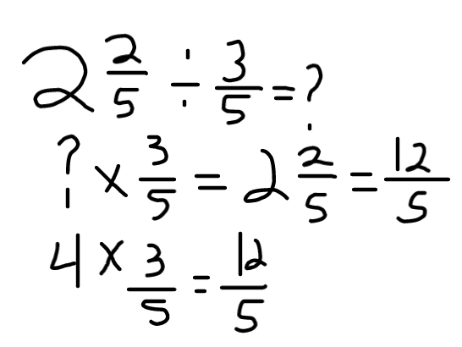

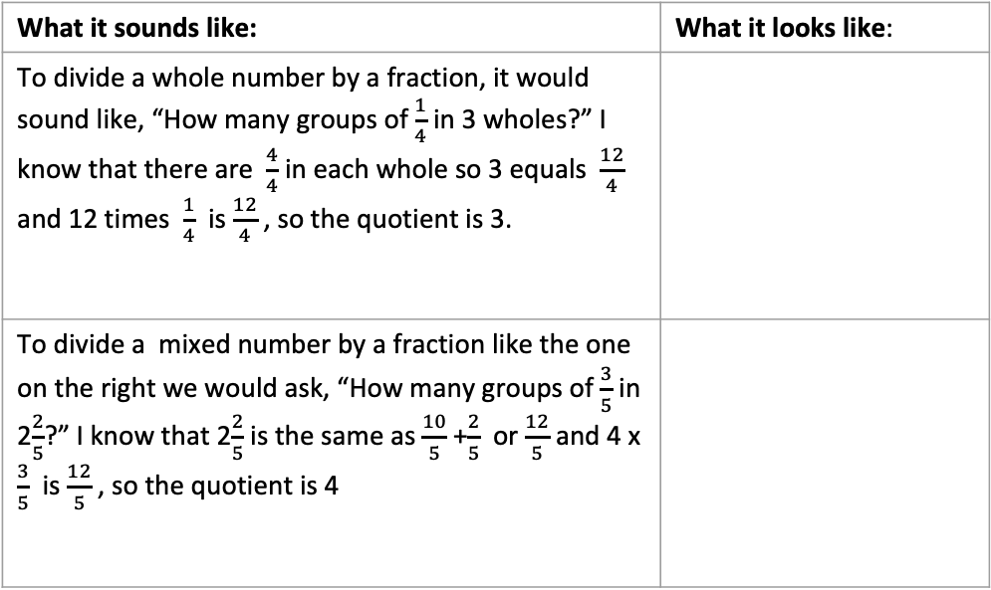
Think Multiplication for Fractions
What it is: This strategy uses the relationship between multiplication and division to solve division problems. It involves thinking about quotient (answer to a division problem) as a missing factor in a multiplication problem.
What it sounds like: To divide a whole number by a fraction, it would sound like, “How many groups of $\frac{1}{4}$ in 3 wholes?” I know that there are $\frac{4}{4}$ in each whole so 3 equals $\frac{12}{4}$ and 12 times $\frac{1}{4}$ is $\frac{12}{4}$ , so the quotient is 3.
When It’s Useful: Think Multiplication is particularly useful when dividing fractions with common denominators or when dividing by a unit fraction (i.e. $\frac{1}{4}$ ).
What it sounds like: | What it looks like:
To divide a whole number by a fraction, it would sound like, “How many groups of $\frac{1}{4}$ in 3 wholes?” I know that there are $\frac{4}{4}$ in each whole so 3 equals $\frac{12}{4}$ and 12 times $\frac{1}{4}$ is $\frac{12}{4}$ , so the quotient is 3.
To divide a mixed number by a fraction like the one on the right we would ask, “How many groups of $\frac{3}{5}$ in 2$\frac{2}{5}$?” I know that 2$\frac{2}{5}$ is the same as $\frac{10}{5}$ +$\frac{2}{5}$ or $\frac{12}{5}$ and 4 x $\frac{3}{5}$ is $\frac{12}{5}$ , so the quotient is 4
Please see PDF in case the formatting of this file changes.

