Slide 1
Directions
Print and cut the triangle cards.
Decimal card slides 2–7.
Fraction card slides 8–9.
Use the blank cards on the last slide to make your own sets.

Slide 2
5.9
6.3
7.7
3.5
2.8
1.8
5.2
1.2
4.4
1.7
2.9
9.6

Slide 3
2.9
3.8
4.7
9.1
5.3
1.8
2.7
2.8
6.3
4.4
7.2
3.6

Slide 4
4.4
3.5
3.7
4.6
8.1
8.1
8.6
7.5
5.7
9.3
1.8
2.9

Slide 5
81.5
30.6
9.5
6.6
24.0
91.0
18.5
57.5
41.5
32.5
90.0
60.0

Slide 6
0.9
50.0
79.7
80.6
12.5
37.5
55.8
57.1
53.9
30
87.1
1.9

Slide 7
20.3
77.5
46.7
90
12.5
26.4
40.7
40.1
43.2
3.1
43.2
83.9

Slide 8
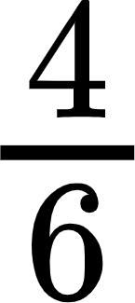
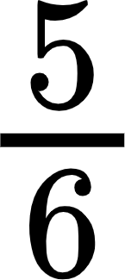
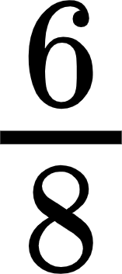
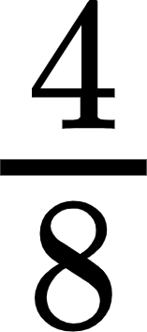

Slide 9
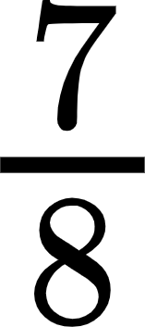
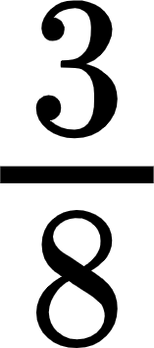

Slide 10
????
????
????
????
????
????
????
????
????
????
????
????

Slide 11
????
????
????
????
????
????
????
????
????
????
????
????

