Slide 1
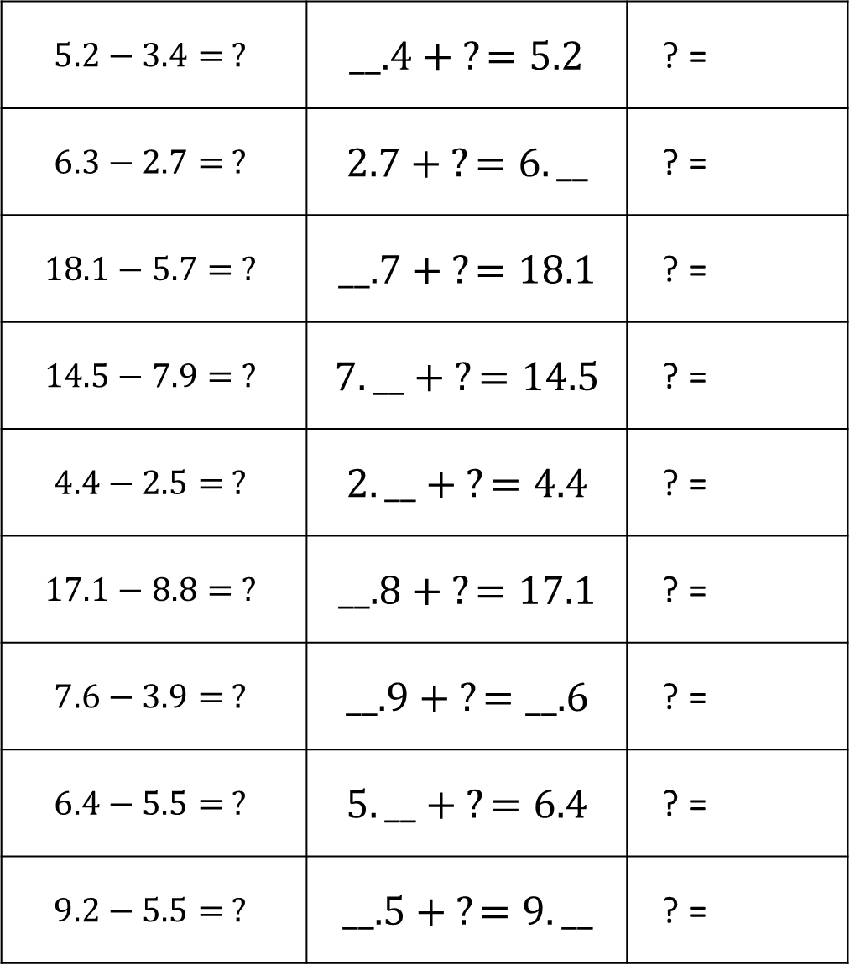
Think Addition Math Libs – Decimals
Directions: Take turns choosing a digit card. Use the digit to fill a number in the Think Addition column. Once a number is completely filled in, find the value of the question mark (?). Be the first to find all the ? values. Please see PDF in case the formatting of this file changes.
$$5.2−3.4= ?$$ | $__.4 + ?=5.2$ | ? =
$$6.3−2.7= ?$$ | $2.7 + ?=6.__$ | ? =
$$18.1−5.7= ?$$ | $__.7 + ?=18.1$ | ? =
$$14.5−7.9= ?$$ | $7.__ + ?=14.5$ | ? =
$$4.4−2.5= ?$$ | $2.__ + ?=4.4$ | ? =
$$17.1−8.8= ?$$ | $__.8 + ?=17.1$ | ? =
$$7.6−3.9= ?$$ | $__.9 + ?=__.6$ | ? =
$$6.4−5.5= ?$$ | $5.__ + ?=6.4$ | ? =
$$9.2−5.5= ?$$ | $__.5 + ?=9.__$ | ? =

Slide 2
Think Addition Math Libs – Decimals
Directions: Take turns choosing a digit card. Use the digit to fill a number in the Think Addition column. Once a number is completely filled in, find the value of the question mark (?). Be the first to find all the ? values.
55.6 – 33.4 = ? | 3__.4 + ? = 55.6 | ? =
61.9 – 27.7 = ? | 27.7 + ? = 61.__ | ? =
98.1 – 31.7 = ? | __1.7 + ? = 98.1 | ? =
114.5 – 79 = ? | 7__ + ? = 114.5 | ? =
34.4 – 32.7 = ? | 32.__ + ? = 34.4 | ? =
117.1 – 68.8 = ? | 6__.8 + ? = 117.1 | ? =
47.6 – 28.9 = ? | __8.9 + ? = __7.6 | ? =
64 – 52.5 = ? | 52.__ + ? = 64 | ? =
94.9 – 58.2 = ? | 5__.2 + ? = 94.__ | ? =

