Slide 1

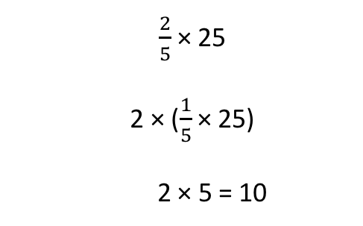
Break Apart to Multiply (by Factors)
Fractions
What it is: This strategy involves breaking apart one or both of the factors (the numbers being multiplied) to solve a problem more efficiently.
Consider $\frac{2}{5}$ × 25.
What it sounds like: “I am finding two-fifths of 25. I will factor a 2 from two-fifths so I have two times one-fifth. Then I will reassociate the one-fifth with 25. I find one-fifth of 25, which is 5. Then I multiply that by 2 and get 10.”
What it looks like:
When it’s useful: Breaking apart into factors is particularly useful when you can create a unit fraction (like $\frac{1}{5}$ or $\frac{1}{4}$) or when you can eliminate the fraction by doubling it or multiplying it by 3 or 4. Students might reason by breaking apart the fraction as a multiple of the unit fraction, or breaking apart the whole number.
 | $\frac{2}{5}$ × 25 2 × ($\frac{1}{5}$ × 25) 2 × 5 = 10

Slide 2
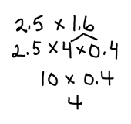
Break Apart to Multiply (by Factors)
Decimals
What it is: This strategy involves breaking apart one or both of the factors (the numbers being multiplied) to solve a problem more efficiently.
Let’s consider 2.5 × 1.6.
The decimal 1.6 is factored into 4 × 0.4, and 4 is reassociated with 2.5.
What it sounds like: “I am thinking about this as whole numbers and know that 25 times 4 equals 100. So I am going to break apart 1.6 into 4 times 0.4. I will reassociate the 4 with 2.5 and multiply to get 10. And 10 times 0.4 is 4.”
What it looks like:
When it’s useful: Breaking apart into factors is useful when reassociating a factor leads to a whole number. In the example, the student noticed the 2.5 and knew (1) that 2.5 × 4 = 10, and (2) that 1.6 has 4 as a factor. The key is to look at each factor and consider whether or not one can be decomposed into factors that can make the other number a whole number, or can make reasoning about the problem manageable.

