Slide 1
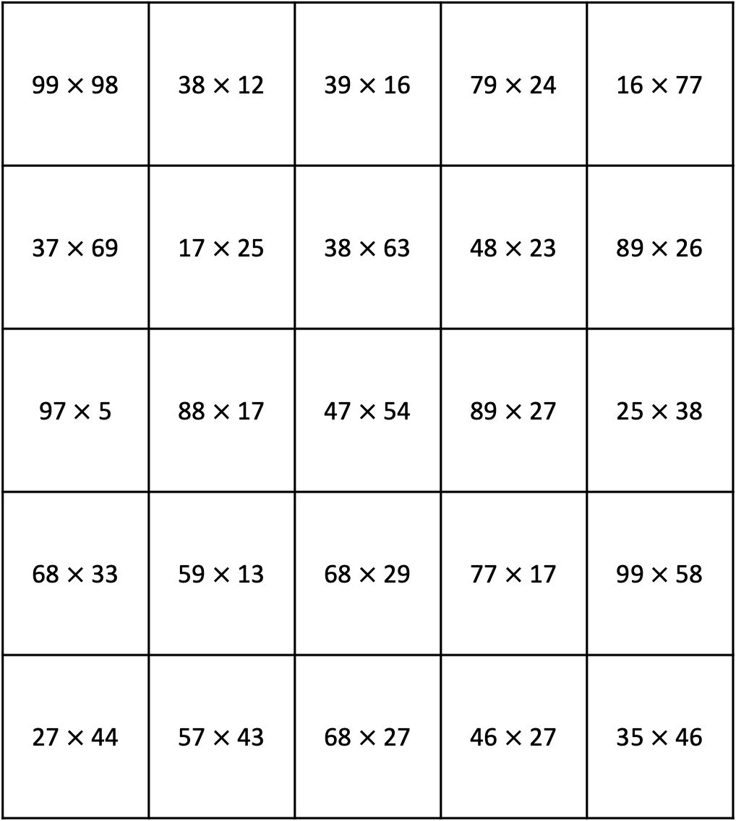
Give Some to Get Some
Directions: Take turns rolling a number. Choose a space on the gameboard where the amount you roll could be given from one factor to the other to show the Compensation strategy. The game ends when all spaces are covered. The player with the most three-in-a-rows wins. Please see PDF in case the formatting of this file changes.
99 $×$ 98 | 38 $×$ 12 | 39 $×$ 16 | 79 $×$24 | 16 $×$ 77
37 $×$69 | 17 $×$ 25 | 38 $×$ 63 | 48 $×$ 23 | 89 $×$26
97 $×$5 | 88 $×$ 17 | 47 $×$ 54 | 89 $×$ 27 | 25 $×$38
68 $×$ 33 | 59 $×$ 13 | 68 $×$ 29 | 77 $×$ 17 | 99 $×$58
27 $×$ 44 | 57 $×$ 43 | 68 $×$ 27 | 46 $×$ 27 | 35 $×$46

