Slide 1
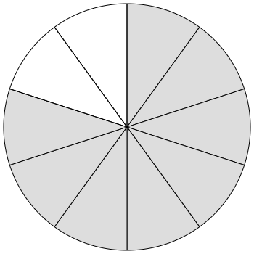
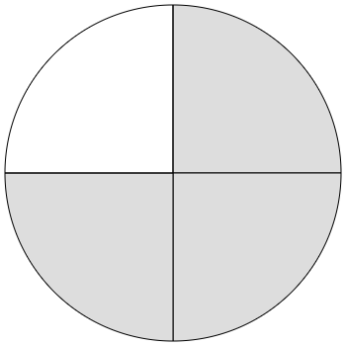
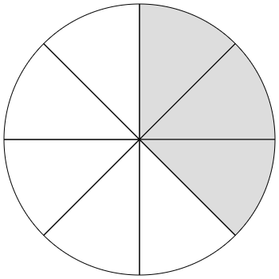
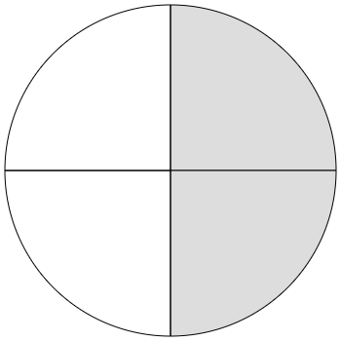
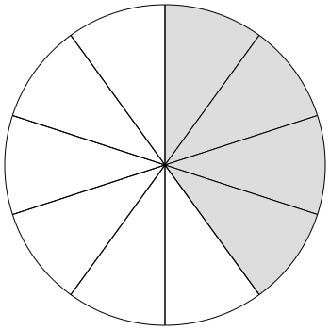
Paired Quick Looks (Fractions)
Directions: Quickly show the two cards and then cover them with another sheet of paper. Have students determine how many there are altogether. Uncover the pair and have partners discuss how they put the quantities together to find the total. As students share, they record the equation(s) that go with it.
 |  | Sum

Slide 2
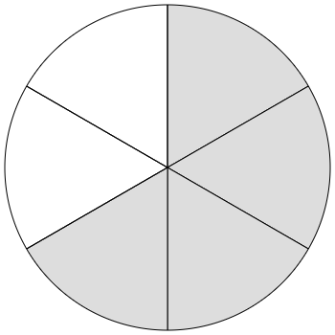
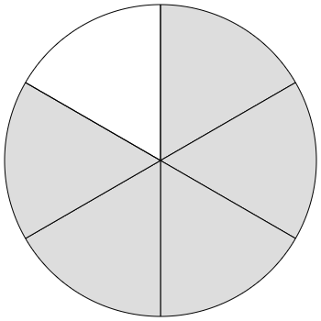
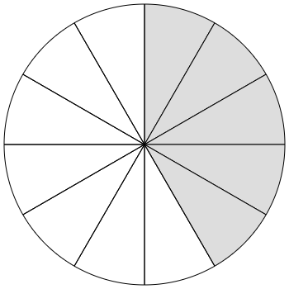
Paired Quick Looks (Fractions)
Directions: Quickly show the two cards and then cover them with another sheet of paper. Have students determine how many there are altogether. Uncover the pair and have partners discuss how they put the quantities together to find the total. As students share, they record the equation(s) that go with it.
 |  | Sum

Slide 3
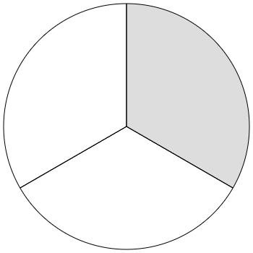
Fraction Paired Quick Looks
Directions: Quickly show the two cards and then cover them with another sheet of paper. Have students determine how many there are altogether. Uncover the pair and have partners discuss how they put the quantities together to find the total. As students share, they record the equation(s) that go with it.
 |  | Sum

Slide 4
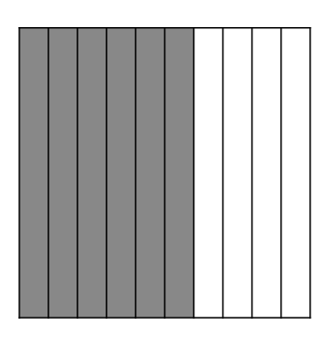
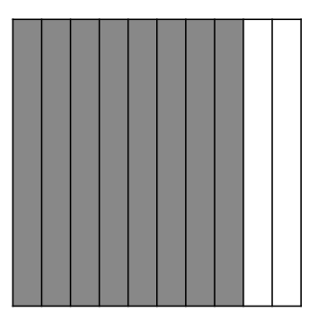
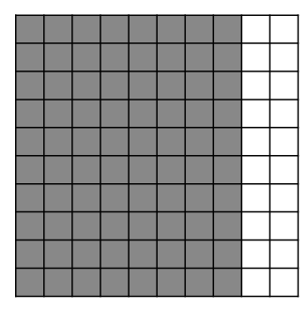
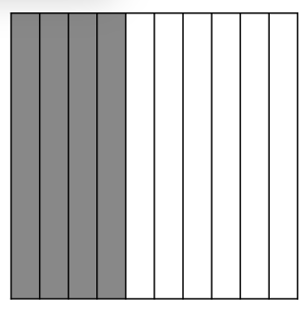
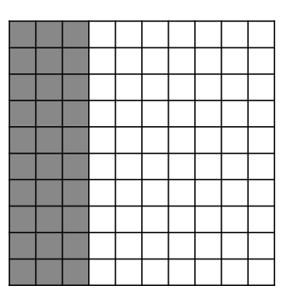
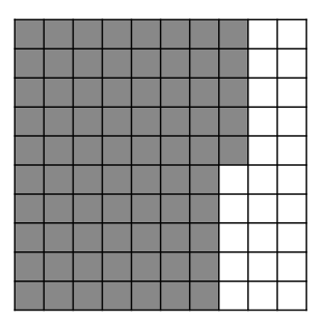
Paired Quick Looks (Decimals)
Directions: Quickly show the two cards and then cover them with another sheet of paper. Have students determine how many there are altogether. Uncover the pair and have partners discuss how they put the quantities together to find the total. As students share, they record the equation(s) that go with it.
 |  | Sum

Slide 5
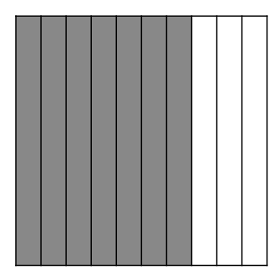
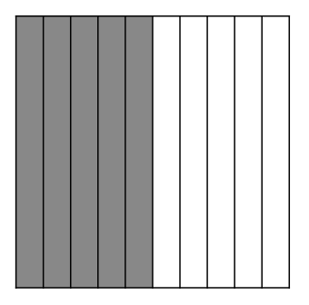
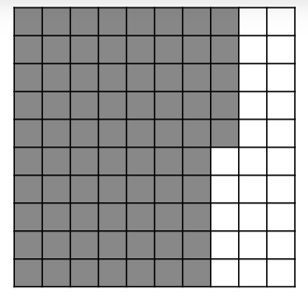
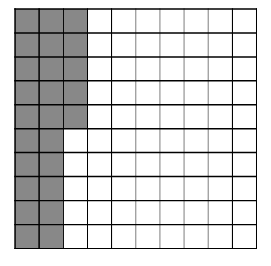
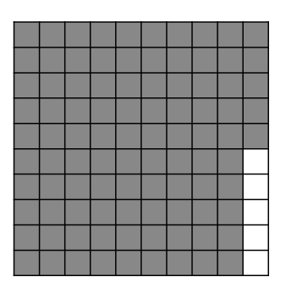
Paired Quick Looks (Decimals)
Directions: Quickly show the two cards and then cover them with another sheet of paper. Have students determine how many there are altogether. Uncover the pair and have partners discuss how they put the quantities together to find the total. As students share, they record the equation(s) that go with it.
 |  | Sum

Slide 6
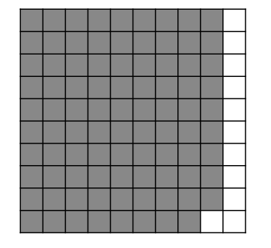
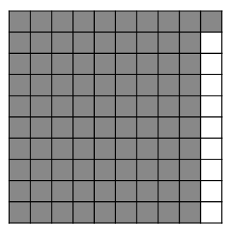
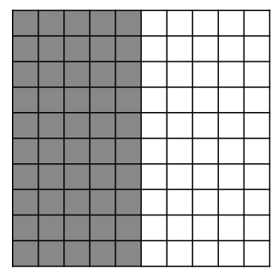
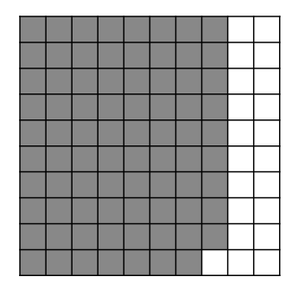
Paired Quick Looks (Decimals)
Directions: Quickly show the two cards and then cover them with another sheet of paper. Have students determine how many there are altogether. Uncover the pair and have partners discuss how they put the quantities together to find the total. As students share, they record the equation(s) that go with it.
 |  | Sum

