Slide 1
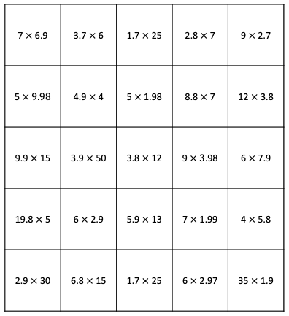
Give Some to Get Some: Decimals
Directions: Take turns rolling a number. Choose a space on the gameboard where the amount you roll could be given to one factor to make a whole. Solve that problem to claim the space. The game ends when all spaces are covered. The player with the most three-in-a-rows wins. Please see PDF in case the formatting of this file changes.

