Slide 1
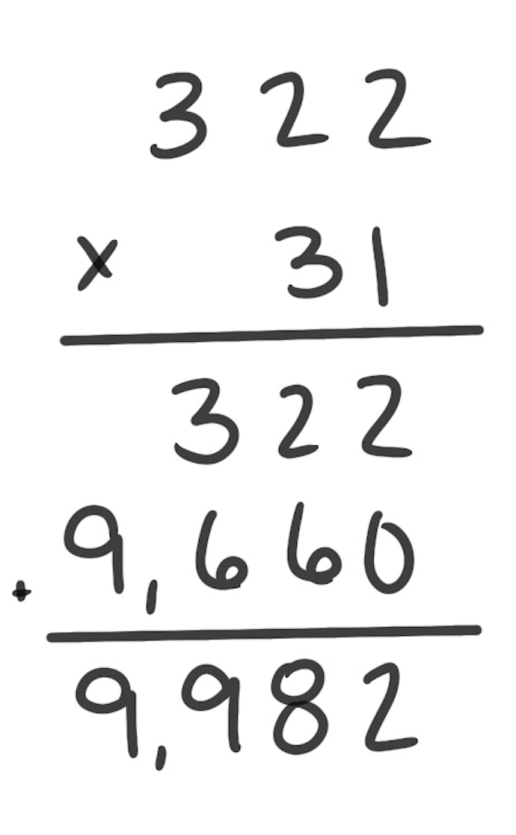
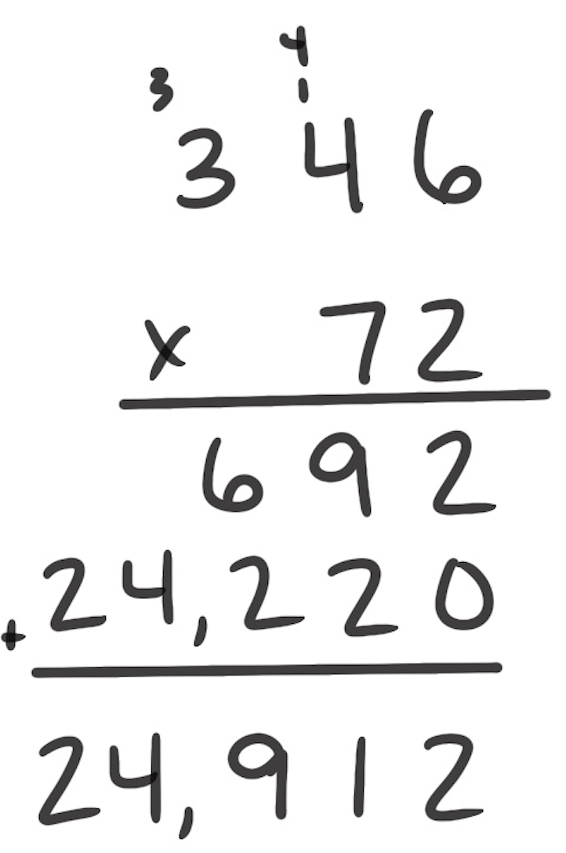
Standard Algorithm for Multiplication
How It Works: The algorithm is a digit-based procedure for multiplying multidigit factors.
Multiply the digit in the ones place of the bottom factor by each digit in the top factor.
Continue to multiply digits by place value from right to left. Record products of each new place value below the products of the previous place value.
Add the products of each place value.
The left example shows a problem with no regrouping. The products of 1 and each digit in the top factor are recorded. The products of the second digit, which represents tens, are recorded on the second line. The two products are added for a sum of 9,982. So, 322 × 31 = 9,982.
The right example shows a problem with regrouping: 2 × 6 = 12. The ones are recorded and the 10 is grouped to be added to the product of the tens place. 2 × 4 tens is 8 tens and 1 more ten is 9 tens recorded as shown. Finding the products of 7 tens requires additional regrouping. The two products are added for a sum of 24,912. So, 346 × 72 = 24,912.
When It’s Useful: The algorithm becomes more useful as the number of digits increases in each factor.

