Slide 1
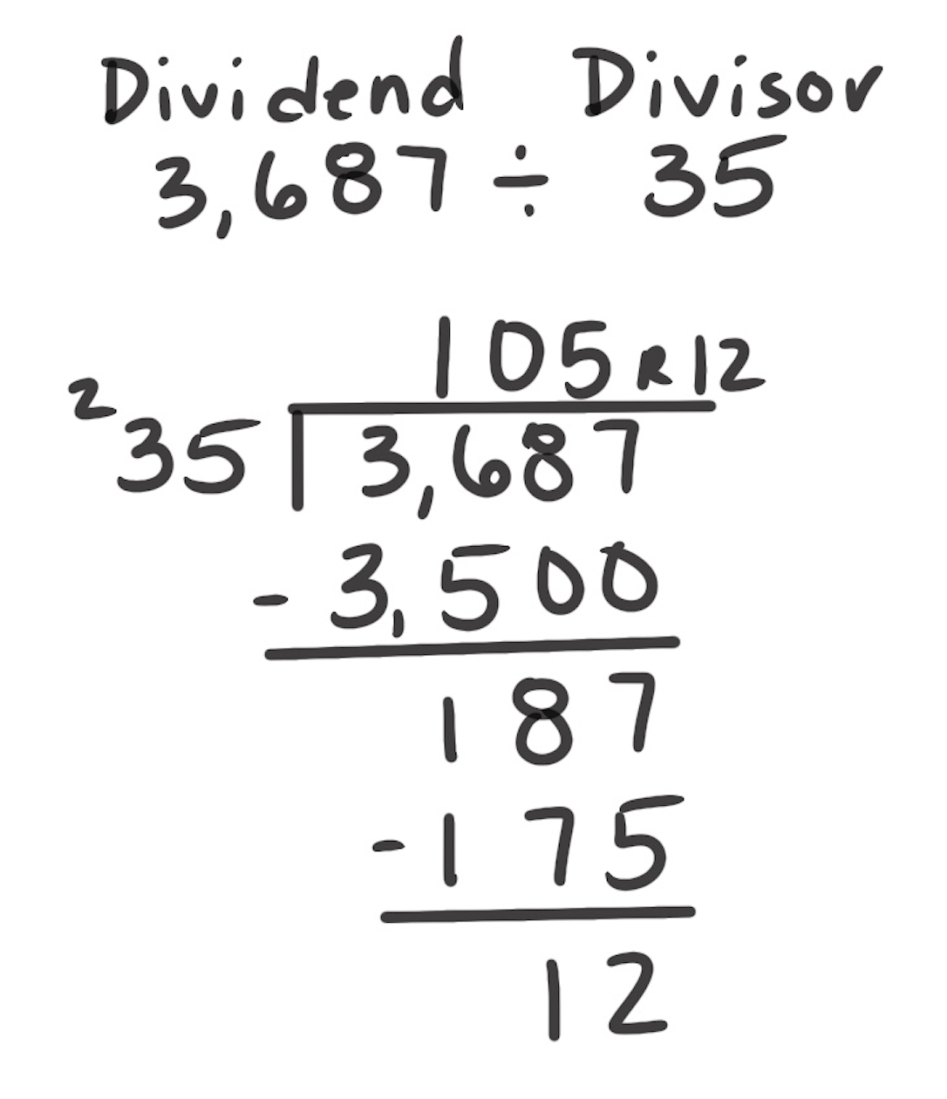
Standard Algorithm for Division
How It Works: The algorithm is a digit-based procedure for dividing.
Determine how many groups of the divisor are in an amount of the dividend. In the following example, there are no (whole number) groups of 35 in 3. So, it is expanded to 36. There is 1 group of 35 in 36.
1 × 35 is 35. Note that the 1 is in the hundreds place so it is 1 hundred times 35, creating 3,500.
3,500 is subtracted from 3,687 with a difference of 187.
There are no (whole number) groups of 18, so a 0 is recorded and 187 is considered.
There are 5 groups of 35 in 187. 5 × 35 = 175.
In this example, 3,687 divided by 35 is 105 with a remainder of 5.
When It’s Useful: The algorithm becomes more useful as the number of digits increases in the dividend or divisor.

