Slide 1
950 – 675 = ? | 675 + ? = 950
714 – 690 = ? | 690 + ? = 714
239 – 182 = ? | 182 + ? = 239
1,201 – 799 = ? | 799 + ? = 1,201
375 – 263 = ? | 263 + ? = 375

Slide 2
5.1 – 3.2 = ? | 3.2 + ? = 5.1
9.65 – 6.9 = ? | 6.9 + ? = 9.65
21.7 – 18 = ? | 18 + ? = 21.7
30 – 27.97 = ? | 27.97 + ? = 30
7.15 – 6.675 = ? | 6.675 + ? = 7.15

Slide 3
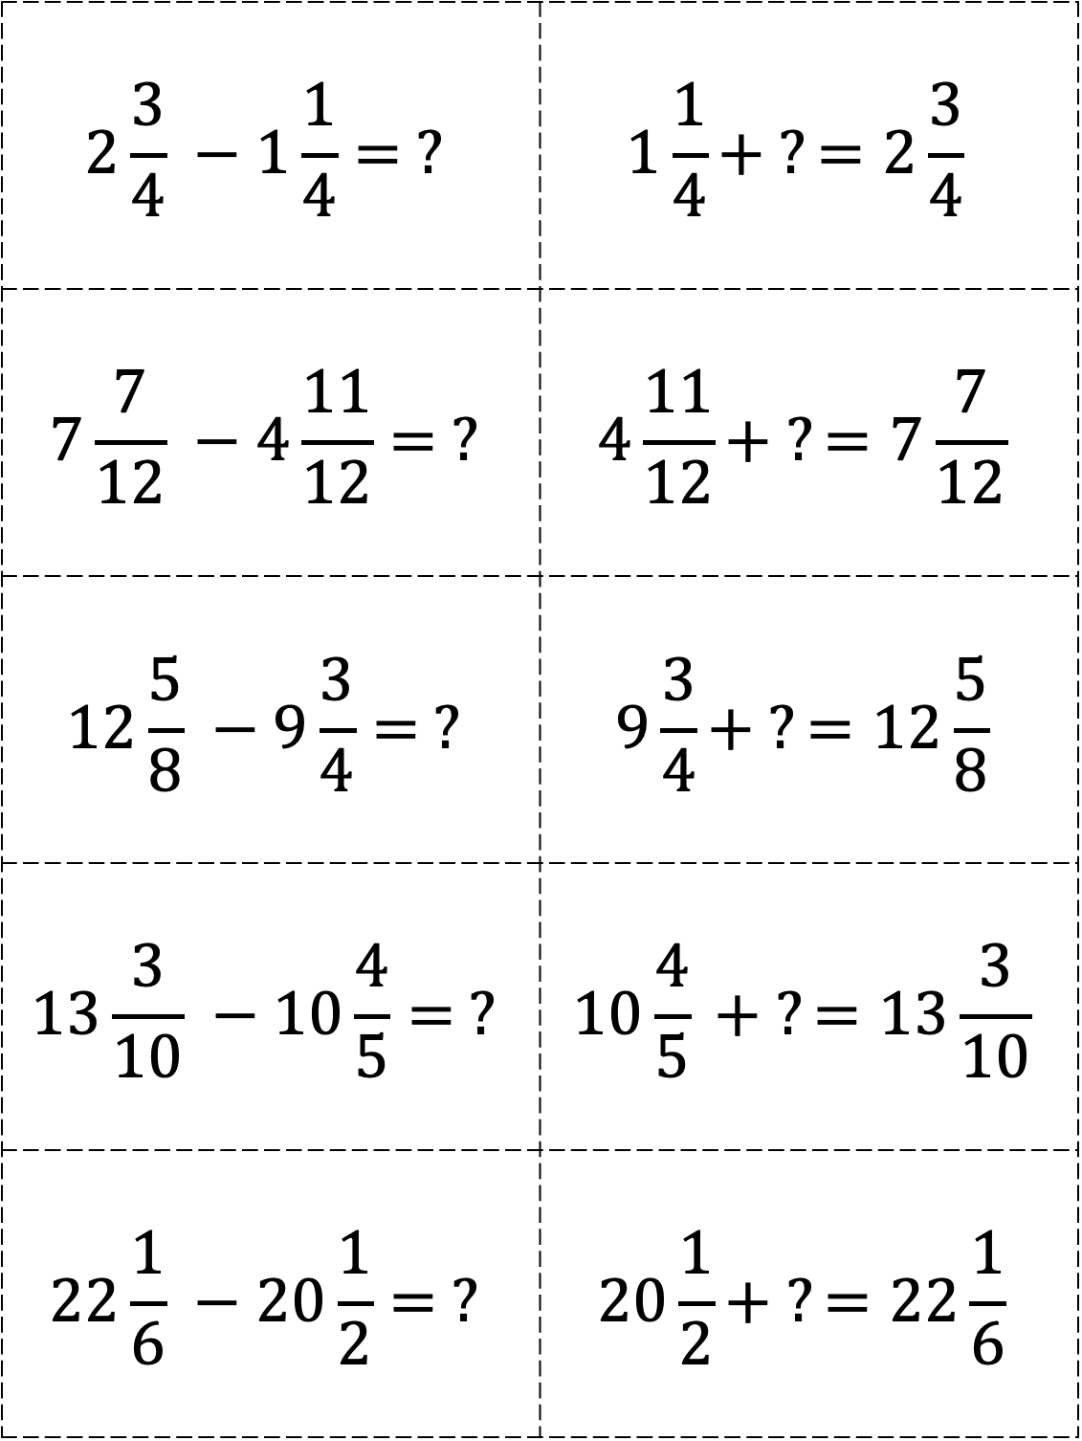
$$2\frac{3}{4} −1\frac{1}{4}= ?$$ | $$1\frac{1}{4}+ ?=2\frac{3}{4}$$
$$7\frac{7}{12} −4\frac{11}{12}= ?$$ | $$4\frac{11}{12}+ ?=7\frac{7}{12}$$
$$12\frac{5}{8} −9\frac{3}{4}= ?$$ | $$9\frac{3}{4}+ ?=12\frac{5}{8}$$
$$13\frac{3}{10} −10\frac{4}{5}= ?$$ | $$10\frac{4}{5} + ?=13\frac{3}{10}$$
$$22\frac{1}{6} −20\frac{1}{2}= ?$$ | $$20\frac{1}{2}+ ?=22\frac{1}{6}$$

Slide 4
⁻4 – 6 = ? | 6 + ? = ⁻4
⁻4 – ⁻6 = ? | ⁻6 + ? = ⁻4
11 – 23 = ? | 23 + ? = 11
⁻11 – 23 = ? | 23 + ? = ⁻11
17 – ⁻14 = ? | ⁻14 + ? = 17

