Slide 1
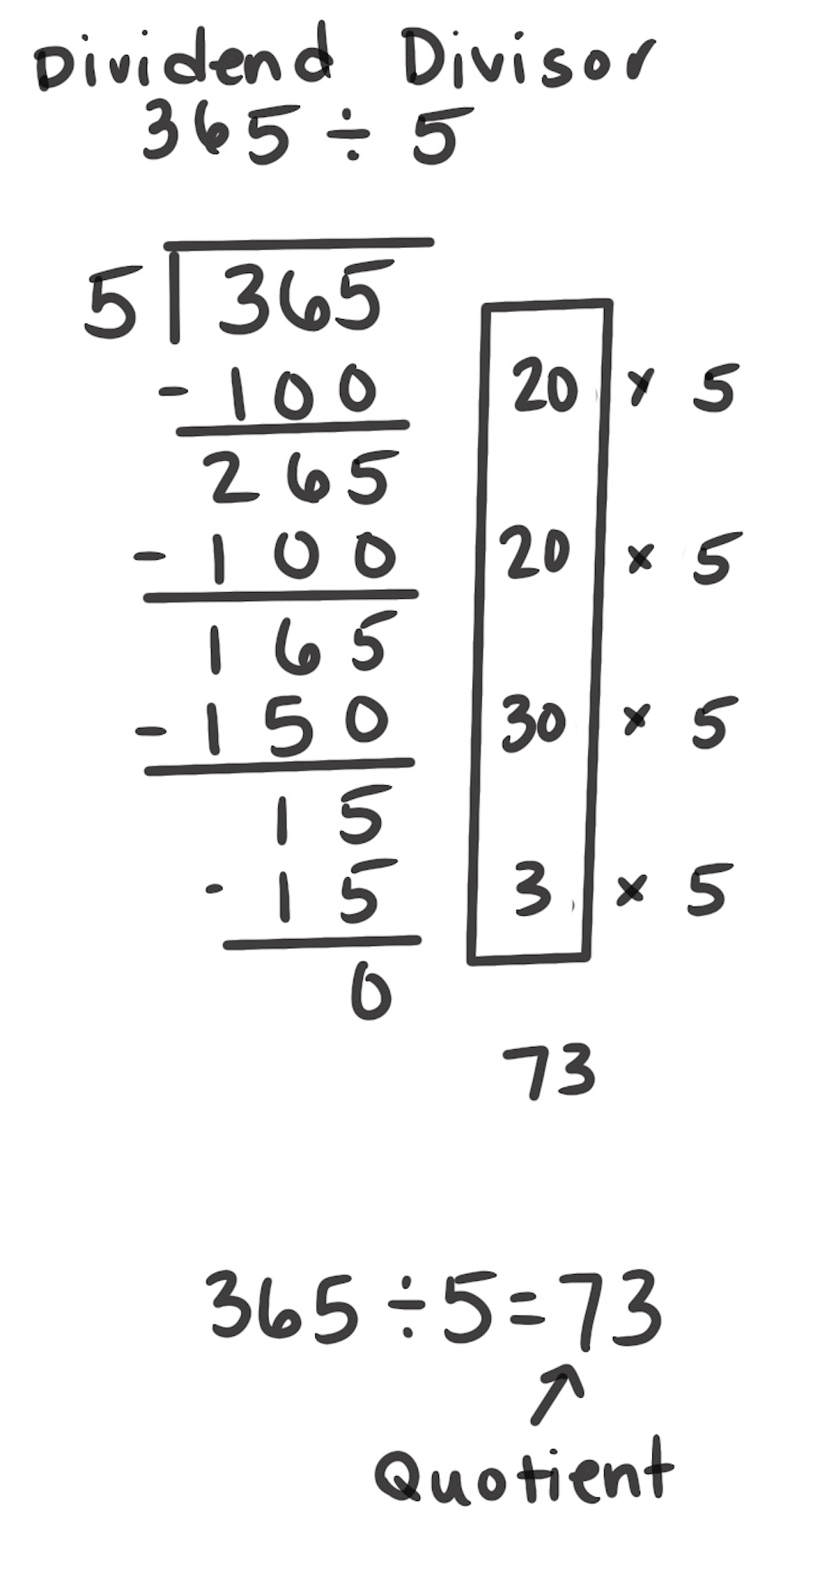
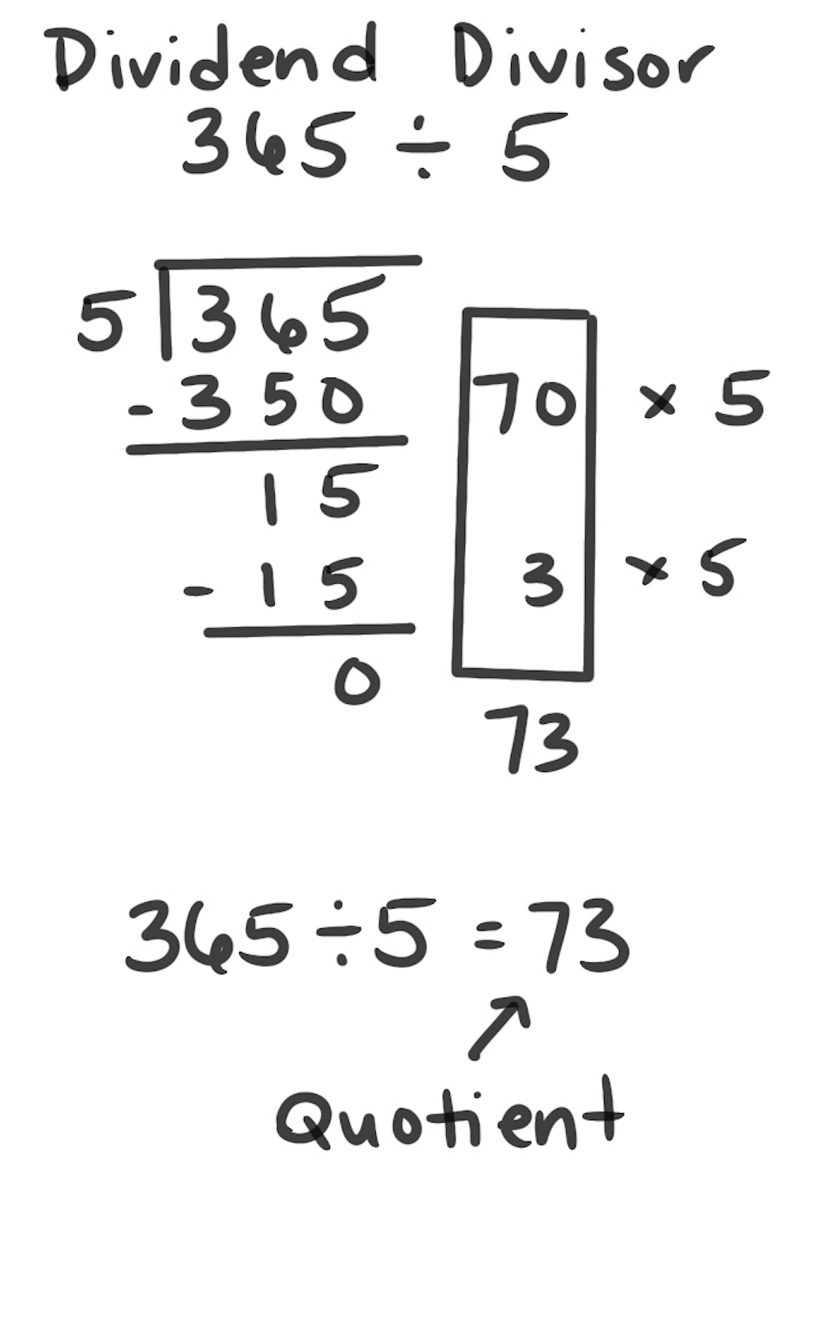
Partial Quotients
How It Works: We can remove easy-to-find groups from the dividend until there are no more groups to remove.
Find a friendly amount to take from the dividend.
Find a friendly amount to take from what is left.
Continue removing friendly amounts until nothing is left to remove.
Find the total number of groups taken away.
The left example shows that 100 is as a friendly amount to remove: 20 groups of 5 are in 100. 100 is removed and 265 is left. Another 100 can be removed, leaving 165. This is continued until nothing is left to remove. Then you add up the number of groups removed: 20 + 20 + 30 + 5 = 73.
The same process is applied to the right example. However, 350 was a friendly amount removed. Again, there are 73 groups of 5 in 365, so 365 ÷ 5 = 73.
When It’s Useful: Partial Quotients is almost always useful. It can become difficult to use as the number of digits increases in the divisor or dividend.

