Slide 1
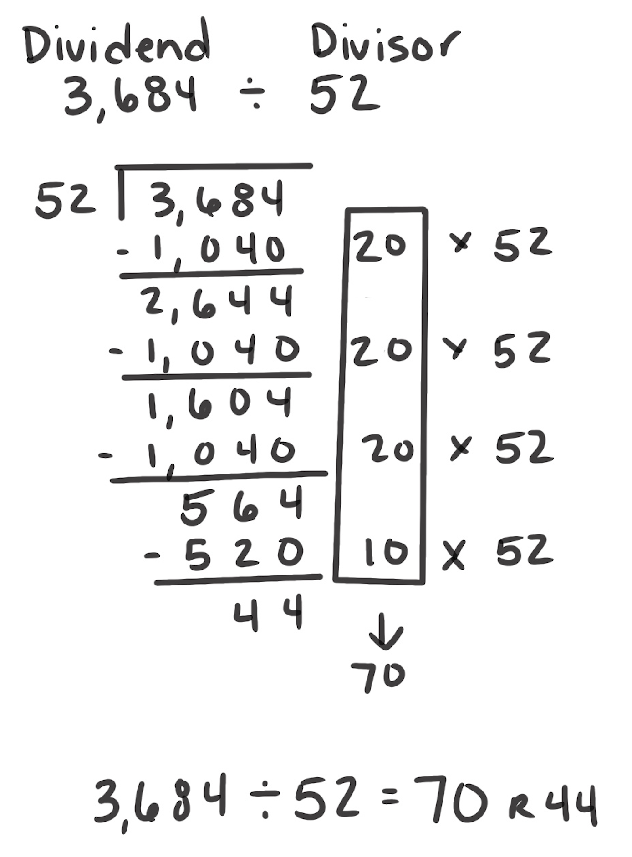
Partial Quotients
How It Works: We can remove easy-to-find groups from the dividend until there are no more groups to remove.
Find a friendly amount to take from the dividend.
Find a friendly amount to take from what is left.
Continue removing friendly amounts until nothing is left to remove.
Find the total number of groups taken away.
In the example, 20 groups of 52 (1,040) were removed from the dividend (3,684). This is continued until 44 was left to remove. A group of 52 couldn’t be removed from 44. So, there are 70 (20 + 20 + 20 + 10) groups of 52 in 3,684 with a remainder of 44.
When It’s Useful: Partial Quotients is almost always useful. It can become unwieldy as the number of digits increases in the divisor or dividend.

