Slide 1
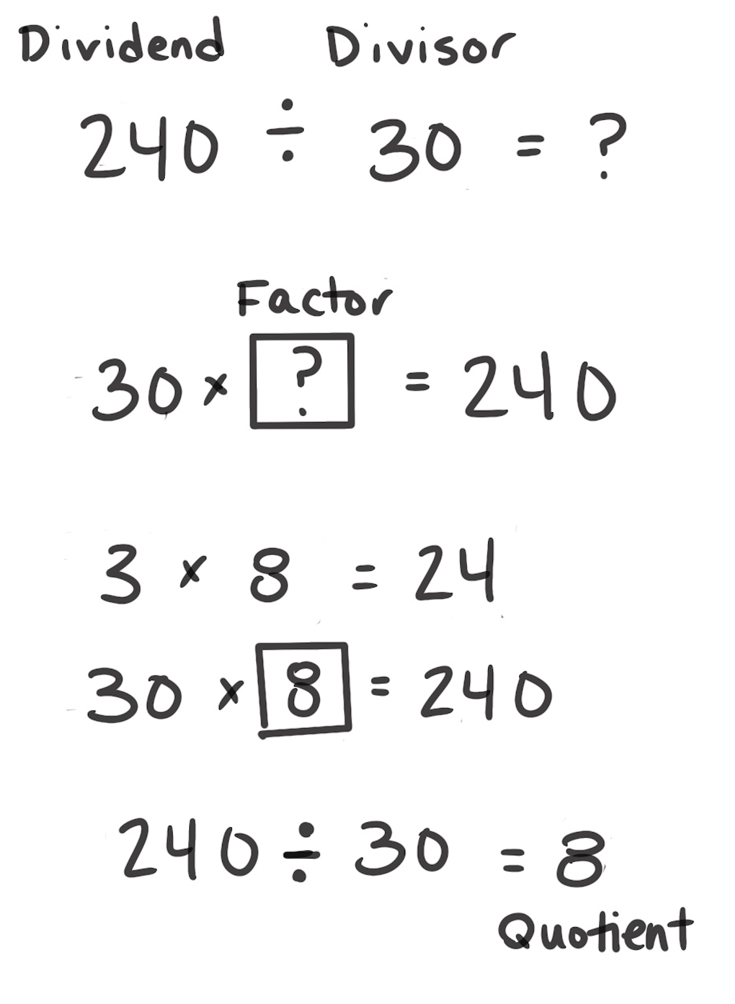
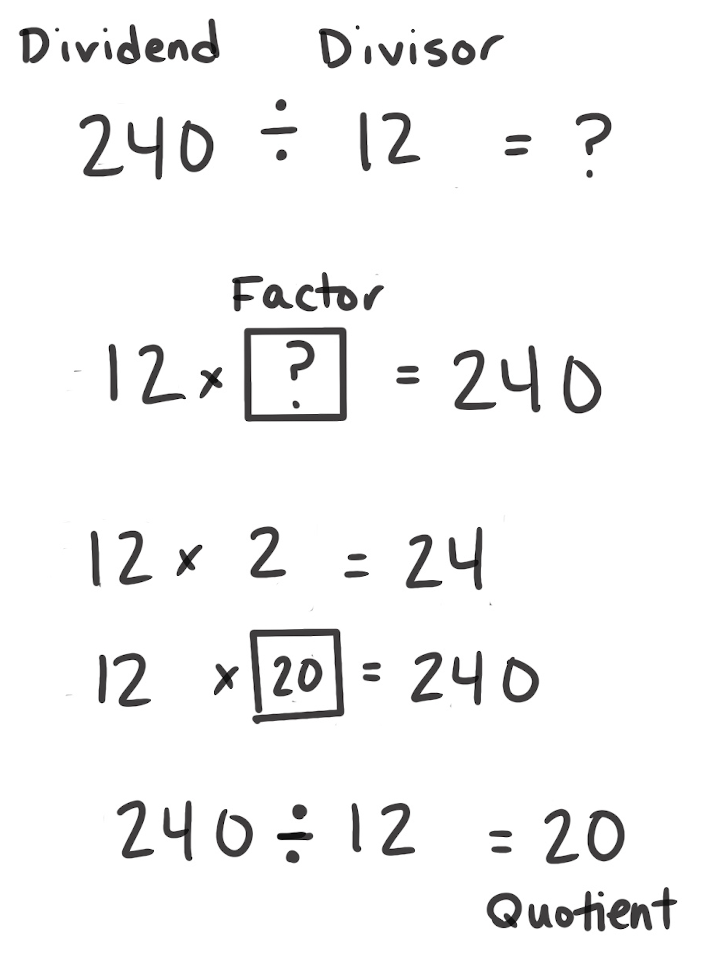
Think Multiplication
How It Works: We can use the relationship between multiplication and division to solve division problems. Division is also a missing factor multiplication problem.
Rethink the division problem as a missing factor multiplication problem.
Use multiplication to find the unknown factor.
Once known, the factor becomes the quotient of the original problem.
The left example shows that the problem is thought as 30 × ? = 240. The person then uses a known basic fact (3 × 8) to find the related problem (30 × 8). The unknown factor, 30, is the quotient of the original problem.
The right example does not rely on a basic fact but a familiar problem of 12 × 2. Several equations were used to find the missing factor.
When It’s Useful: Think Multiplication is useful when division problems have clear relationships to multiplication problems.

