Slide 1
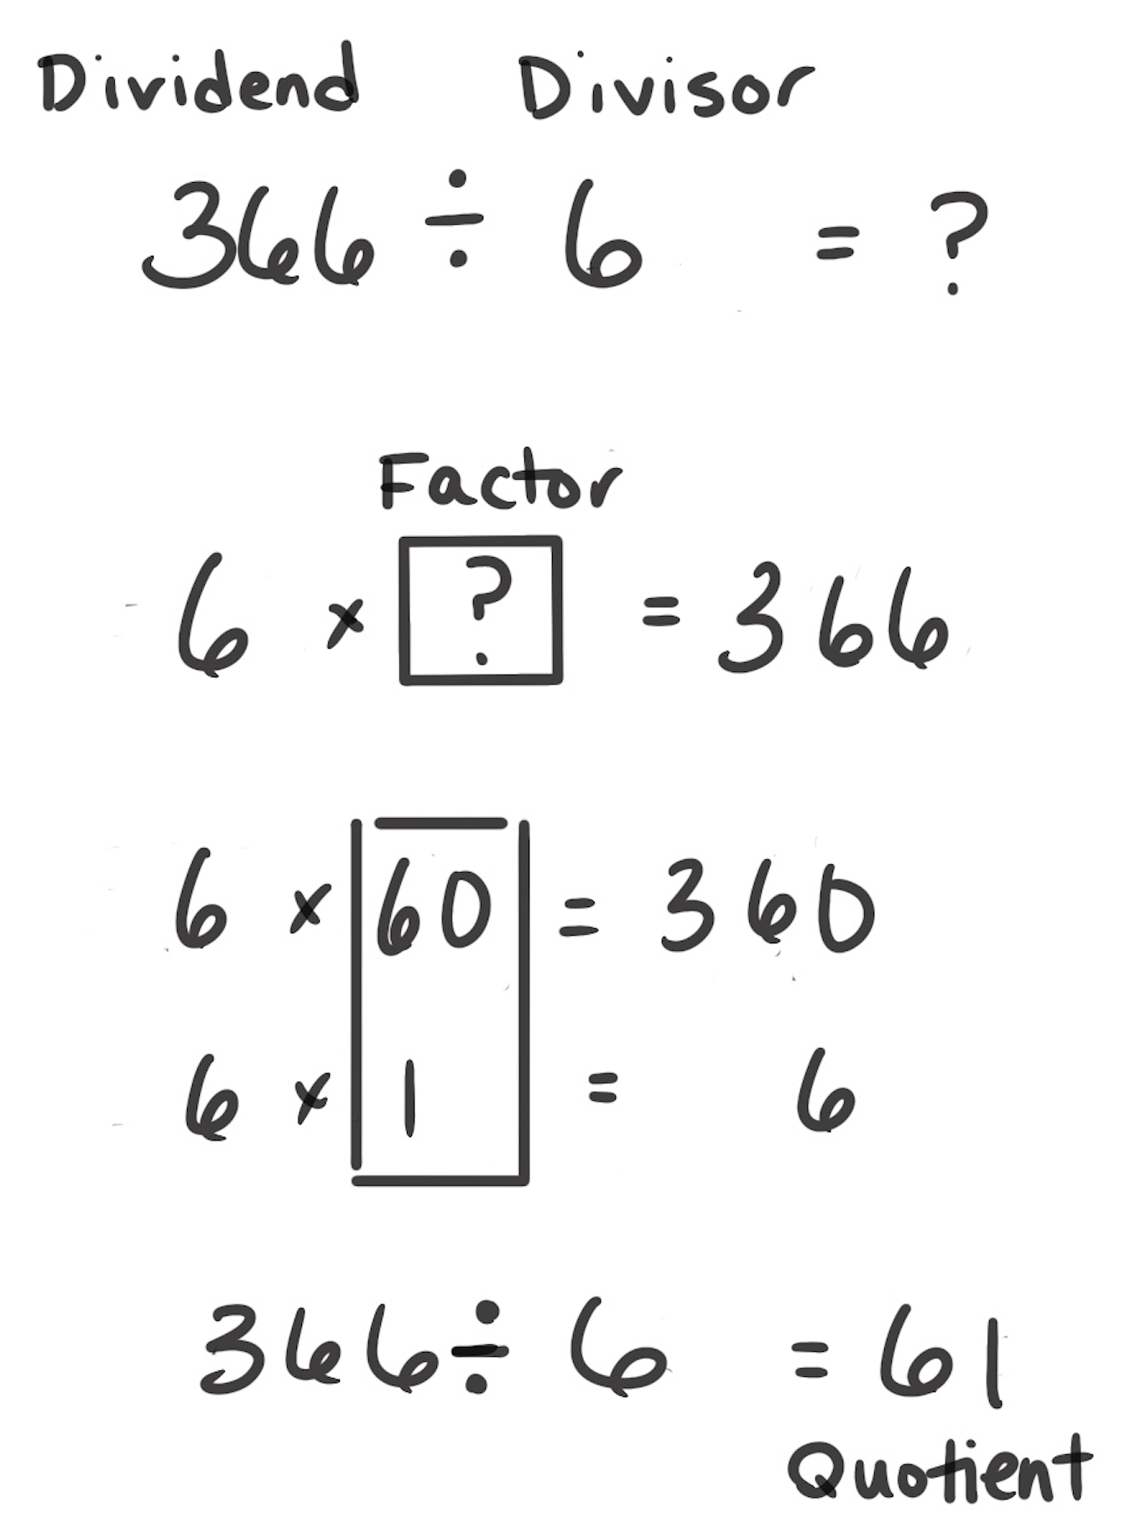
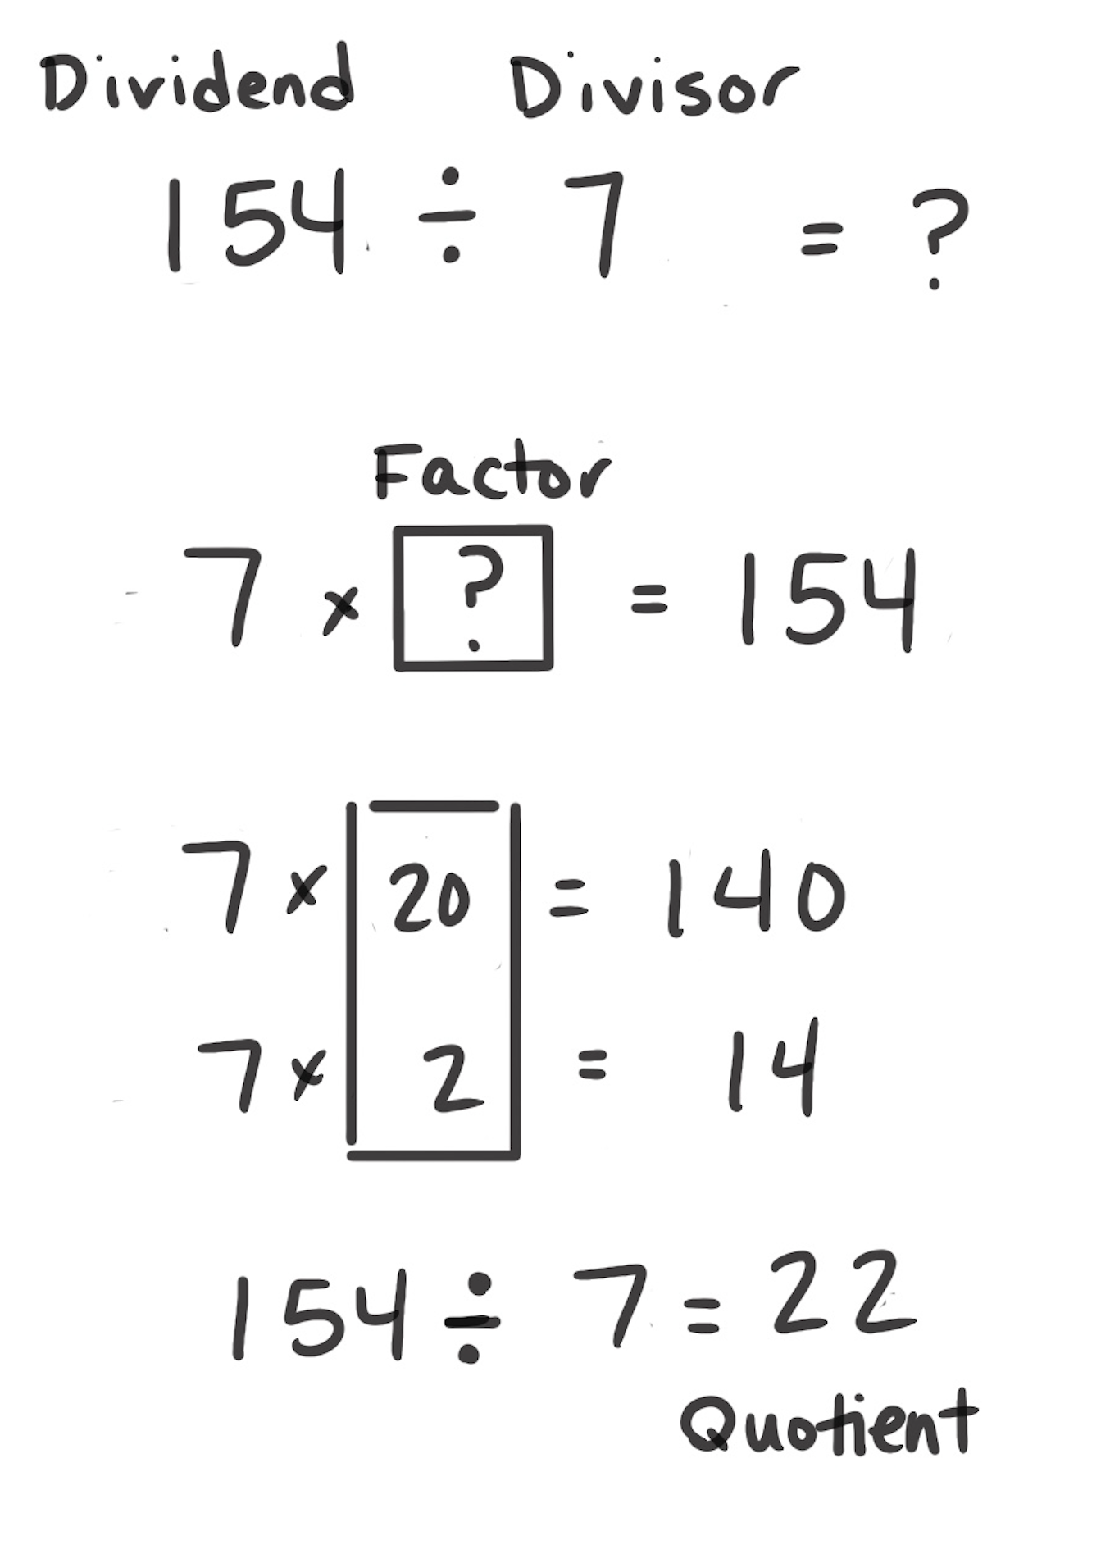
Think Multiplication
How It Works: We can use the relationship between multiplication and division to solve division problems. Division is also a missing factor multiplication problem.
Rethink the division problem as a missing factor multiplication problem.
Use multiplication to find the unknown factor.
Once known, the factor becomes the quotient of the original problem.
The left example shows that the problem is thought as 6 × ? = 366. The relationships between 366 and 6 are recognized. 6 × 60 = 360. 6 × 1 = 6. 6 × 61 = 366, so 366 ÷ 6 = 61.
The right example is similar. 154 is recognized as 140 and 14, which are both products of 7.
When It’s Useful: Think Multiplication is useful when division problems have clear relationships to multiplication problems.

