Slide 1
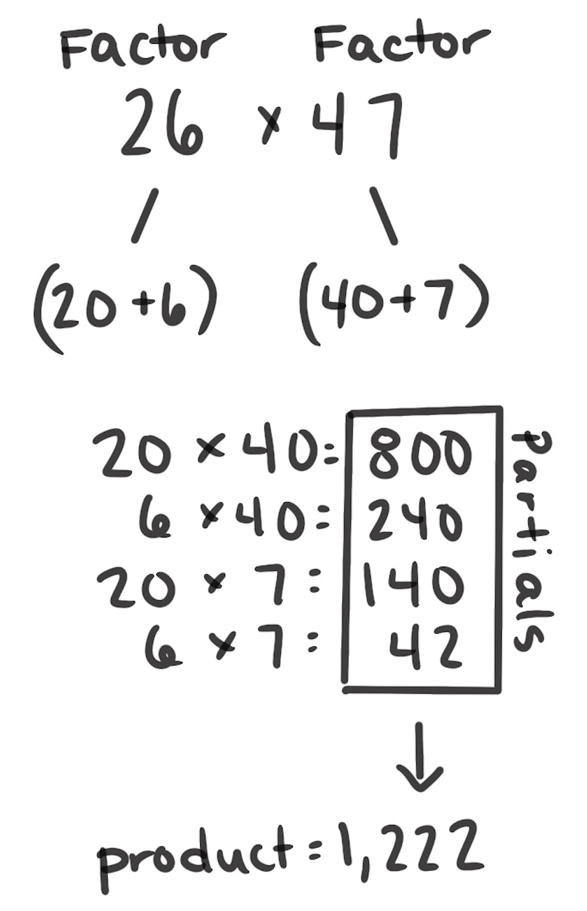
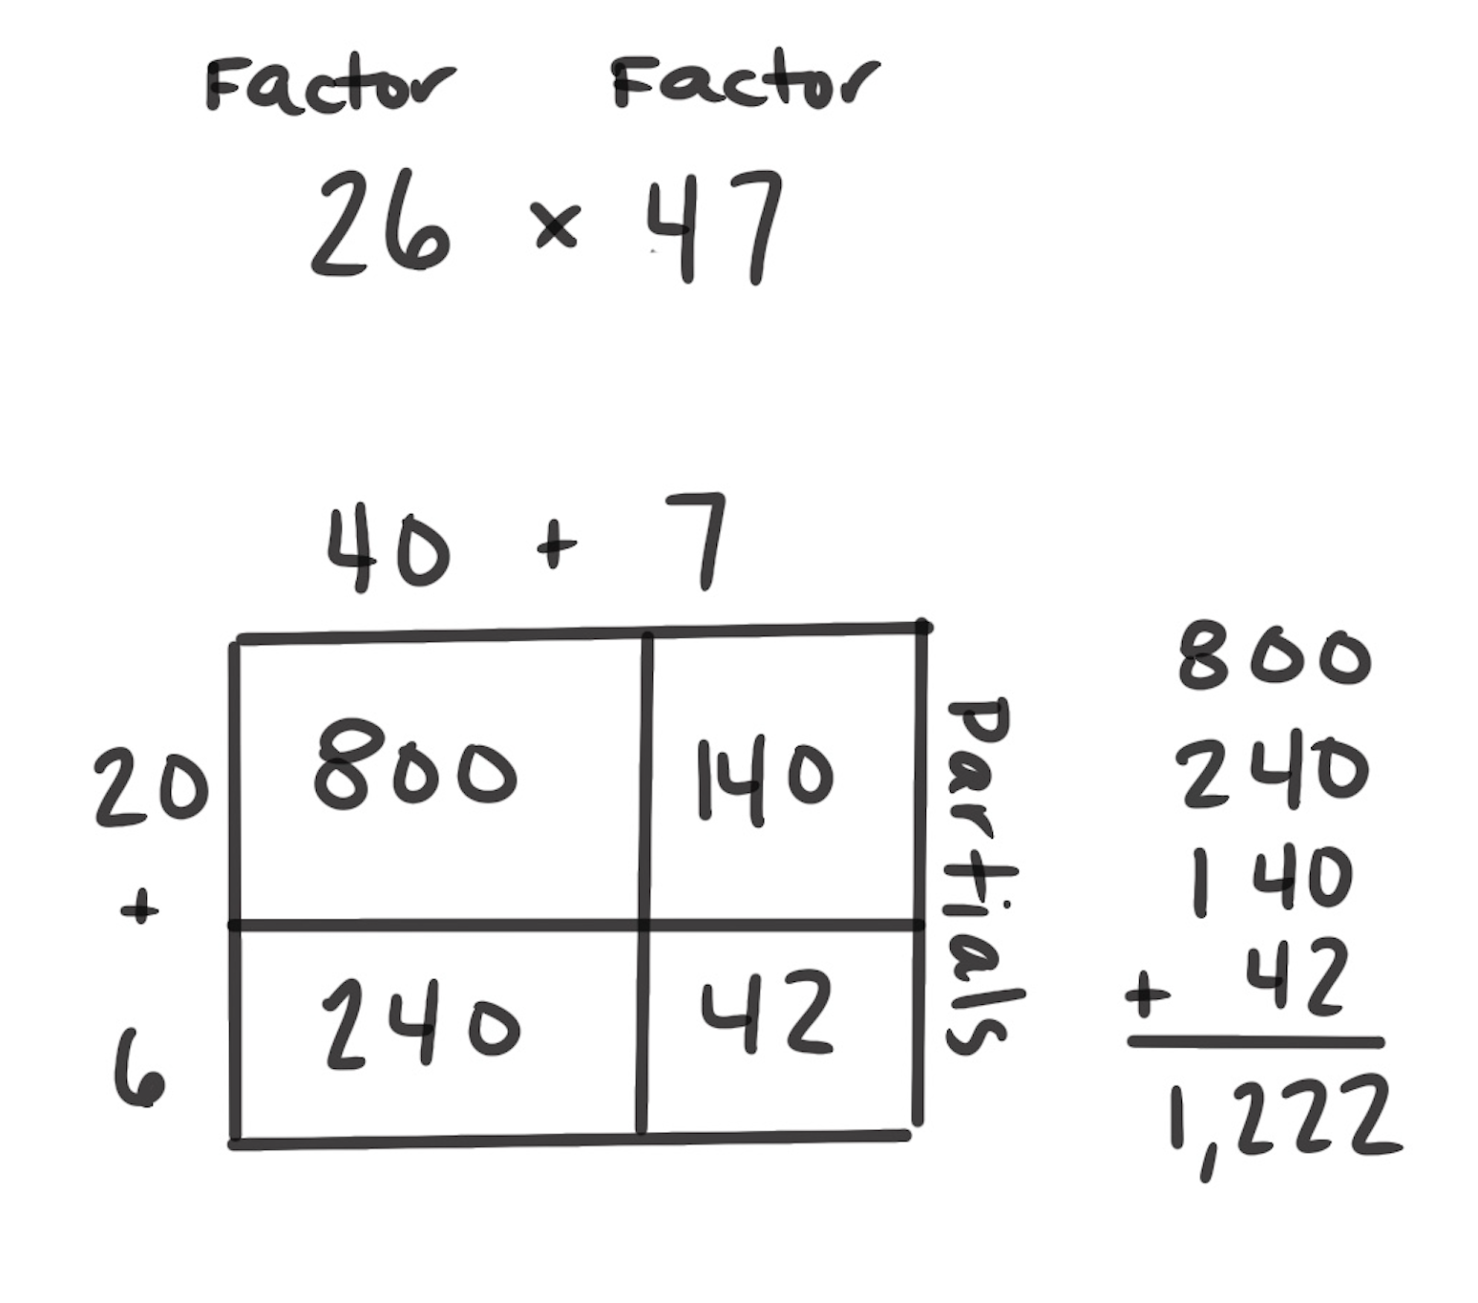
Partial Products
How It Works: We can break apart factors by place value to multiply. The parts of each factor are multiplied by each of the parts of the other factor. The partial products are added together to get your answer.
Decompose each factor.
Multiply the parts of each factor by each of the parts of the other factor.
Add each of the partial products together to get your final answer.
In the example, 26 × 47, each factor is decomposed by place value: 20 + 6 and 40 + 7. Then, each part is multiplied by each part of the other factor. 20 is multiplied by 40. 20 is also multiplied by 7, since those are the parts from the other factor. Also, 6 is multiplied by 40 and 6 is multiplied by 7, since those are the parts from the other factor. The partial products are then added together.
The example on the right is an area model. The rectangle represents how the area of these two factors can be decomposed.
When It’s Useful: Partial Products is a useful strategy for two- and three-digit factors. It is not as useful when the numbers get larger.

