Slide 1
44 – 39 | 25 – 55
81 – 213 | 17 – 45
-32 – 83 | -44 – 66
-16 – 77 | -51 – 318
-29 – 144 | 90 – 18
Please see PDF in case the formatting of this file changes.

Slide 2
1.83 – 3.55 | -8.8 – 1.14
3.9 – 1.44 | 1.35 – 5.03
0.14 – 3.09 | 6.2 – 17.3
1.48 – 2.7 | 5.3 – 3.76
4.83 – 45.2 | 9.03 – 1.13

Slide 3
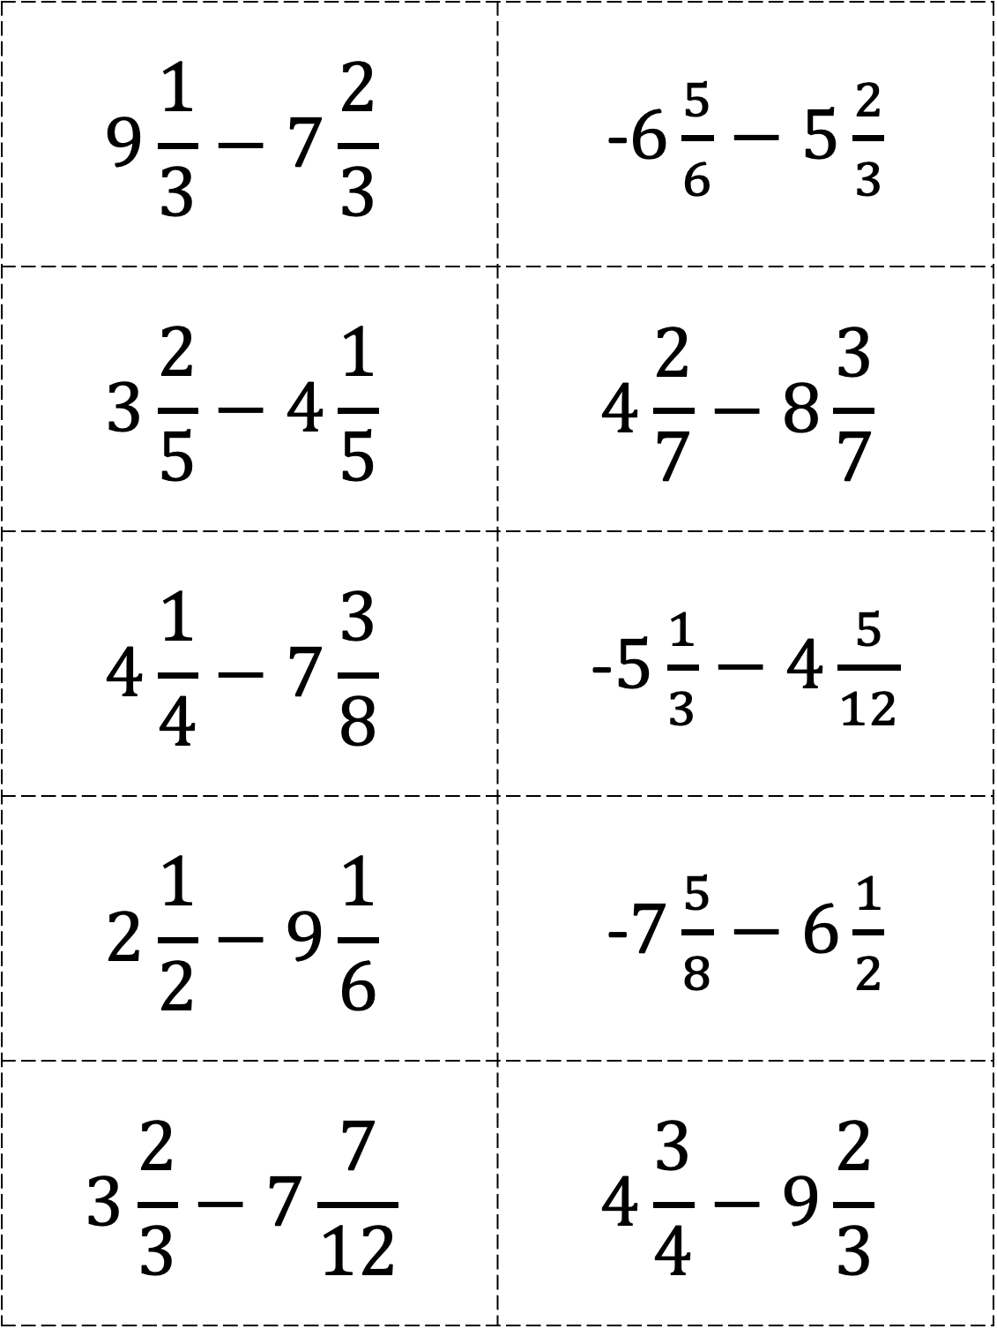
$$9\frac{1}{3}−7\frac{2}{3}$$ | -$6\frac{5}{6}−5\frac{2}{3}$
$$3\frac{2}{5}−4\frac{1}{5}$$ | $$4\frac{2}{7}−8\frac{3}{7}$$
$$4\frac{1}{4}−7\frac{3}{8}$$ | -$5\frac{1}{3}−4\frac{5}{12}$
$$2\frac{1}{2}−9\frac{1}{6}$$ | -$7\frac{5}{8}−6\frac{1}{2}$
$$3\frac{2}{3}−7\frac{7}{12}$$ | $$4\frac{3}{4}−9\frac{2}{3}$$

Slide 4
$$9\frac{1}{3}−7\frac{2}{3}$$ | $$6\frac{5}{6}−5\frac{2}{3}$$
$$6\frac{2}{5}−2\frac{1}{5}$$ | $$14\frac{4}{7}−8\frac{3}{7}$$
$$11\frac{3}{4}−7\frac{3}{8}$$ | $$7\frac{1}{3}−4\frac{5}{12}$$
$$12\frac{1}{2}−9\frac{1}{6}$$ | $$8\frac{5}{8}−6\frac{1}{2}$$
$$7\frac{2}{3}−3\frac{5}{12}$$ | $$9\frac{3}{4}−9\frac{2}{3}$$

