Slide 1
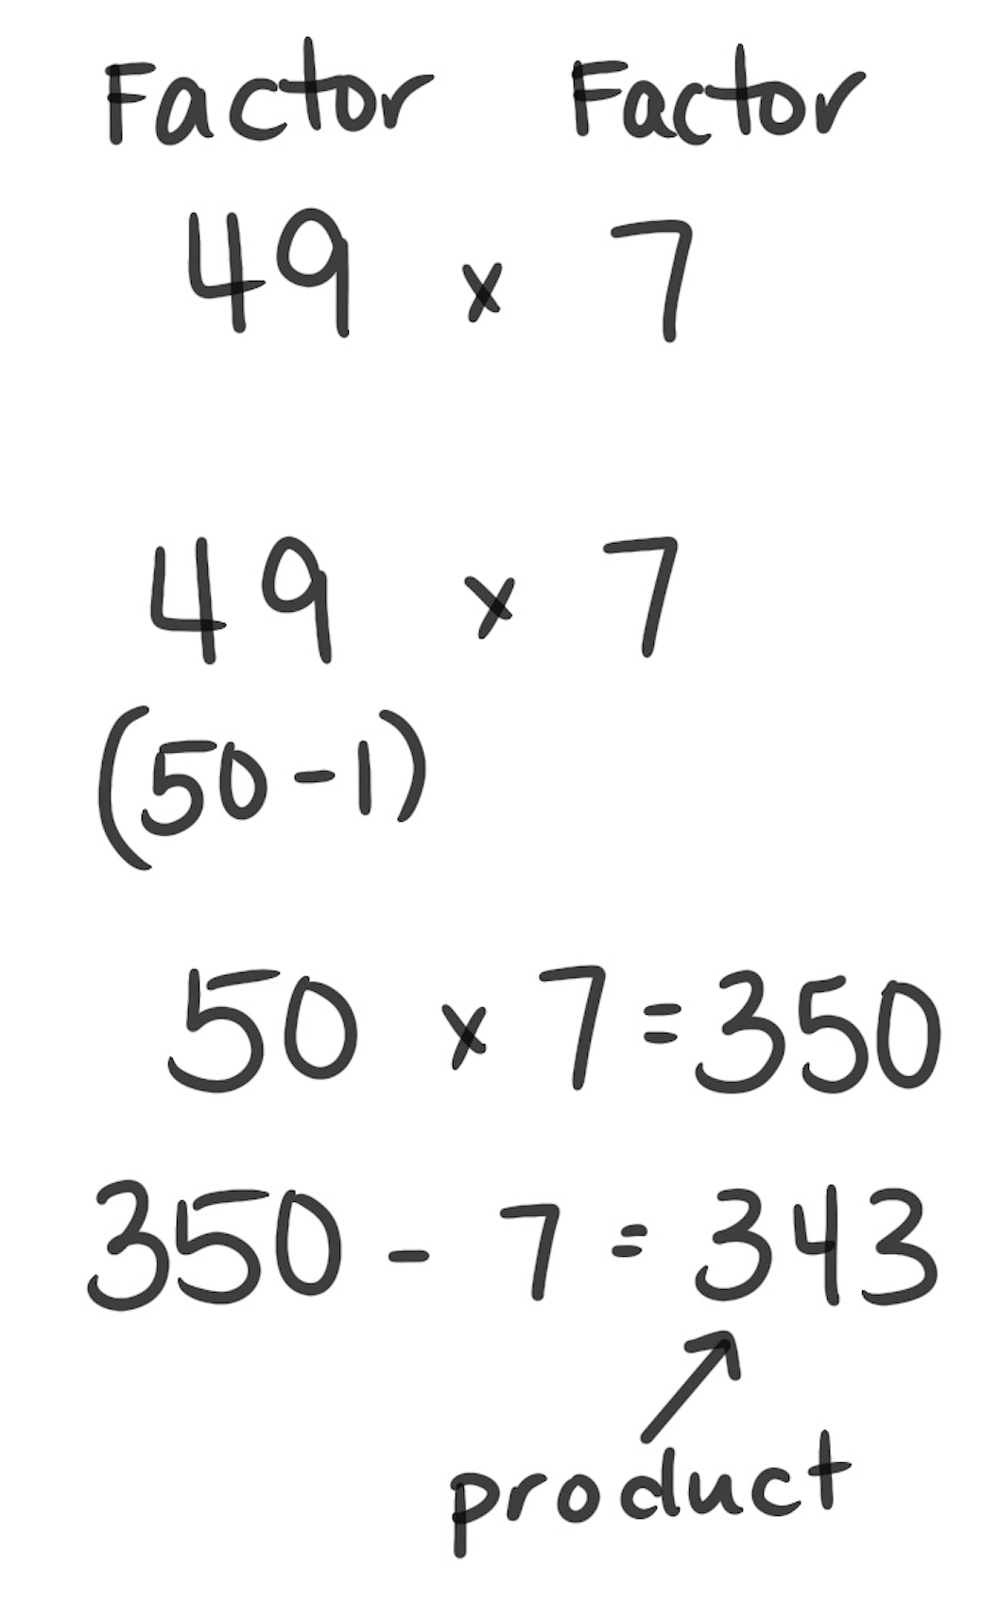
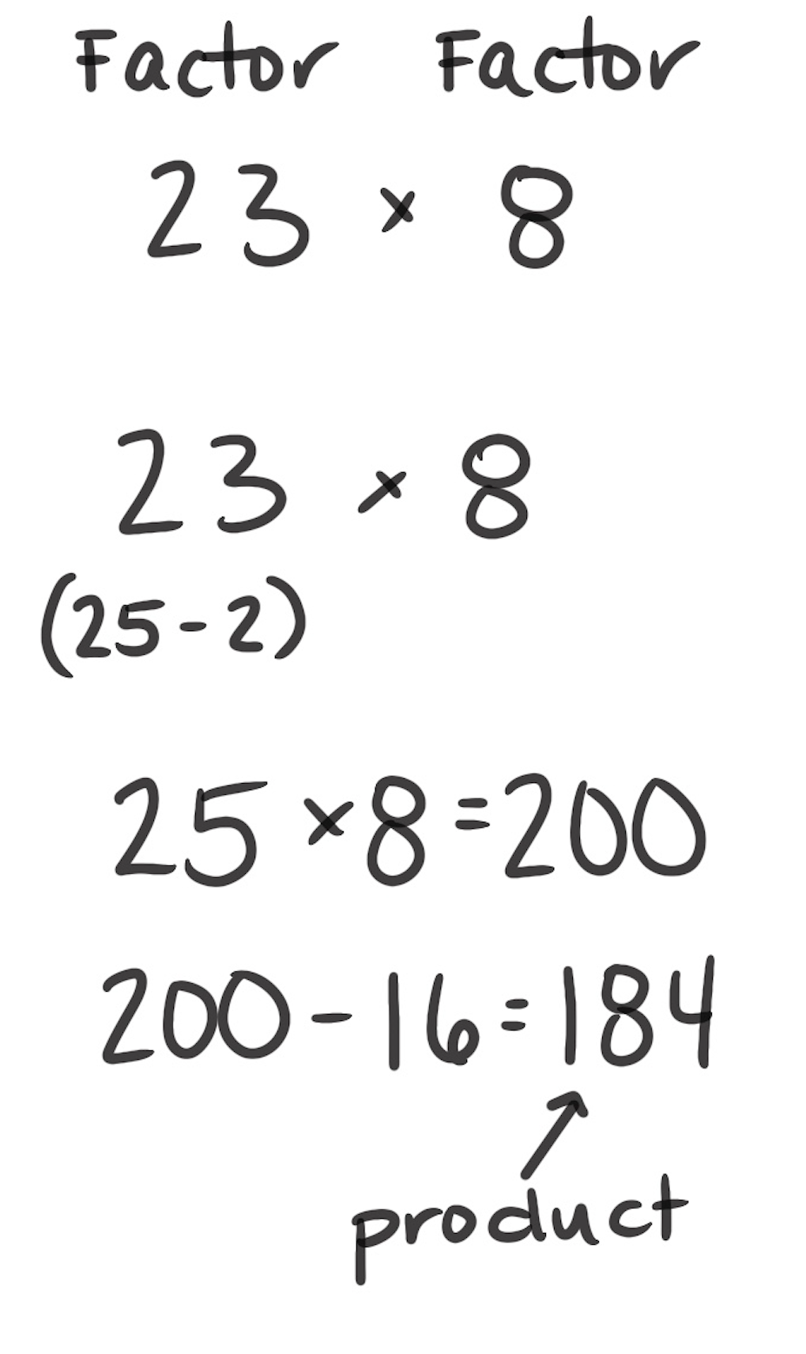
Compensation
How It Works: We can change a factor to find a product and then you can compensate for the change.
Decide on a friendlier computation.
Change a factor and find the product.
Compensate (undo) the amount that was changed.
The left example shows that there are 49 groups of 7: 49 × 7. You can change 49 to 50 because 50 is easier to multiply with. This means you are adding an extra group to make it 50 groups instead of 49. Multiply 50 groups of 7: 50 × 7 = 350. Then, you can take away the extra group of 7: 350 – 7 = 343.
The right example shows that 23 × 8 can be changed to 25 × 8, which means you added 2 groups to 23. You now have 25 groups: 25 × 8 = 200. Then, take away the two extra groups of 8 (i.e., 16): 200 – 16 = 184. So, 23 × 8 = 184.
When It’s Useful: Compensation is useful any time a factor can be easily changed to a a factor that is easier to multiply. For example, 23 × 17 can be thought of as
23 × 20 – 23 × 3, but that number sentence may not be easier to multiply.

