Slide 1
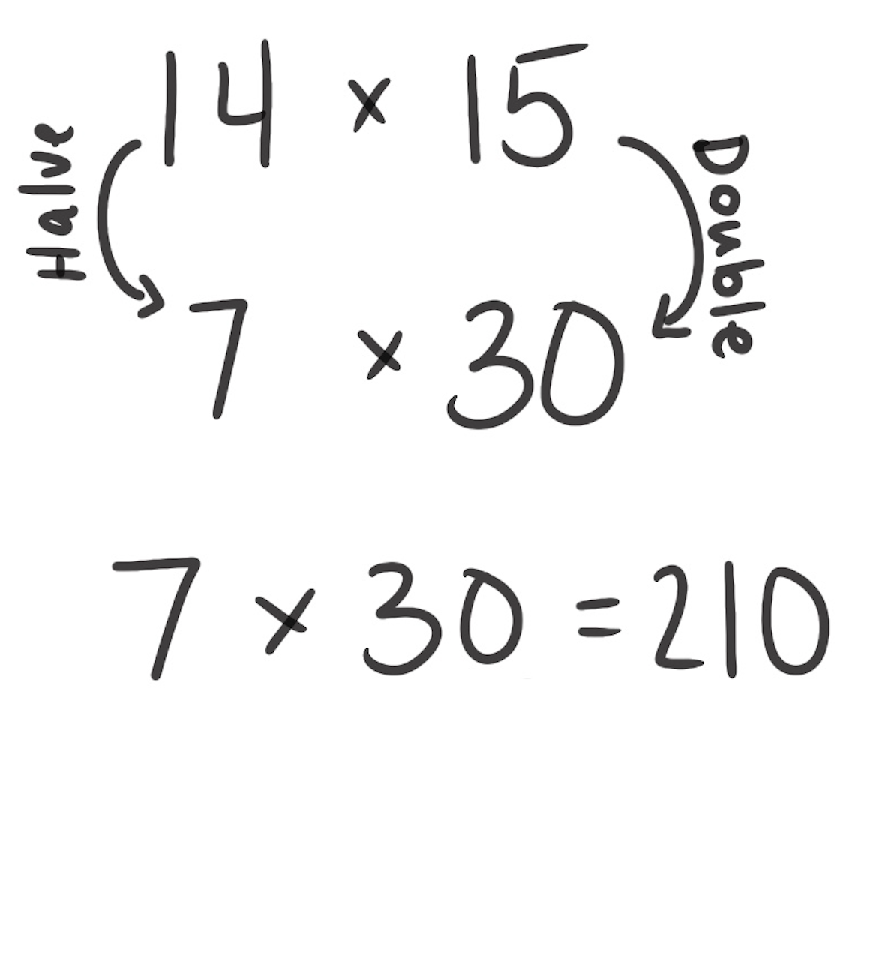
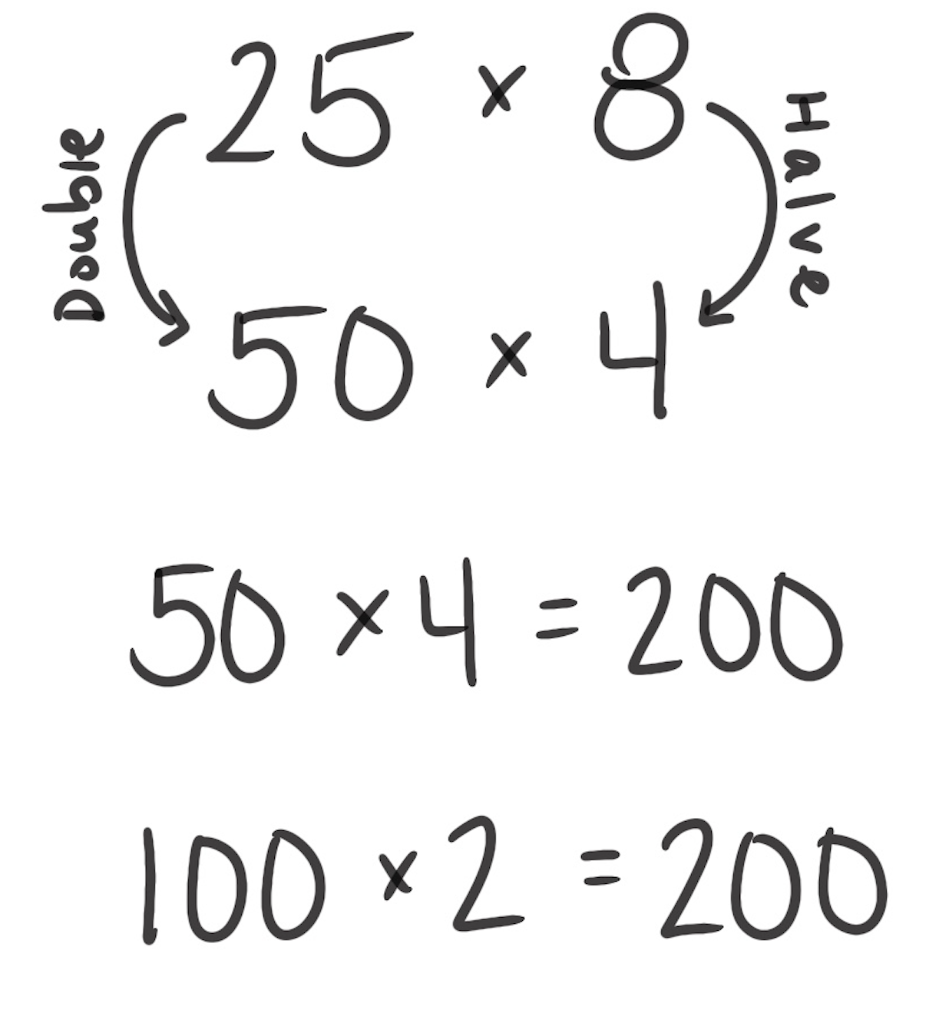
Halve and Double
How It Works: We can halve a factor and double another to get an answer.
Choose which factor to halve and which to double.
Halve one factor.
Double the other factor.
Find the product by multiplying.
The left example shows that you can halve 14 and double 15. These new numbers make it easier to multiply. Now the number sentence is 7 × 30, which is 210. So, 14 × 15 = 210.
The right example shows a different way that you can halve and double. The problem is 25 × 8: 8 can be halved and 25 doubled to create 50 × 4. You can double and halve again: 4 can be halved and 50 doubled, resulting in 100 × 2. 100 × 2 = 200 is the same as 25 × 8 = 200.
When It’s Useful: Halving and doubling is useful when one factor is an even number. It also helps when both factors can be easily halved and doubled. For example, 38 × 17 is not a good fit for this strategy because 19 × 34 is not a friendly problem to solve.

