Slide 1
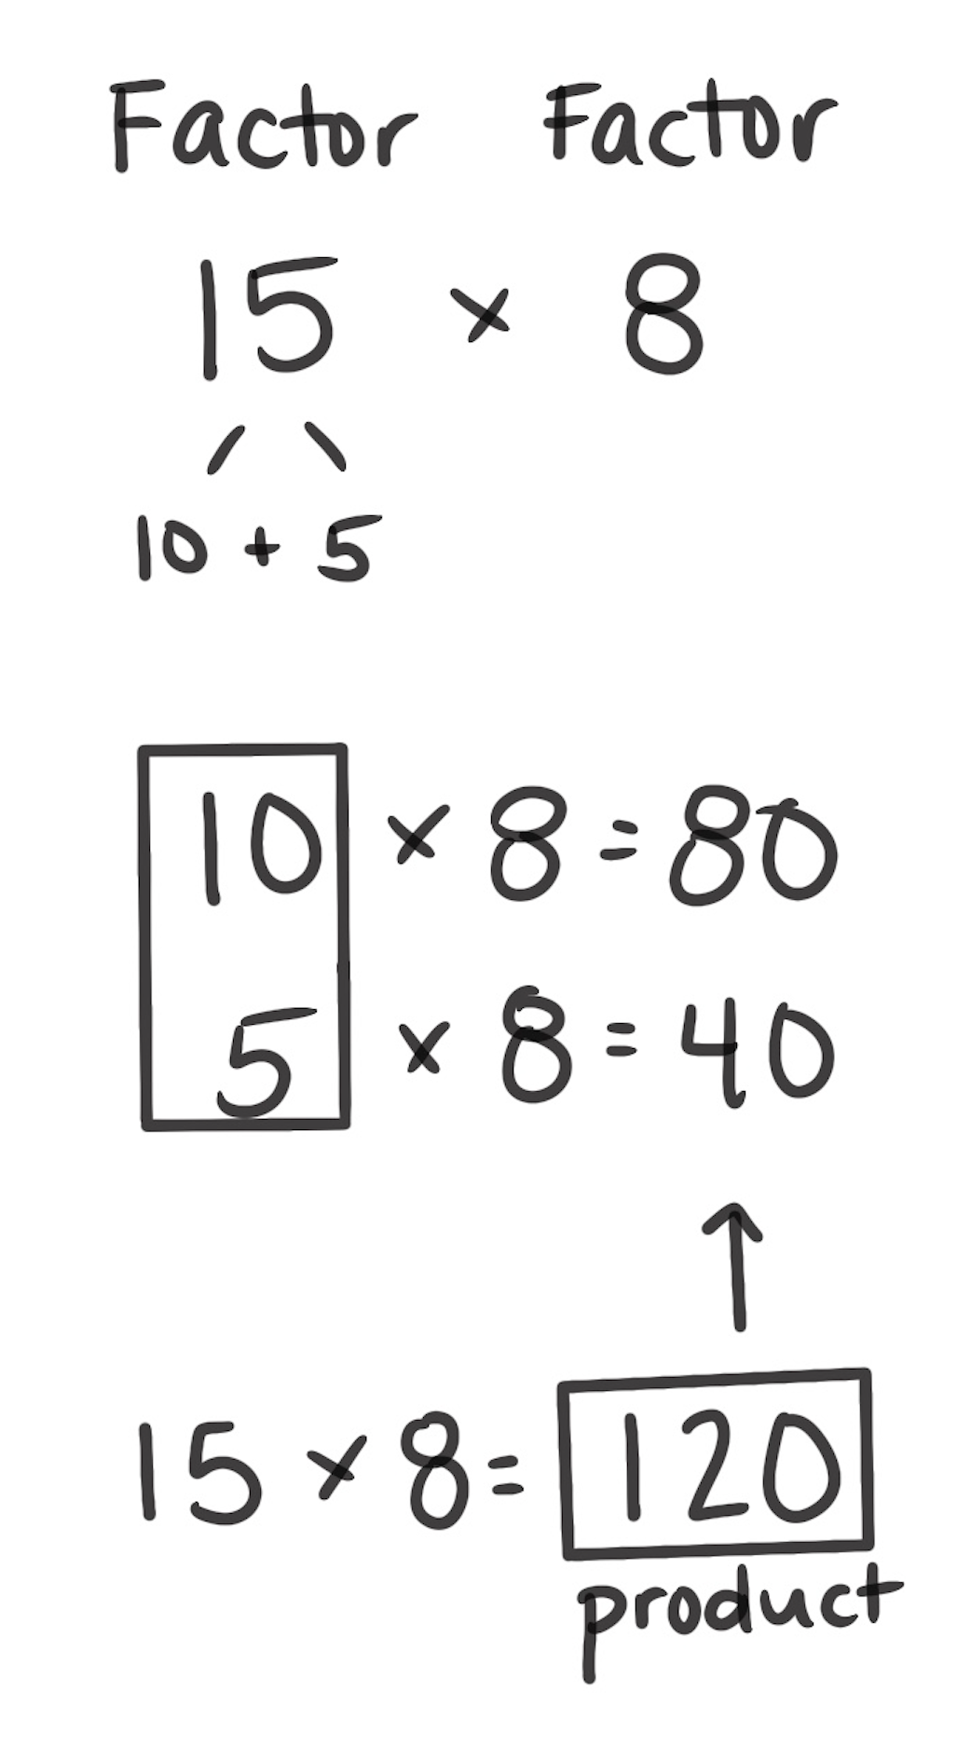
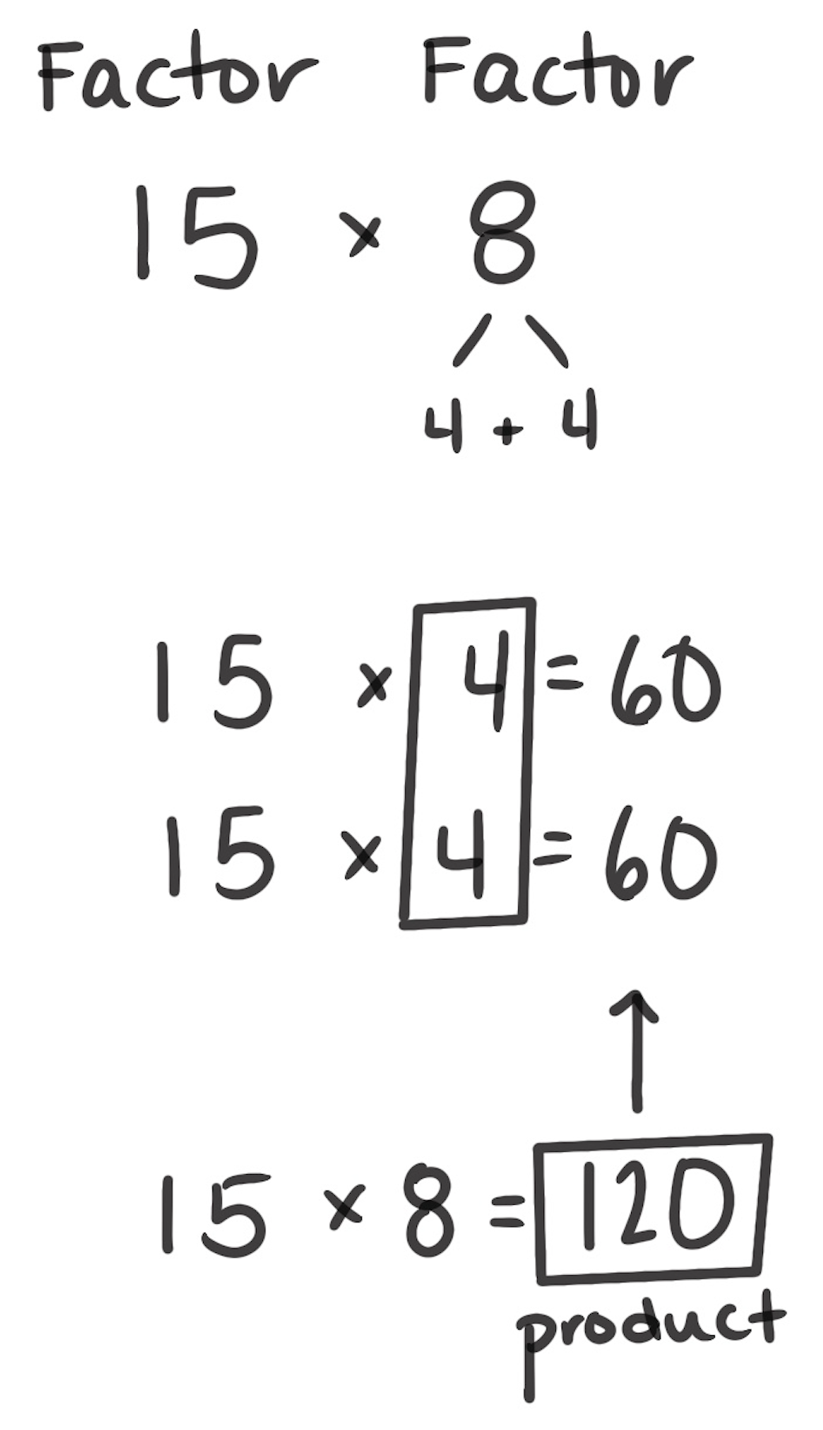
Break Apart by Addends to Multiply
How It Works: We can break apart either factor.
Choose which factor to break apart.
Break apart that factor into a sum. Multiply each addend by the other factor.
Add all the products together. This gives you the answer to the original problem.
The left example shows that, 15 is broken apart into 10 and 5. Multiply the first part, 10 × 8 is 80. Then multiply the second part, 5 × 8 is 40. The 80 and 40 are added.
80 + 40 = 120. The answer to the original problem is 120, 15 × 8 = 120.
The right example shows that 8 is broken apart into 4 and 4. Multiply the first part:
15 × 4 is 60. Then multiply the second part: 15 × 4 is 60. The 60 and 60 are added:
60 + 60 = 120. The answer to the original problem is 120, 15 × 8 = 120.
When It’s Useful: Breaking apart by addition to multiply is often useful. Any factor can be broken apart in different ways. The goal is to break apart factors in a way that makes the most sense.

Slide 2
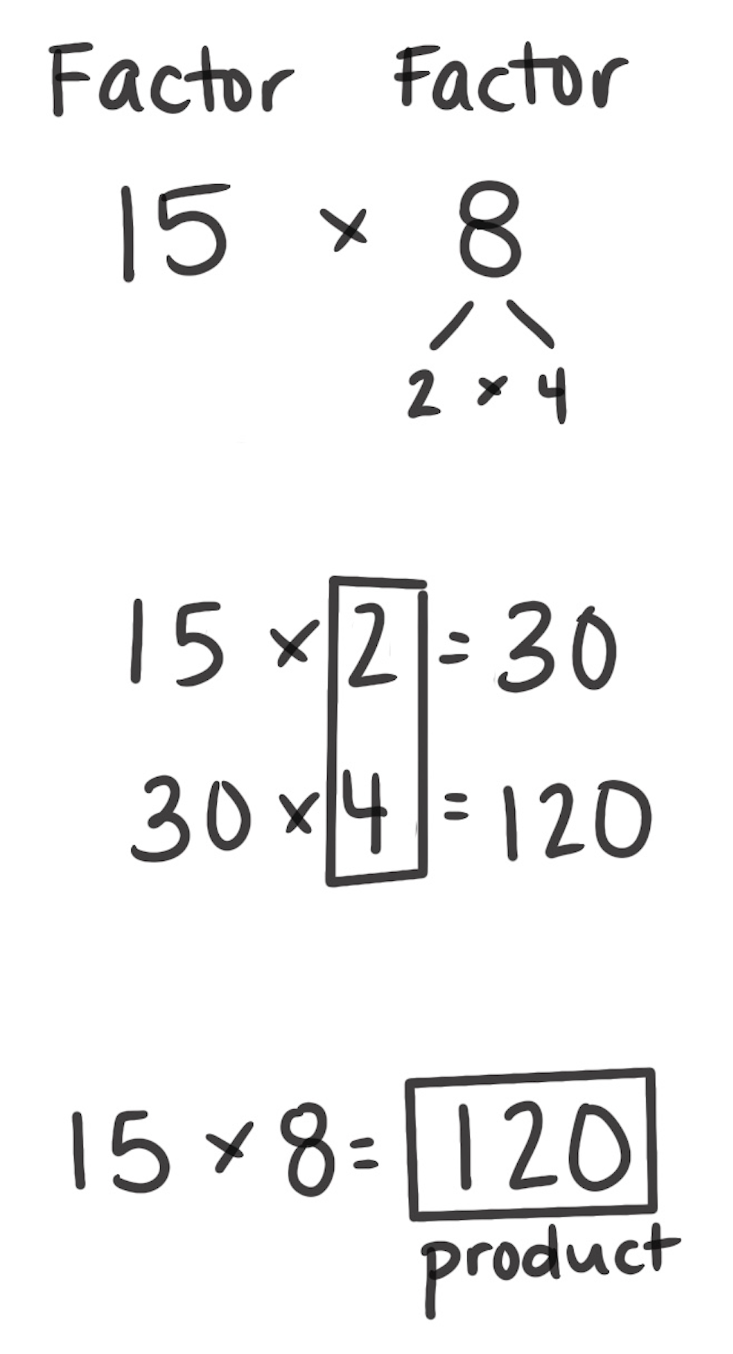
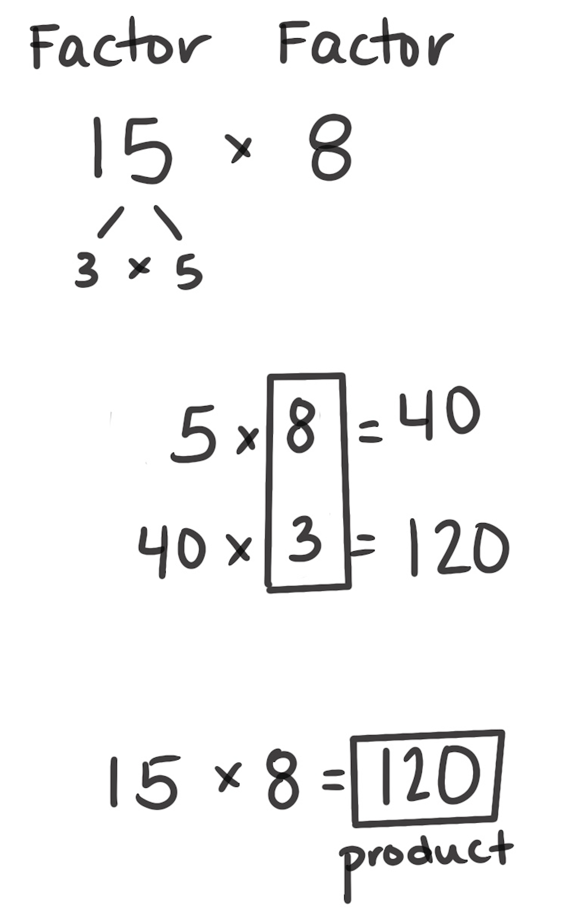
Break Apart by Factors to Multiply
How It Works: We can break apart either factor into its factors and find the product of the original problem.
Choose which factor to break apart by its factors.
Multiply the other factor by one of the parts.
Then, multiply that product by the other part.
The left example shows that 8 is broken apart into 2 × 4. Multiply the first part:
15 × 2 = 30. Then multiply the 30 by 4: 30 × 4 = 120. So, 15 × 8 = 120.
The right example shows that 15 is broken apart into 3 × 5. Multiply the first part:
3 × 8 = 24. Then multiply the 24 by 5: 24 × 5 = 120. So, 15 × 8 = 120.
When It’s Useful: Breaking apart by factors to multiply is most useful when one factor can be broken apart easily. In the example, breaking apart 8 works well because
2 × 15 and 30 × 4 are friendly. Breaking apart 15 into 3 × 5 works, but 24 × 5 may be a difficult one to multiply.

