Slide 1
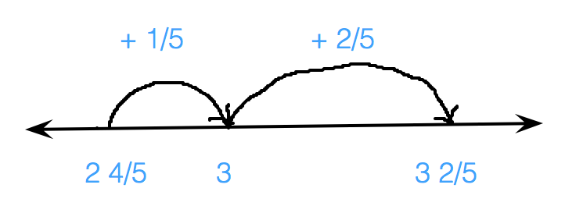
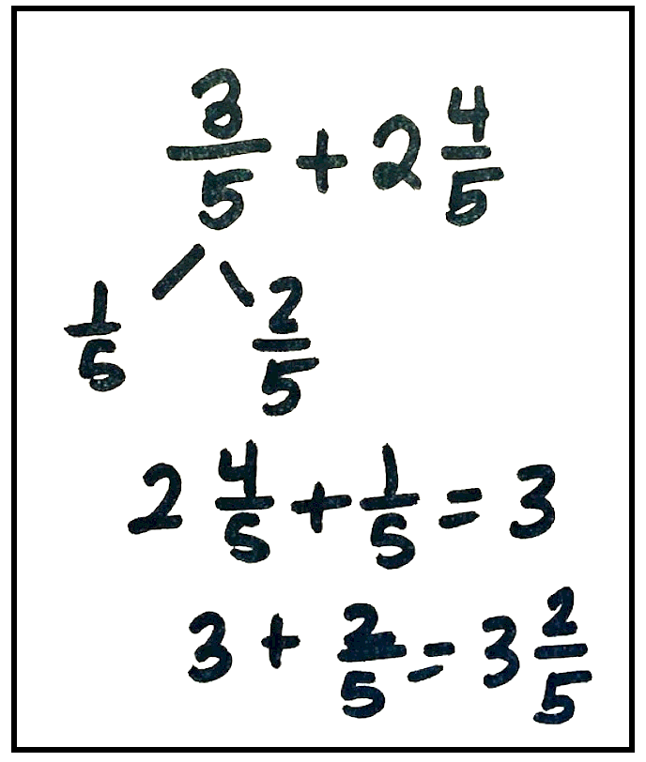
Count On Strategy: Fraction Addition
What It Is: This strategy involves starting with the larger number (addend) and then counting on with the other addend, using a convenient (efficient) chunks of your choosing.
Let’s look at $\frac{3}{5}+2\frac{4}{5}$.
What It Sounds Like: I will start with $2\frac{4}{5}$ and count on $\frac{1}{5}$ (so I am at 3), then add $\frac{2}{5}$ to reach a total of $3\frac{2}{5}$ .
What It Looks like: A good way to visualize this strategy is with a number line. An open number line doesn’t have all the “tick marks,” just marks that help solve the problem:
A third option is to count on mentally, perhaps visualizing a number line.
When This Strategy Is Useful: This strategy is a good idea when one of the numbers is relatively small and/or easy to count on in chunks.
A second option is to record how to break apart one of the addends. On the left, see the problem shared above. On the right is a fraction example (which can also be illustrated on a number line).

Slide 2
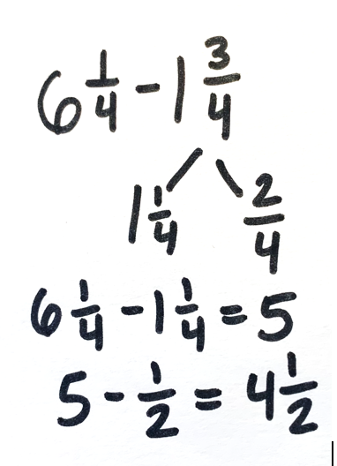
Count Back Strategy:
Fraction Subtraction
What It Is: This strategy involves breaking apart the second number (subtrahend) into convenient (efficient) chunks and taking away each of those chunks.
Let’s look at $6\frac{1}{4} \text{–} 1\frac{3}{4}$.
What It Sounds Like: I will start with $6\frac{1}{4}$ and count back 1 (so I am at $5\frac{1}{4}$), then subtract $\frac{1}{4}$ to reach 5, and finally $\frac{2}{4}$ to reach $4\frac{2}{4}$ or $4\frac{1}{2}$ OR I will start at $6\frac{1}{4}$ and subtract $1\frac{1}{4}$ . That is 5. Take away the remaining $\frac{1}{2}$, and the answer is $4\frac{1}{2}$ .
What It Looks Like: A good way to visualize this strategy is with a number line. An open number line doesn’t have all the “tick marks,” just marks that help solve the problem:
A third option is to count back mentally, perhaps visualizing a number line.
When This Strategy Is Useful: This strategy is a good idea when one of the numbers is relatively small and/or easy to take away in chunks.
A second option is to record how to break apart one of the addends. On the left, see the problem shared above.

Slide 3
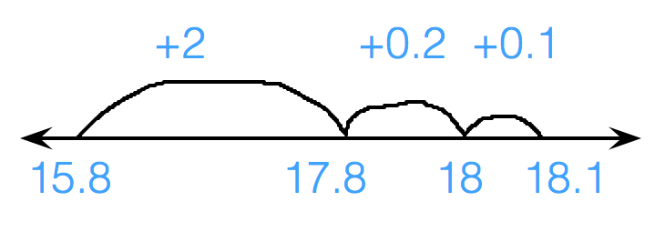
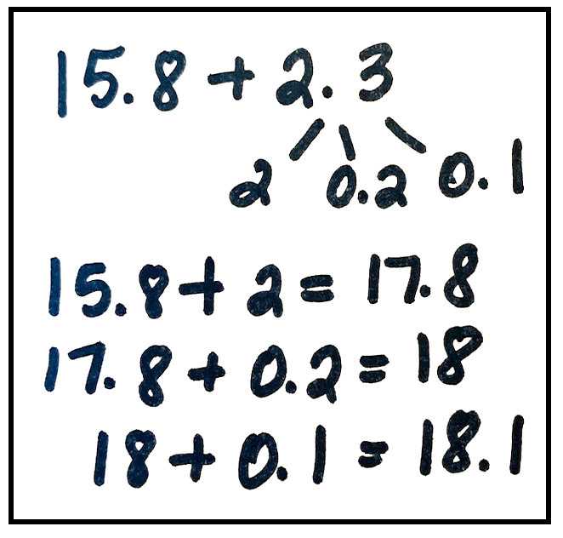
Count On Strategy: Decimal Addition
What It Is: This strategy involves starting with the larger number (addend), and then counting on with the other addend, using a convenient (efficient) chunks of your choosing.
Let’s look at 15.8 + 2.3.
What It Sounds Like: I will start with 15.8, then add 2 (so I am at 17.8), then add two-tenths to 18 and add the remaining one-tenth to reach a total of 18.1.
What It Looks Like: A good way to visualize this strategy is with a number line. An open number line doesn’t have all the “tick marks,” just marks that help solve the problem:
A third option is to count on mentally, perhaps visualizing a number line.
When This Strategy Is Useful: This strategy is a good idea when one of the numbers is relatively small and/or easy to count on in chunks.
A second option is to record how to break apart one of the addends. On the left, see the problem shared above. On the right is a fraction example (which can also be illustrated on a number line).

Slide 4
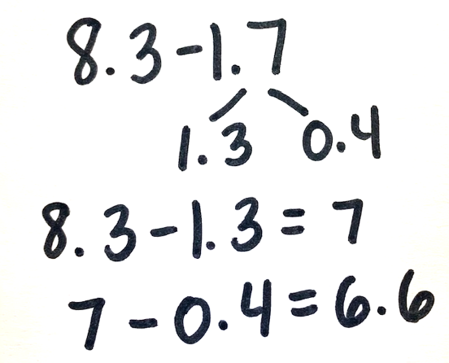
Count Back Strategy:
Decimal Subtraction
What It Is: This strategy involves breaking apart the second number (subtrahend) into convenient (efficient) chunks and taking away each of those chunks.
Let’s look at 8.3 – 1.7.
What It Sounds Like: I will count back 1 (so I am at 7.3), then subtract three-tenths to reach 7, and finally subtract four tenths to equal 6.6 OR I will subtract 1.3. That gives me 7. Then I take away the remaining four-tenths, and the answer is 6.6.
What It Looks Like: A good way to visualize this strategy is with a number line. An open number line doesn’t have all the “tick marks,” just marks that help solve the problem:
A second option is to record how to break apart one of the addends. On the left, see the problem shared above.
A third option is to count back mentally, perhaps visualizing a number line.
When Is This Strategy Useful: This strategy is a good idea when one of the numbers is relatively small and/or easy to take away in chunks.

