Slide 1
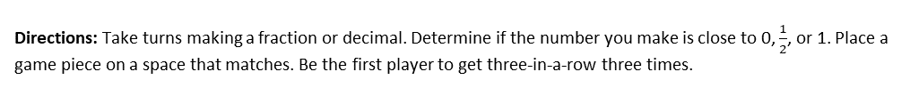
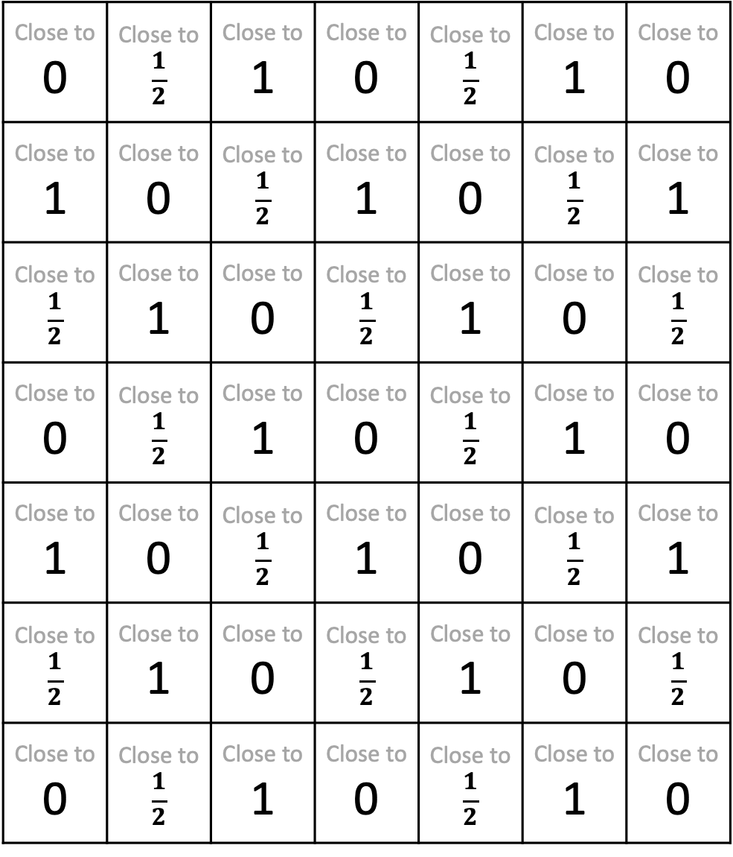
Three Close Covers
Directions: Take turns making a fraction or decimal. Determine if the number you make is close to 0, $\frac{1}{2}$, or 1. Place a game piece on a space that matches. Be the first player to get three-in-a-row three times.
Close to 0 | Close to $$\frac{1}{2}$$ | Close to 1 | Close to 0 | Close to $$\frac{1}{2}$$ | Close to 1 | Close to 0
Close to 1 | Close to 0 | Close to $$\frac{1}{2}$$ | Close to 1 | Close to 0 | Close to $$\frac{1}{2}$$ | Close to 1
Close to $$\frac{1}{2}$$ | Close to 1 | Close to 0 | Close to $$\frac{1}{2}$$ | Close to 1 | Close to 0 | Close to $$\frac{1}{2}$$
Close to 0 | Close to $$\frac{1}{2}$$ | Close to 1 | Close to 0 | Close to $$\frac{1}{2}$$ | Close to 1 | Close to 0
Close to 1 | Close to 0 | Close to $$\frac{1}{2}$$ | Close to 1 | Close to 0 | Close to $$\frac{1}{2}$$ | Close to 1
Close to $$\frac{1}{2}$$ | Close to 1 | Close to 0 | Close to $$\frac{1}{2}$$ | Close to 1 | Close to 0 | Close to $$\frac{1}{2}$$
Close to 0 | Close to $$\frac{1}{2}$$ | Close to 1 | Close to 0 | Close to $$\frac{1}{2}$$ | Close to 1 | Close to 0

