Slide 1
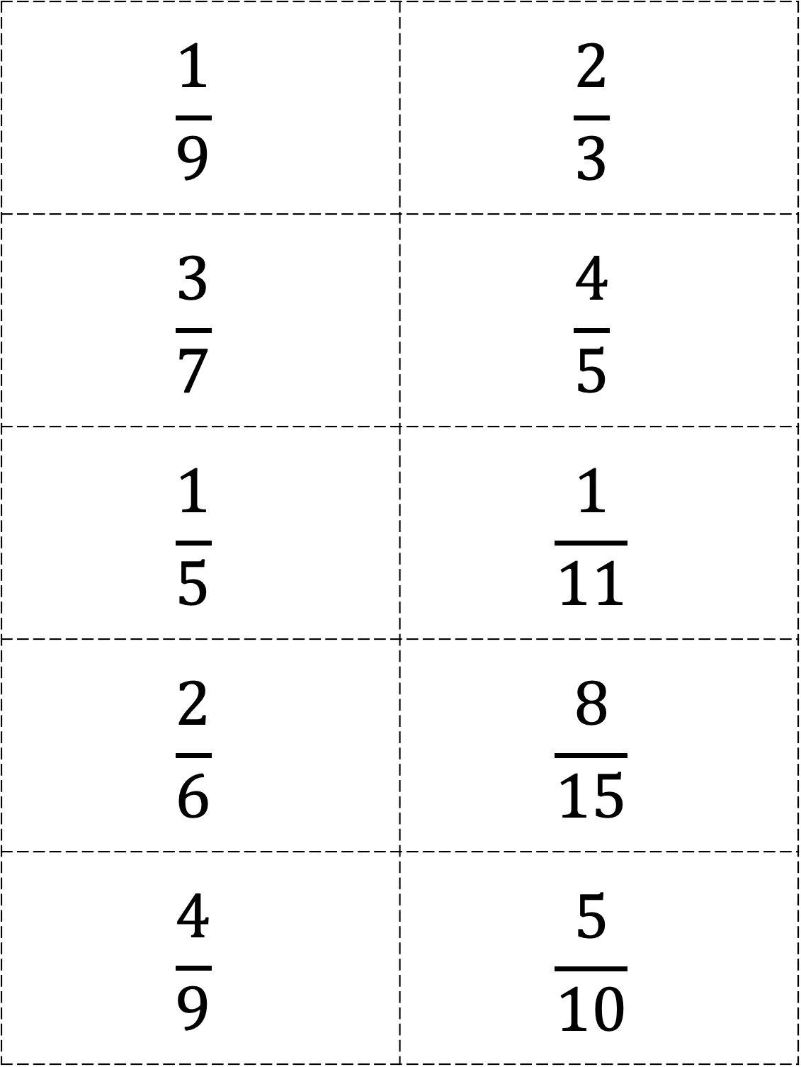
$$\frac{1}{9}$$ | $$\frac{2}{3}$$
$$\frac{3}{7}$$ | $$\frac{4}{5}$$
$$\frac{1}{5}$$ | $$\frac{1}{11}$$
$$\frac{2}{6}$$ | $$\frac{8}{15}$$
$$\frac{4}{9}$$ | $$\frac{5}{10}$$
Please see PDF in case the formatting of this file changes.

Slide 2
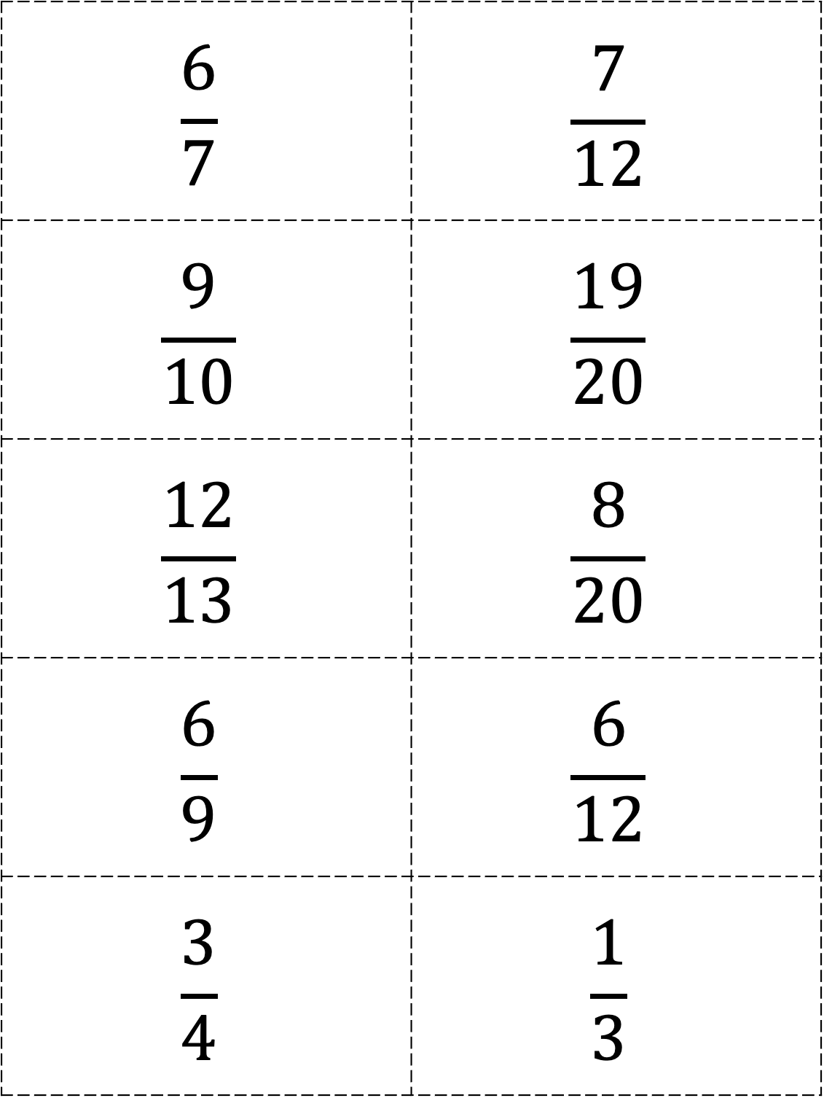
$$\frac{6}{7}$$ | $$\frac{7}{12}$$
$$\frac{9}{10}$$ | $$\frac{19}{20}$$
$$\frac{12}{13}$$ | $$\frac{8}{20}$$
$$\frac{6}{9}$$ | $$\frac{6}{12}$$
$$\frac{3}{4}$$ | $$\frac{1}{3}$$

Slide 3
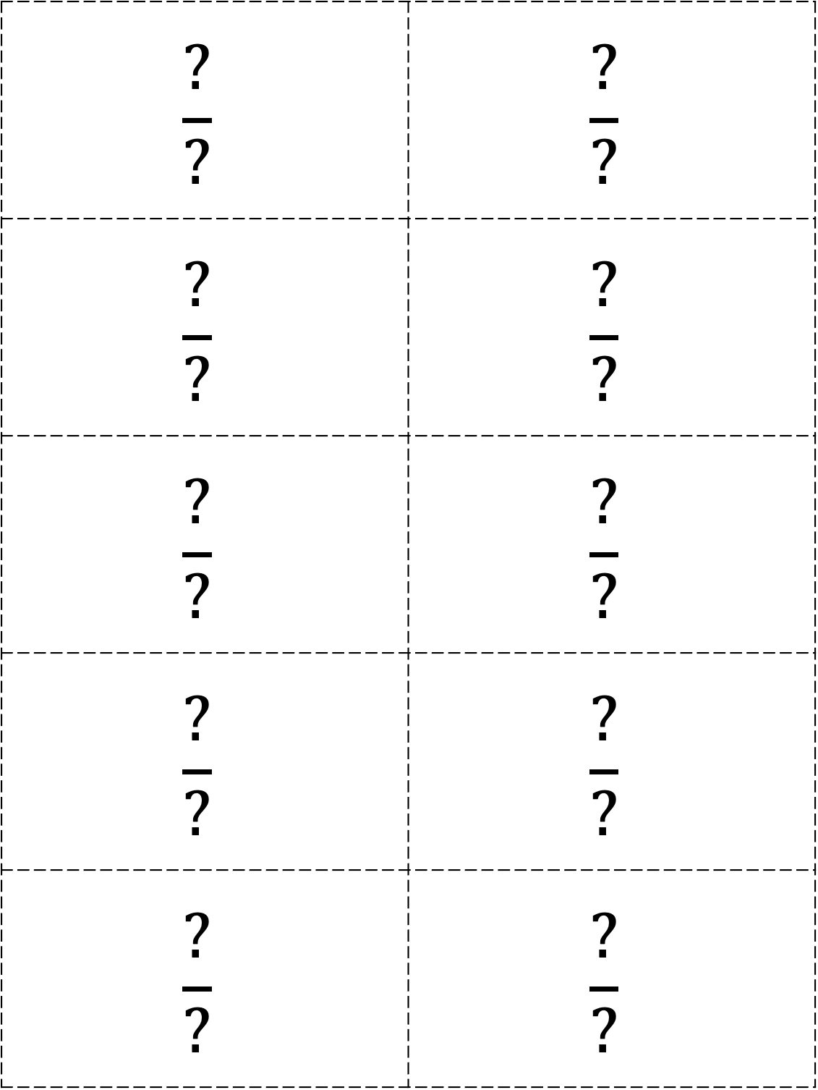
$$\frac{?}{?}$$ | $$\frac{?}{?}$$
$$\frac{?}{?}$$ | $$\frac{?}{?}$$
$$\frac{?}{?}$$ | $$\frac{?}{?}$$
$$\frac{?}{?}$$ | $$\frac{?}{?}$$
$$\frac{?}{?}$$ | $$\frac{?}{?}$$

