Slide 1
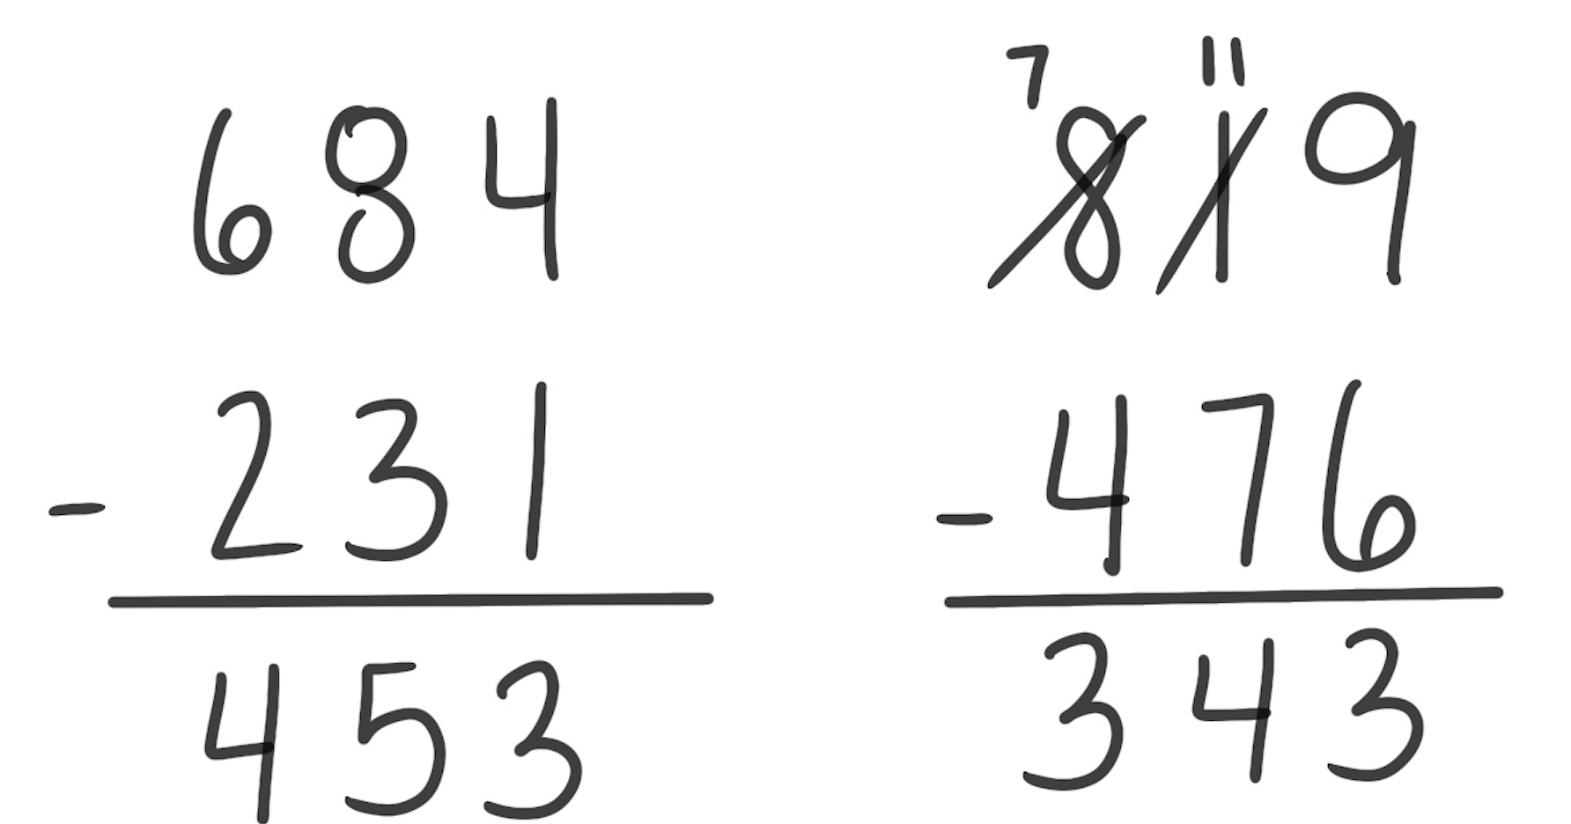
Standard Algorithm for Subtraction
How It Works: Numbers are aligned vertically by place value. Each place value is subtracted from right to left. The right example, 819 – 476, requires regrouping, meaning 7 tens cannot be taken from 1 ten. If subtracted it would lead to a negative number. The 8 hundreds becomes 7 hundreds and 10 tens. Those 10 tens and 1 more ten make 11 tens. The 7 tens can be taken from 11 tens, leaving 4 tens as shown below.
Things to Remember:
Place values are being subtracted. In the left example (684 – 231), 3 tens are subtracted from 8 tens and 2 hundreds are being subtracted from 6 hundreds.
Knowing when to use an algorithm is just as important as knowing how to use an algorithm. A problem like 500 – 300 should not need an algorithm for solving.
Students should always think about what is a reasonable answer. In the problem on the right, 400 is reasonable by thinking 800 – 400. 300 could also be reasonable by thinking 800 – 500. As you see, the actual difference is close to both 400 and 300.

