Slide 1
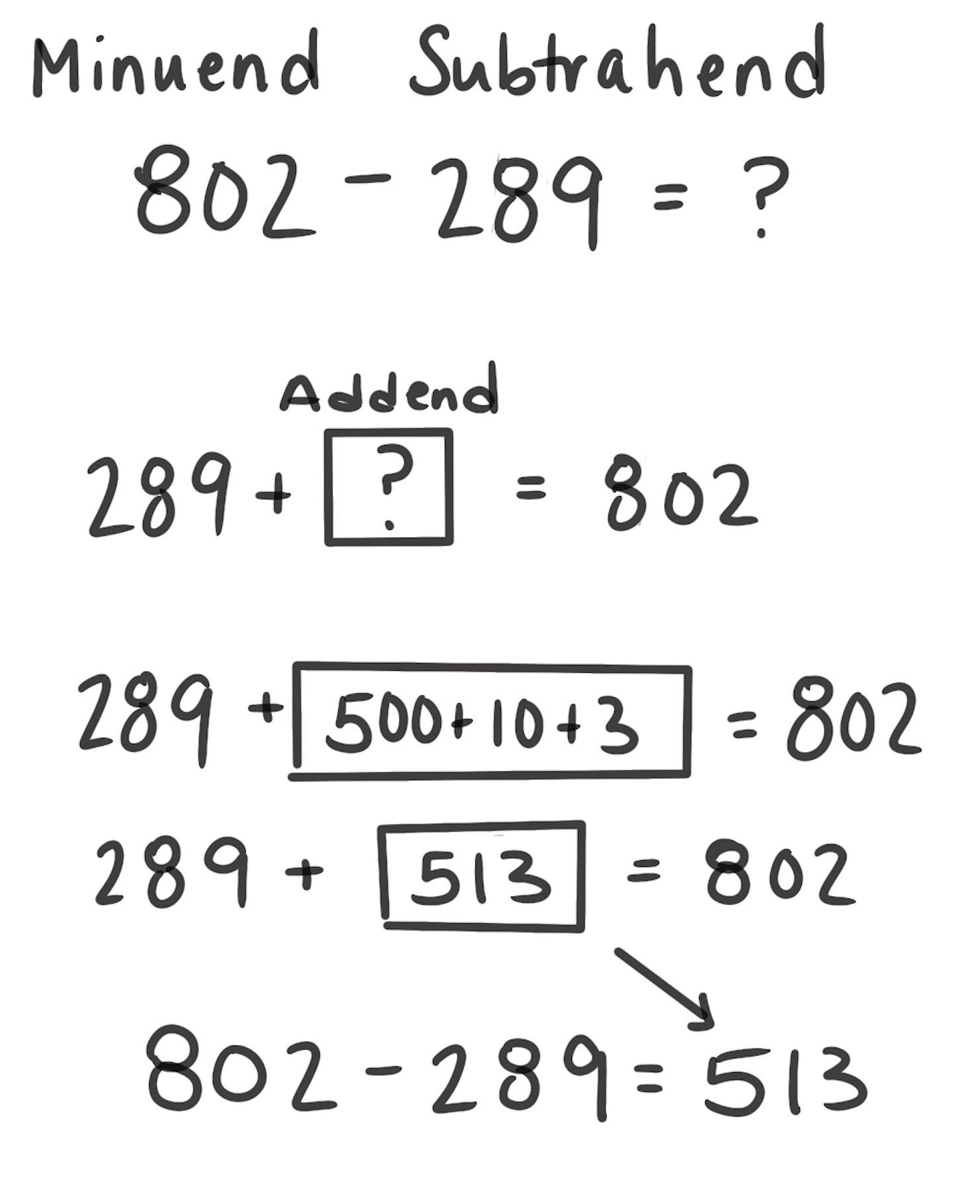
Think Addition Strategy for Subtraction
How It Works: We can use the relationship between addition and subtraction to solve subtraction problems. Subtraction is also a missing part addition problem.
Rethink the subtraction problem as a missing part addition problem.
Add up to find the missing part.
The missing part is the answer to the subtraction problem.
For example, 802 – 289 can be thought of as 289 plus something is 802. We can count up from 289 to 802, which is 513. So, 802 – 289 = 513.
When It’s Useful: This strategy is useful when numbers are close together or when the Count Up or Count Back strategy isn’t extensive.

