Slide 1
Take Ten
Directions: Place ten game pieces on the chart. Take turns making hundredths. If the hundredth you make combines with a hundredth you covered, remove the piece. The first player to remove all of their pieces wins.
0.01 | 0.02 | 0.03 | 0.04 | 0.05 | 0.06 | 0.07 | 0.08 | 0.09 | 0.10
0.11 | 0.12 | 0.13 | 0.14 | 0.15 | 0.16 | 0.17 | 0.18 | 0.19 | 0.20
0.21 | 0.22 | 0.23 | 0.24 | 0.25 | 0.26 | 0.27 | 0.28 | 0.29 | 0.30
0.31 | 0.32 | 0.33 | 0.34 | 0.35 | 0.36 | 0.37 | 0.38 | 0.39 | 0.40
0.41 | 0.42 | 0.43 | 0.44 | 0.45 | 0.46 | 0.47 | 0.48 | 0.49 | 0.50
0.51 | 0.52 | 0.53 | 0.54 | 0.55 | 0.56 | 0.57 | 0.58 | 0.59 | 0.60
0.61 | 0.62 | 0.63 | 0.64 | 0.65 | 0.66 | 0.67 | 0.68 | 0.69 | 0.70
0.71 | 0.72 | 0.73 | 0.74 | 0.75 | 0.76 | 0.77 | 0.78 | 0.79 | 0.80
0.81 | 0.82 | 0.83 | 0.84 | 0.85 | 0.86 | 0.87 | 0.88 | 0.89 | 0.90
0.91 | 0.92 | 0.93 | 0.94 | 0.95 | 0.96 | 0.97 | 0.98 | 0.99 | 1.00

Slide 2
Take Ten
Directions: Place ten game pieces on the chart. Take turns making hundredths. If the hundredth you make combines with a hundredth you covered, remove the piece. The first player to remove all of their pieces wins.
0.91 | 0.92 | 0.93 | 0.94 | 0.95 | 0.96 | 0.97 | 0.98 | 0.99 | 1.00
0.81 | 0.82 | 0.83 | 0.84 | 0.85 | 0.86 | 0.87 | 0.88 | 0.89 | 0.90
0.71 | 0.72 | 0.73 | 0.74 | 0.75 | 0.76 | 0.77 | 0.78 | 0.79 | 0.80
0.61 | 0.62 | 0.63 | 0.64 | 0.65 | 0.66 | 0.67 | 0.68 | 0.69 | 0.70
0.51 | 0.52 | 0.53 | 0.54 | 0.55 | 0.56 | 0.57 | 0.58 | 0.59 | 0.60
0.41 | 0.42 | 0.43 | 0.44 | 0.45 | 0.46 | 0.47 | 0.48 | 0.49 | 0.50
0.31 | 0.32 | 0.33 | 0.34 | 0.35 | 0.36 | 0.37 | 0.38 | 0.39 | 0.40
0.21 | 0.22 | 0.23 | 0.24 | 0.25 | 0.26 | 0.27 | 0.28 | 0.29 | 0.30
0.11 | 0.12 | 0.13 | 0.14 | 0.15 | 0.16 | 0.17 | 0.18 | 0.19 | 0.20
0.01 | 0.02 | 0.03 | 0.04 | 0.05 | 0.06 | 0.07 | 0.08 | 0.09 | 0.10

Slide 3
Take Ten
Directions: Place ten game pieces on the chart. Take turns making a two-digit number with tenths. If you number combines with one of the numbers you covered to make ten, remove the piece. The first player to remove all of their pieces wins.
0.1 | 0.2 | 0.3 | 0.4 | 0.5 | 0.6 | 0.7 | 0.8 | 0.9 | 1.0
1.1 | 1.2 | 1.3 | 1.4 | 1.5 | 1.6 | 1.7 | 1.8 | 1.9 | 2.0
2.1 | 2.2 | 2.3 | 2.4 | 2.5 | 2.6 | 2.7 | 2.8 | 2.9 | 3.0
3.1 | 3.2 | 3.3 | 3.4 | 3.5 | 3.6 | 3.7 | 3.8 | 3.9 | 4.0
4.1 | 4.2 | 4.3 | 4.4 | 4.5 | 4.6 | 4.7 | 4.8 | 4.9 | 5.0
5.1 | 5.2 | 5.3 | 5.4 | 5.5 | 5.6 | 5.7 | 5.8 | 5.9 | 6.0
6.1 | 6.2 | 6.3 | 6.4 | 6.5 | 6.6 | 6.7 | 6.8 | 6.9 | 7.0
7.1 | 7.2 | 7.3 | 7.4 | 7.5 | 7.6 | 7.7 | 7.8 | 7.9 | 8.0
8.1 | 8.2 | 8.3 | 8.4 | 8.5 | 8.6 | 8.7 | 8.8 | 8.9 | 9.0
9.1 | 9.2 | 9.3 | 9.4 | 9.5 | 9.6 | 9.7 | 9.8 | 9.9 | 10.0

Slide 4
Take Ten
Directions: Place ten game pieces on the chart. Take turns making a two-digit number with tenths. If you number combines with one of the numbers you covered to make ten, remove the piece. The first player to remove all of their pieces wins.
9.1 | 9.2 | 9.3 | 9.4 | 9.5 | 9.6 | 9.7 | 9.8 | 9.9 | 10.0
8.1 | 8.2 | 8.3 | 8.4 | 8.5 | 8.6 | 8.7 | 8.8 | 8.9 | 9.0
7.1 | 7.2 | 7.3 | 7.4 | 7.5 | 7.6 | 7.7 | 7.8 | 7.9 | 8.0
6.1 | 6.2 | 6.3 | 6.4 | 6.5 | 6.6 | 6.7 | 6.8 | 6.9 | 7.0
5.1 | 5.2 | 5.3 | 5.4 | 5.5 | 5.6 | 5.7 | 5.8 | 5.9 | 6.0
4.1 | 4.2 | 4.3 | 4.4 | 4.5 | 4.6 | 4.7 | 4.8 | 4.9 | 5.0
3.1 | 3.2 | 3.3 | 3.4 | 3.5 | 3.6 | 3.7 | 3.8 | 3.9 | 4.0
2.1 | 2.2 | 2.3 | 2.4 | 2.5 | 2.6 | 2.7 | 2.8 | 2.9 | 3.0
1.1 | 1.2 | 1.3 | 1.4 | 1.5 | 1.6 | 1.7 | 1.8 | 1.9 | 20
0.1 | 0.2 | 0.3 | 0.4 | 0.5 | 0.6 | 0.7 | 0.8 | 0.9 | 1.0

Slide 5
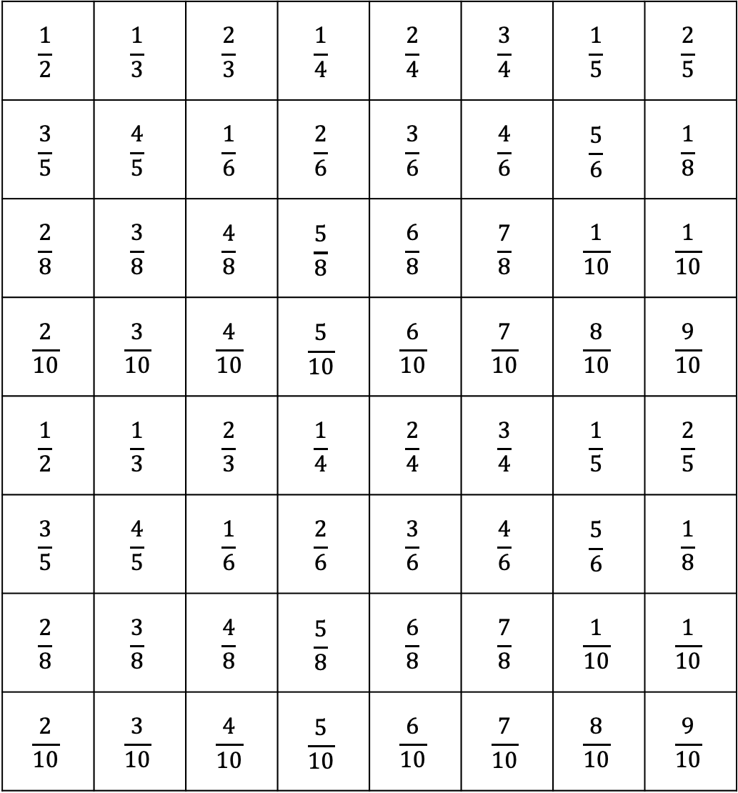
Take Ten
Directions: Place ten game pieces on the chart. Take turns rolling two digits. Make a fraction with those digits. Remove a game piece from the space if the fraction it covers combines with the fraction you made to make a whole. Be the first to remove all ten pieces.
$$\frac{1}{2}$$ | $$\frac{1}{3}$$ | $$\frac{2}{3}$$ | $$\frac{1}{4}$$ | $$\frac{2}{4}$$ | $$\frac{3}{4}$$ | $$\frac{1}{5}$$ | $$\frac{2}{5}$$
$$\frac{3}{5}$$ | $$\frac{4}{5}$$ | $$\frac{1}{6}$$ | $$\frac{2}{6}$$ | $$\frac{3}{6}$$ | $$\frac{4}{6}$$ | $$\frac{5}{6}$$ | $$\frac{1}{8}$$
$$\frac{2}{8}$$ | $$\frac{3}{8}$$ | $$\frac{4}{8}$$ | $$\frac{5}{8}$$ | $$\frac{6}{8}$$ | $$\frac{7}{8}$$ | $$\frac{1}{10}$$ | $$\frac{1}{10}$$
$$\frac{2}{10}$$ | $$\frac{3}{10}$$ | $$\frac{4}{10}$$ | $$\frac{5}{10}$$ | $$\frac{6}{10}$$ | $$\frac{7}{10}$$ | $$\frac{8}{10}$$ | $$\frac{9}{10}$$
$$\frac{1}{2}$$ | $$\frac{1}{3}$$ | $$\frac{2}{3}$$ | $$\frac{1}{4}$$ | $$\frac{2}{4}$$ | $$\frac{3}{4}$$ | $$\frac{1}{5}$$ | $$\frac{2}{5}$$
$$\frac{3}{5}$$ | $$\frac{4}{5}$$ | $$\frac{1}{6}$$ | $$\frac{2}{6}$$ | $$\frac{3}{6}$$ | $$\frac{4}{6}$$ | $$\frac{5}{6}$$ | $$\frac{1}{8}$$
$$\frac{2}{8}$$ | $$\frac{3}{8}$$ | $$\frac{4}{8}$$ | $$\frac{5}{8}$$ | $$\frac{6}{8}$$ | $$\frac{7}{8}$$ | $$\frac{1}{10}$$ | $$\frac{1}{10}$$
$$\frac{2}{10}$$ | $$\frac{3}{10}$$ | $$\frac{4}{10}$$ | $$\frac{5}{10}$$ | $$\frac{6}{10}$$ | $$\frac{7}{10}$$ | $$\frac{8}{10}$$ | $$\frac{9}{10}$$

