Slide 1
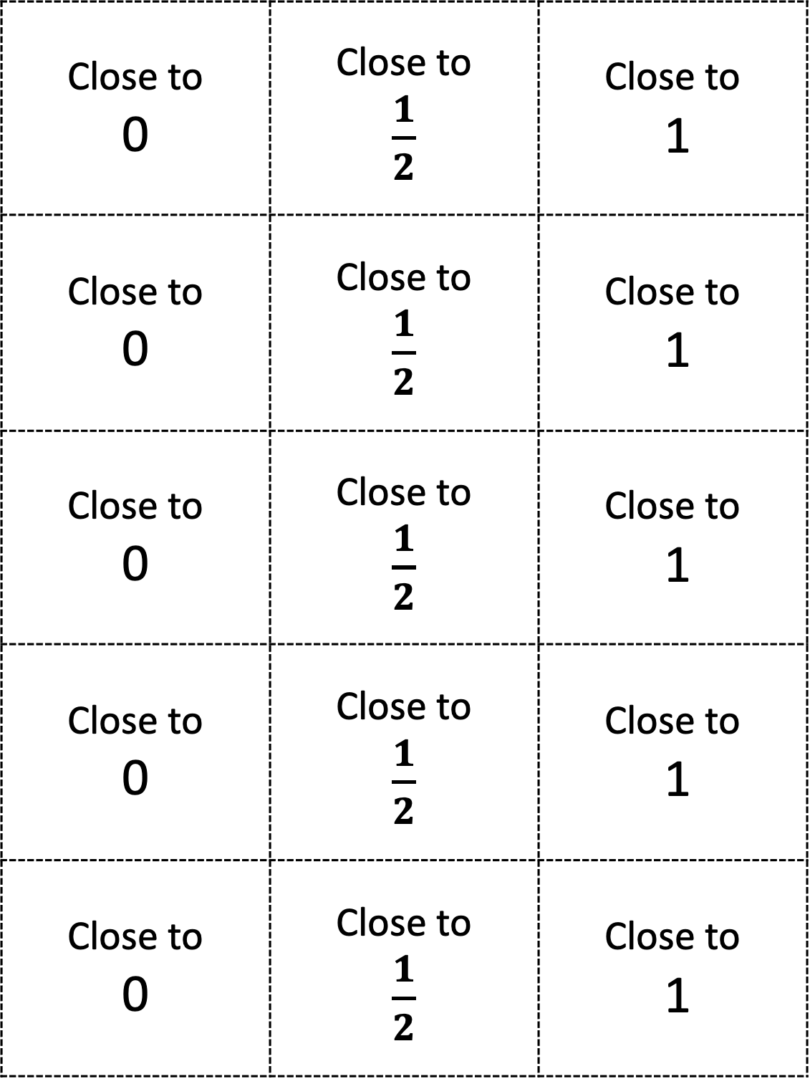
Close to 0 | Close to $\frac{1}{2}$ | Close to 1
Close to 0 | Close to $\frac{1}{2}$ | Close to 1
Close to 0 | Close to $\frac{1}{2}$ | Close to 1
Close to 0 | Close to $\frac{1}{2}$ | Close to 1
Close to 0 | Close to $\frac{1}{2}$ | Close to 1

