Slide 1
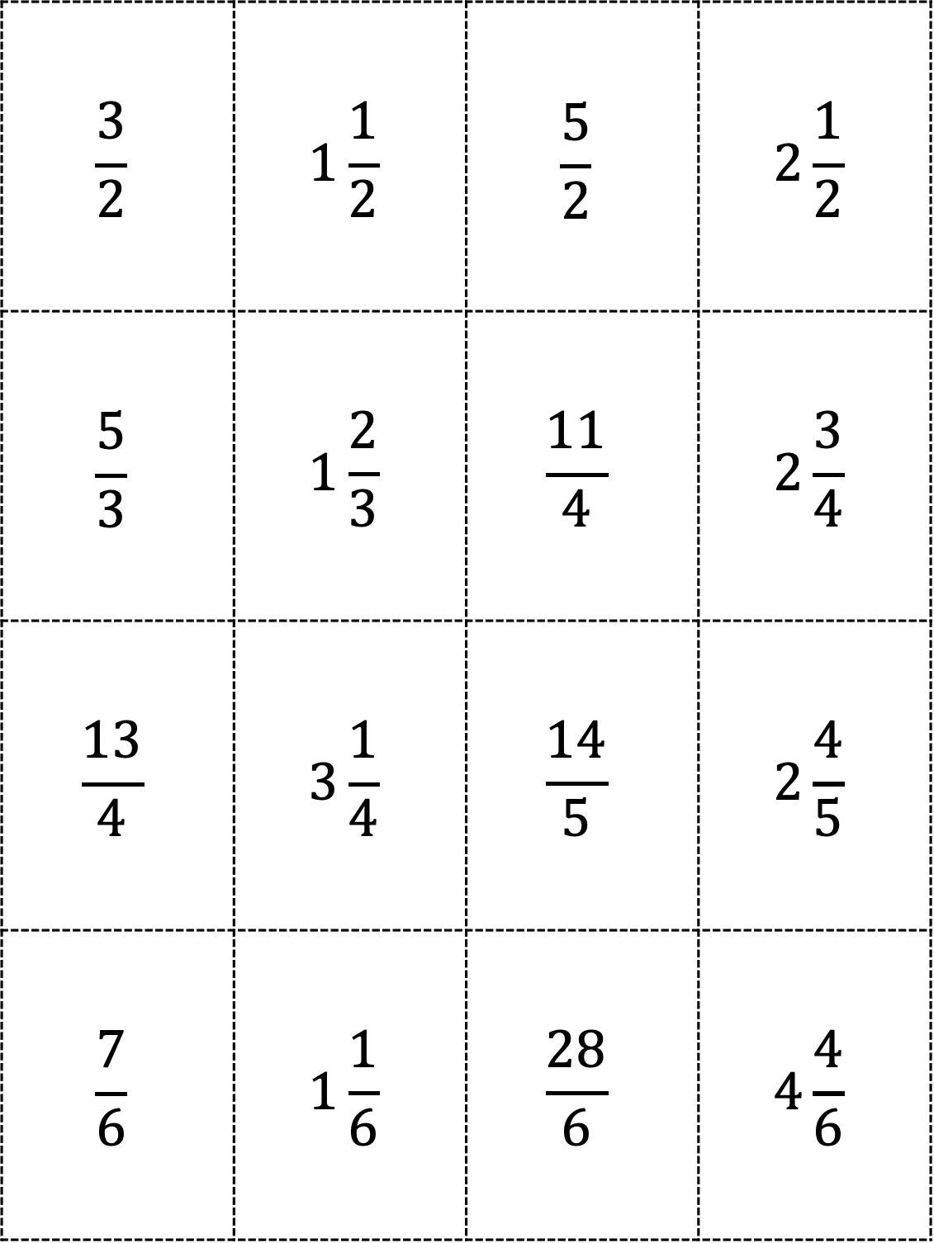
$$\frac{3}{2}$$ | $$1\frac{1}{2}$$ | $$\frac{5}{2}$$ | $$2\frac{1}{2}$$
$$\frac{5}{3}$$ | $$1\frac{2}{3}$$ | $$\frac{11}{4}$$ | $$2\frac{3}{4}$$
$$\frac{13}{4}$$ | $$3\frac{1}{4}$$ | $$\frac{14}{5}$$ | $$2\frac{4}{5}$$
$$\frac{7}{6}$$ | $$1\frac{1}{6}$$ | $$\frac{28}{6}$$ | $$4\frac{4}{6}$$
Please see PDF in case the formatting of this file changes.

Slide 2
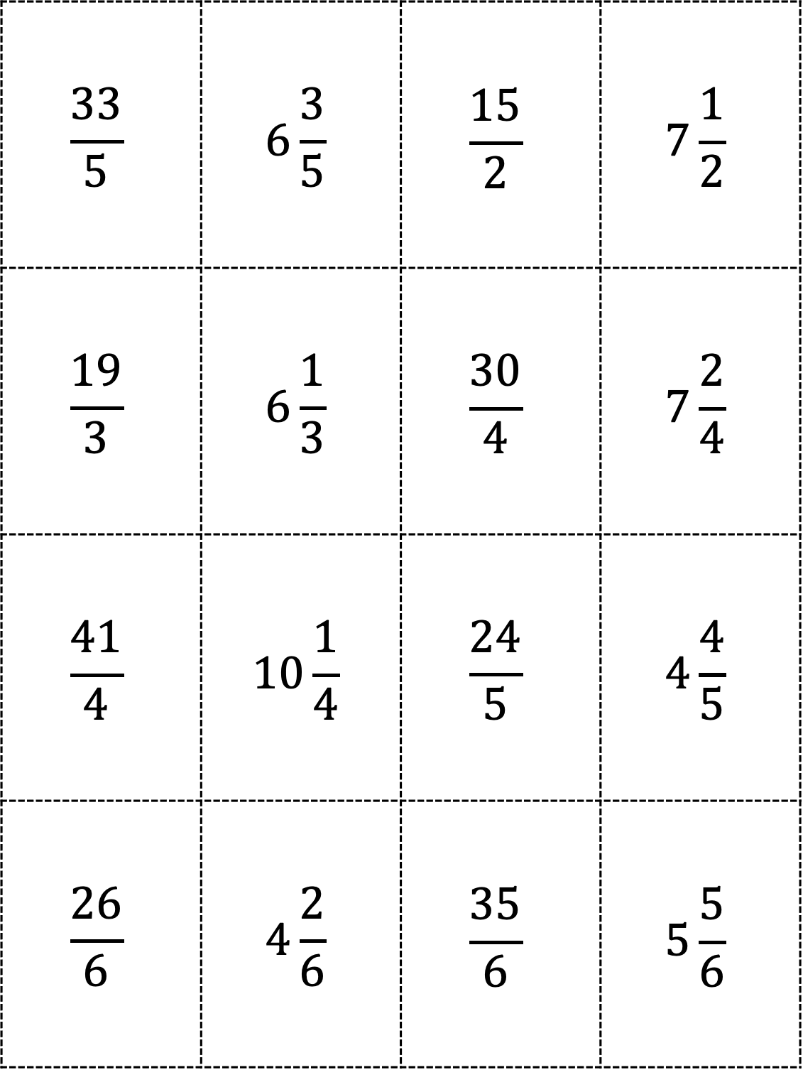
$$\frac{33}{5}$$ | $$6\frac{3}{5}$$ | $$\frac{15}{2}$$ | $$7\frac{1}{2}$$
$$\frac{19}{3}$$ | $$6\frac{1}{3}$$ | $$\frac{30}{4}$$ | $$7\frac{2}{4}$$
$$\frac{41}{4}$$ | $$10\frac{1}{4}$$ | $$\frac{24}{5}$$ | $$4\frac{4}{5}$$
$$\frac{26}{6}$$ | $$4\frac{2}{6}$$ | $$\frac{35}{6}$$ | $$5\frac{5}{6}$$

