Slide 1
Conclusion Moving Forward
The Teacher Clarity Playbook

Slide 2
Objectives for Today
Participants will:
Consider three ways to measure one’s own success with teacher clarity

Slide 3
What is Teacher Clarity?
Fendick (1990) defined teacher clarity as “a measure of the clarity of communication between teachers and students in both directions” (p. xiv)
Clarity of organization
Clarity of explanation
Clarity of examples and guided practice
Clarity of assessment of student learning

Slide 4
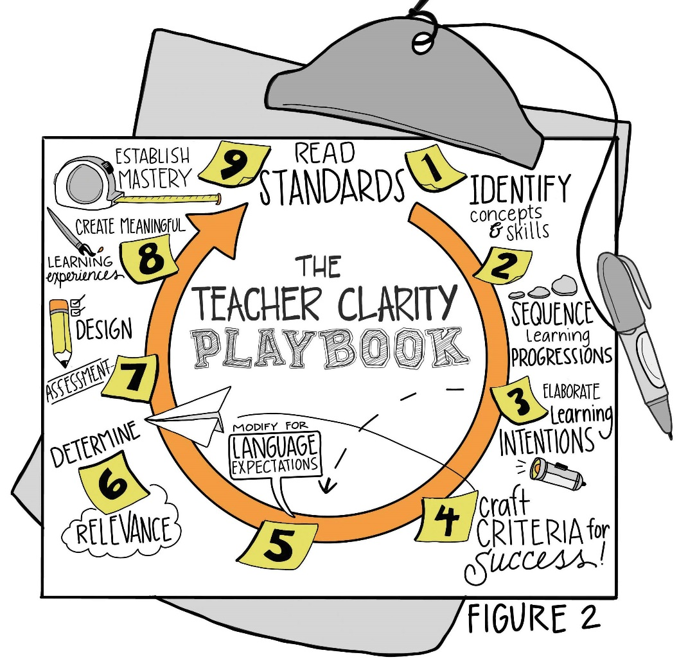
A Process for Planning for Teacher Clarity

Slide 5
Three Ways to Measure One’s Clarity
Ask students what they are learning and why.
Use pre-assessment and post-assessment data to compare results.
Share results with students.

Slide 6
PLC Conversations
How will we measure our success toward achieving higher levels of teacher clarity?
How will we continue to collaborate?

Slide 7
Wrap Up: Why Are We Doing This?
“When learning is organized and intentional, and when the learner knows what he or she is learning, great things can happen. When students don’t know what they are learning, don’t care about their learning, and have no idea if they are learning, great things are unlikely to happen.” (pg. xiv)

