Slide 1
Module 1. Identifying Concepts and Skills
The Teacher Clarity Playbook

Slide 2
Objectives for Today
Participants will:
Differentiate between concepts and skills in standards
Examine examples of concepts and skills in four grade levels
Complete a guided learning exercise to check for understanding
Apply the process to identify concepts and skills in the selected standard

Slide 3
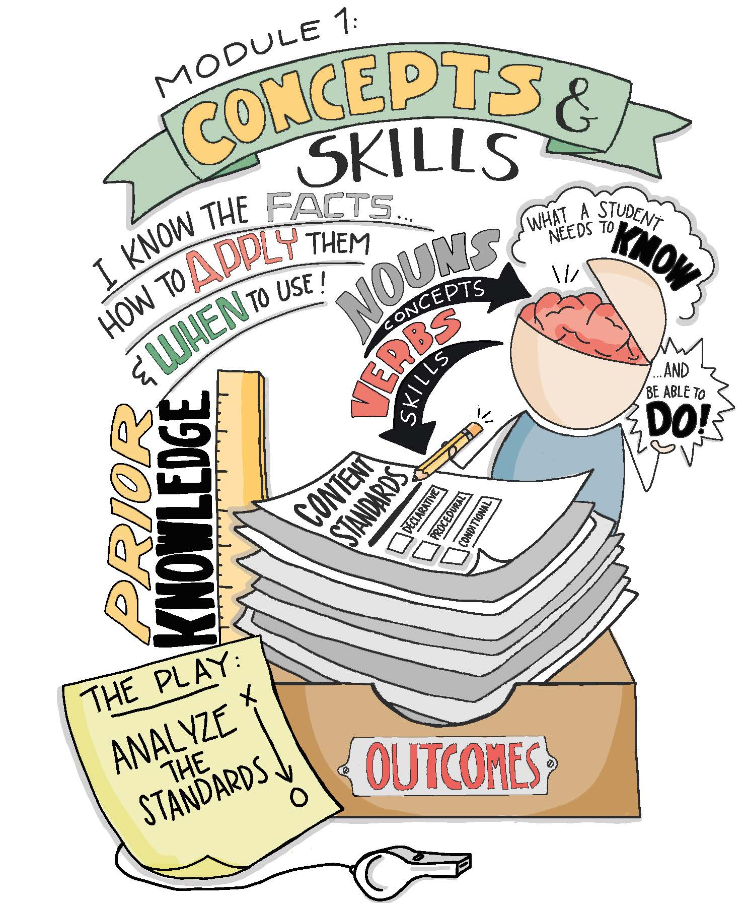

Slide 4
Modeling
Read and discuss the four examples on page 4-5.
Are there points of divergence?
How might we come to consensus?

Slide 5
Guided Practice
Use the two examples on page 6 to apply this process.
Follow the detailed instructions to complete the exercise.
Check for understanding by viewing the possible answers in the appendix of The Teacher Clarity Playbook.

Slide 6
On Your Own
Individually or in teams, use the same process with your selected standard.
Complete this on chart paper, or using digital collaboration tools.

Slide 7
PLC Conversations
What challenged you in this module?
How will you package and pace the standards? Would a pacing guide for all of the standards be useful?
How will you know if you analyzed the standard(s) correctly?

Slide 8
Wrap Up: Why Are We Doing This?
“Knowing the standards well allows teachers to identify the necessary prior knowledge and to determine the expectations for students’ success. In nearly all cases, the standards themselves articulate outcomes of learning and often call upon students to apply what they have learned to an ever-widening set of situations and texts.” (p. 9)

