Slide 3
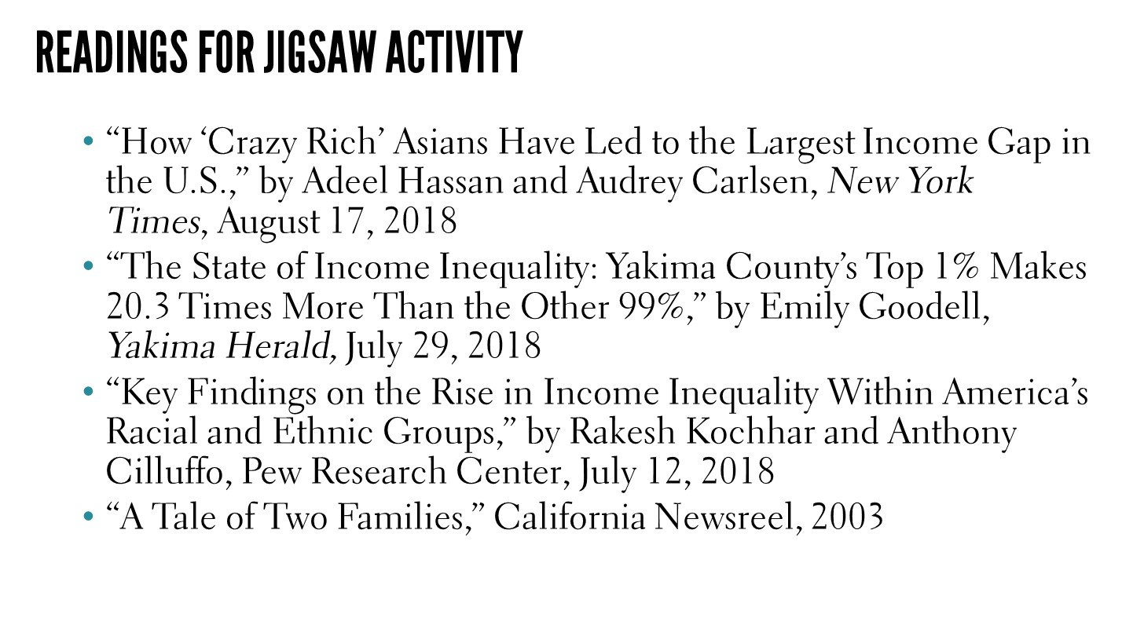

Slide 6
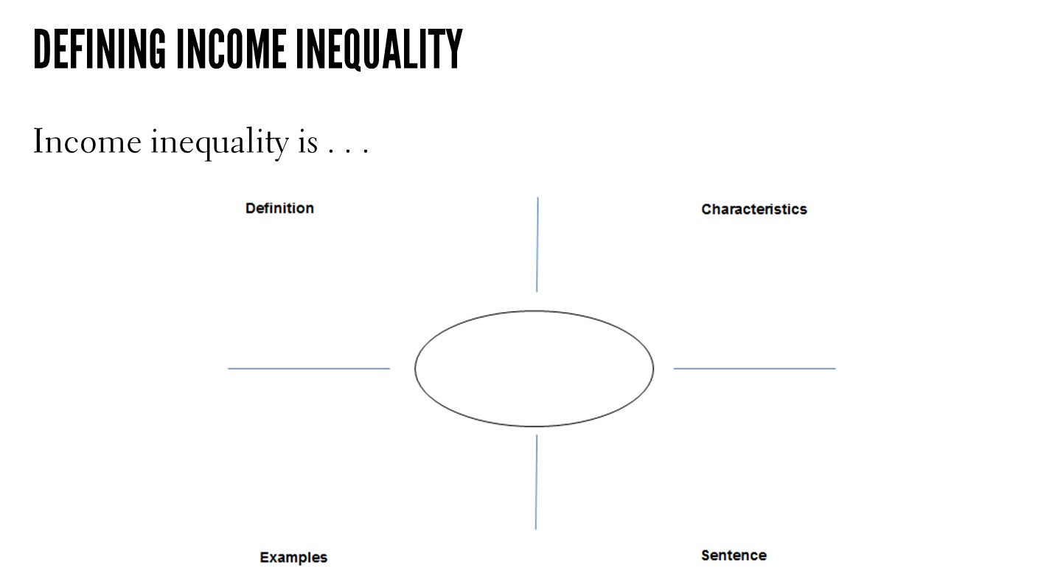

Slide 8
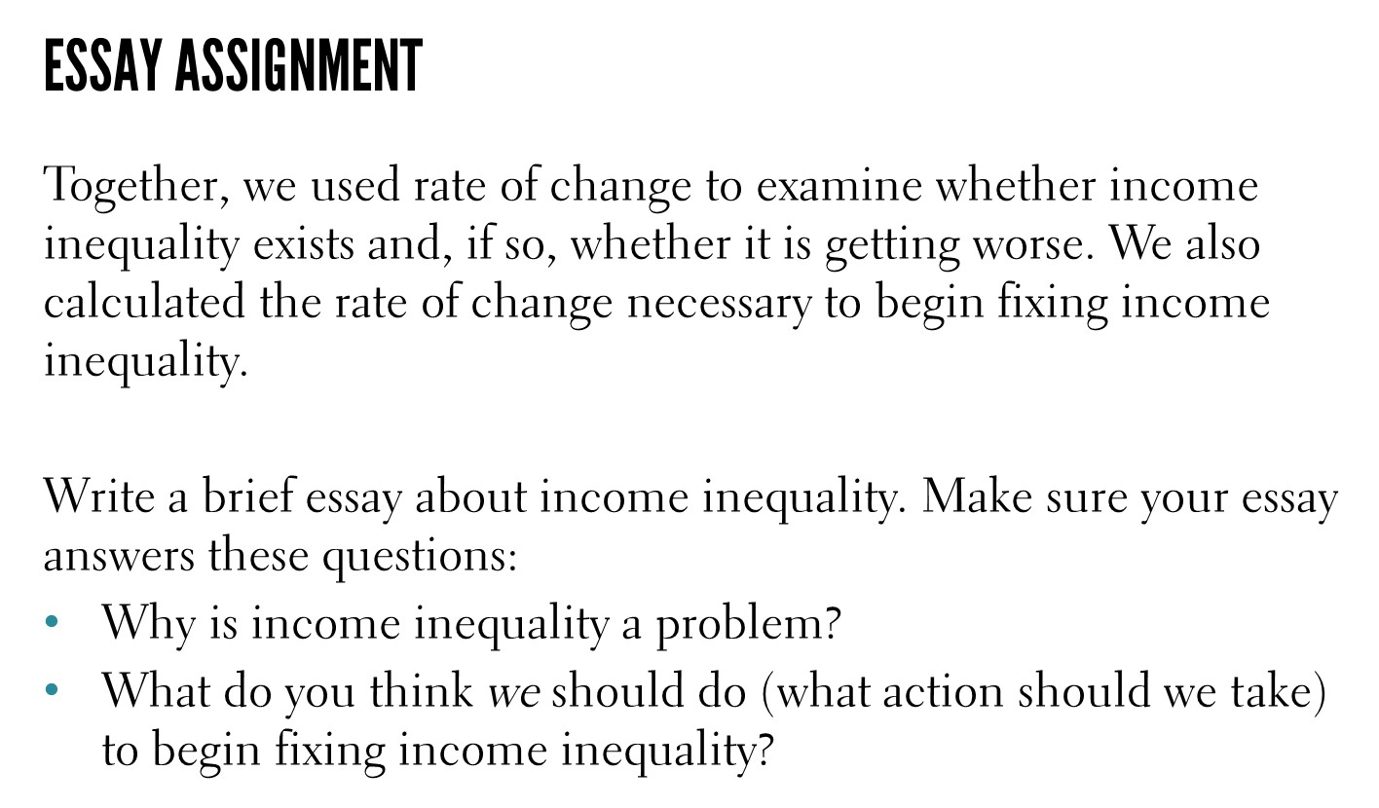

Slide 9
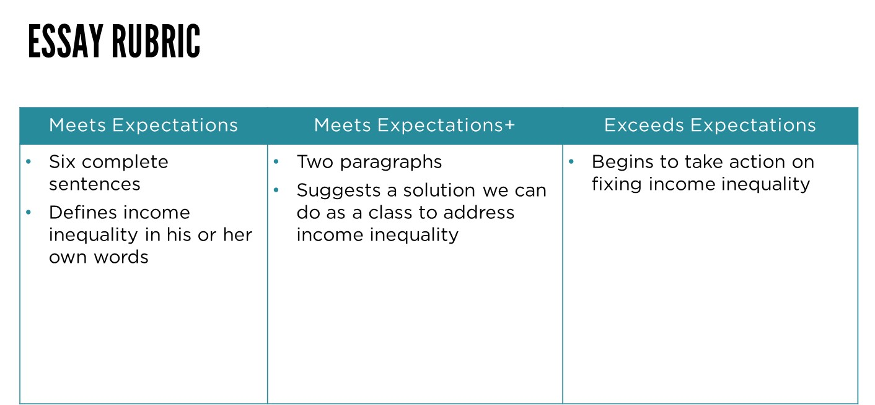
[BL1]Not a fan of including a rubric; I suspect it will cause students to write to that instead of their passion.

