Slide 1
Module 5
Engagement
Engagement by Design

Slide 2
Objectives for Today
Participants will
Learn about the “engagement gap”
Study the three types of engagement
Explore the “engagement equation”
Learn how applying all the facets of engagement results in enhanced student outcomes

Slide 3
The Engagement Gap
When it comes to tackling the achievement gap,
there must first be an understanding that this is a symptom of a much greater challenge . . .
an engagement gap.

Slide 4
Dimensions of Engagement
Behavioral Engagement Academic behaviors and actions | Participates in school functions Attends and participates in class activities and discussions Follows school rules Studies Completes assignments
Cognitive Engagement Psychological effort | Desires challenge Self-regulates Plans, monitors, and evaluates one’s thinking and learning
Emotional Engagement How students feel | Is comfortable talking to peers Engages in group learning Asks questions of teachers Interested, inquisitive, and curious about academic content

Slide 5
Dimensions of Engagement
Behavioral Engagement Academic behaviors and actions | Participates in school functions Attends and participates in class activities and discussions Follows school rules Studies Completes assignments
Cognitive Engagement Psychological effort | Desires challenge Self-regulates Plans, monitors, and evaluates one’s thinking and learning
Emotional Engagement How students feel | Is comfortable talking to peers Engages in group learning Asks questions of teachers Interested, inquisitive, and curious about academic content

Slide 6
Dimensions of Engagement
Behavioral Engagement Academic behaviors and actions | Participates in school functions Attends and participates in class activities and discussions Follows school rules Studies Completes assignments
Cognitive Engagement Psychological effort | Desires challenge Self-regulates Plans, monitors, and evaluates one’s thinking and learning
Emotional Engagement How students feel | Is comfortable talking to peers Engages in group learning Asks questions of teachers Interested, inquisitive, and curious about academic content

Slide 7
Dimensions of Engagement
Behavioral Engagement Academic behaviors and actions | Participates in school functions Attends and participates in class activities and discussions Follows school rules Studies Completes assignments
Cognitive Engagement Psychological effort | Desires challenge Self-regulates Plans, monitors, and evaluates one’s thinking and learning
Emotional Engagement How students feel | Is comfortable talking to peers Engages in group learning Asks questions of teachers Interested, inquisitive, and curious about academic content

Slide 8
Balanced Model for Optimal Learning

Slide 9
The Engagement Equation
S = Students R = Relationships
T = Teachers TC = Teacher Clarity
C = Content CH = Challenge
P = Purpose SW = Student Worth
V = voice

Slide 10
Student Voice: Most Critical Component
Students want to be understood.
Students deserve to be understood.
Students must take responsibility for expressing thoughts and advocating for themselves and others.
Teachers must afford opportunities to all students to turn their voices into meaningful action.

Slide 11
Voice

Slide 12
The Importance of Self-Worth
Self-worth occurs when students know they are uniquely valued members of the school community; have a person in their lives they can trust and learn from; and believe they have the ability to achieve—academically, personally, and socially.
Quaglia and Corso, 2014

Slide 13
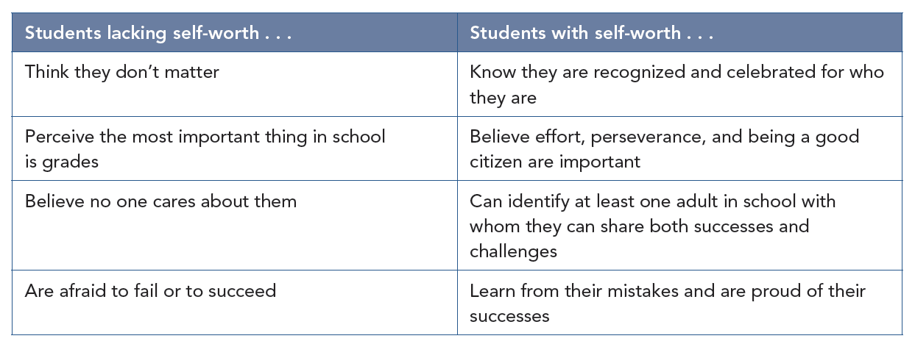
Self-Worth

Slide 14
Purpose
When students find purpose in their experience at school, they are 17 times more likely to be academically motivated to learn.

Slide 15
Purpose

Slide 16
Engaged Students
Look Like? Sound Like? Feel Like?
Engaged students . . .
  Lose track of time and space
  Are not afraid to fail or succeed
  Are able to express their honest opinions and concerns
  Are emotionally, intellectually, and behaviorally invested in learning

Slide 17
Engaged Students

Slide 18
Engaged Classrooms

Slide 19
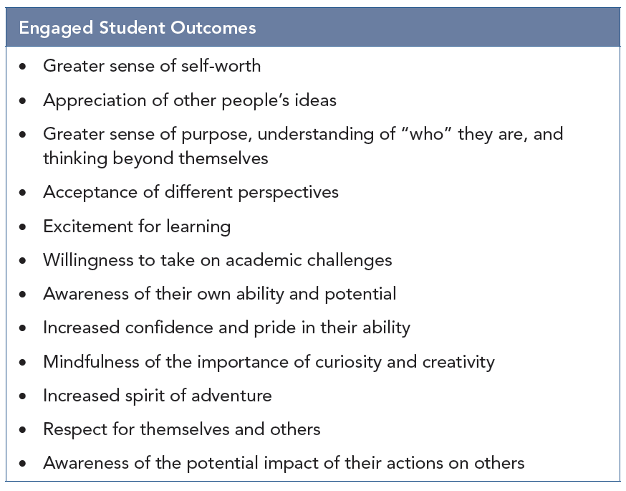
Engaged Student Outcomes

