Slide 1
Module 4 Challenge
Engagement by Design

Slide 2
Objectives for Today
Participants will
Understand the theoretical framework for struggle
Learn how productive struggle enhances engagement
Analyze four quadrants in the overlap of difficulty and complexity
Learn tasks that enhance fluency, strategic thinking, struggle, and stamina

Slide 3
Vygotsky’s Theory
Zone of Actual Development
Zone of Proximal Development
ZPD
Zone of Potential
(Future) Development

Slide 4
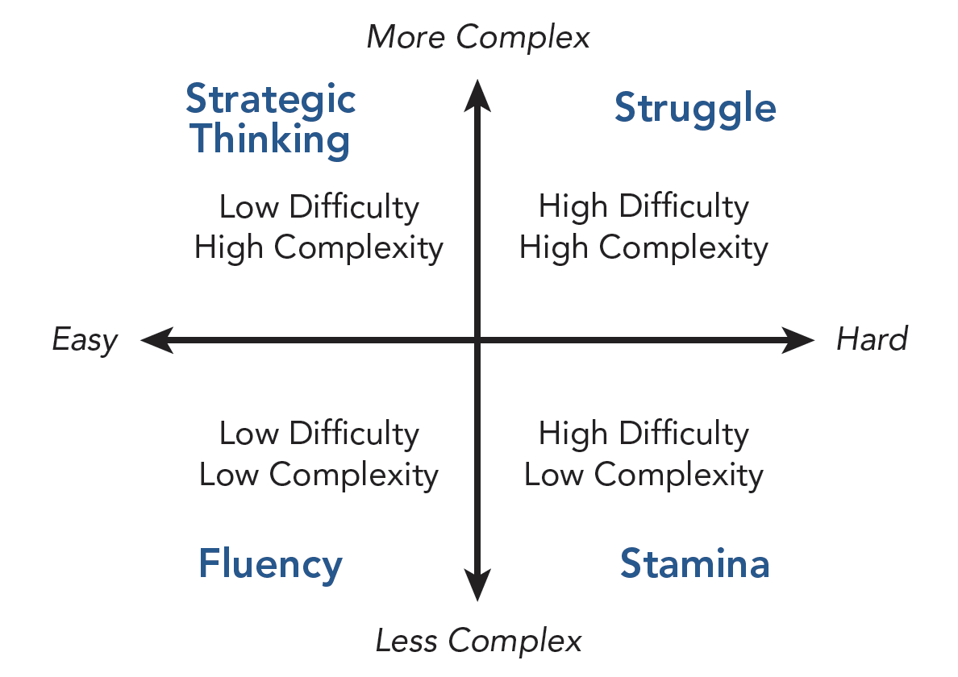
Difficulty and Complexity

Slide 5
Fluency
Perform tasks with a level of fluidity, speed, accuracy
Important to developing expertise
Rapid recognition of specific skills in reading, writing, and mathematics
Continual movement toward fluent production throughout school

Slide 6
Three Tools That Develop Fluency
Spaced practice: distributing practice over time
Repeated reading: deepens comprehension and contributes to fluent reading
Mnemonics: aid in information storage and rapid retrieval assists—best when students construct their own devices
Types of mnemonics: words, images, graphic organizers

Slide 7
Stamina
Building endurance and staying power
Importance of monitoring student progress and offering feedback
Ways teachers can help students develop stamina
Help them understand and have a growth mindset
Push with clear expectations and gentle support
Model perseverance
Teach positive self-talk
Remind them how the brain changes with use

Slide 8
Tools That Build Stamina: Wide Independent Reading
Wide independent reading builds students’ background knowledge and their vocabulary. Choice about what to read enhances and offers students opportunities to make decisions.
Factors for Implementing Successful Wide Reading
Access: wide range of topics and genres | Appeal: address students’ interests
Conducive environment: quiet and comfortable setting | Encouragement: supportive adult role models
Staff training: focuses on goals and procedures | Nonaccountability: no book reports
Follow-up activities: conversations, book talks, and book recommendations | Distributed time to read: 15–20 minutes daily

Slide 9
Tools That Build Stamina: Research Projects
Offer students opportunities to . . .
Engage in research
Analyze the research
Summarize and synthesize findings
Teachers support students, helping them with pacing, sustaining focus, and completing a project.
Research is enhanced when there is relevance, differentiation, and some degree of choice.

Slide 10
Strategic Thinking
Strategic thinking develops these abilities in students:
Formulate goals and create a plan to achieve them
Gather and integrate information
Make decisions about how to proceed
Reflect on one’s actions and thinking
Adjust actions based on these reflections

Slide 11
Consider These Quotes From Outliers
Practice isn’t the thing you do once you’re good. It’s the thing you do that makes you good.
If you work hard enough and assert yourself, and use your mind and imagination, you can shape the world to your desires.
Malcolm Gladwell

Slide 12
Struggle That Builds Expertise
Tasks that contribute to critical thinking development that also involve struggle include
Peer critiques
Close reading within and across documents
Project-based learning

Slide 13
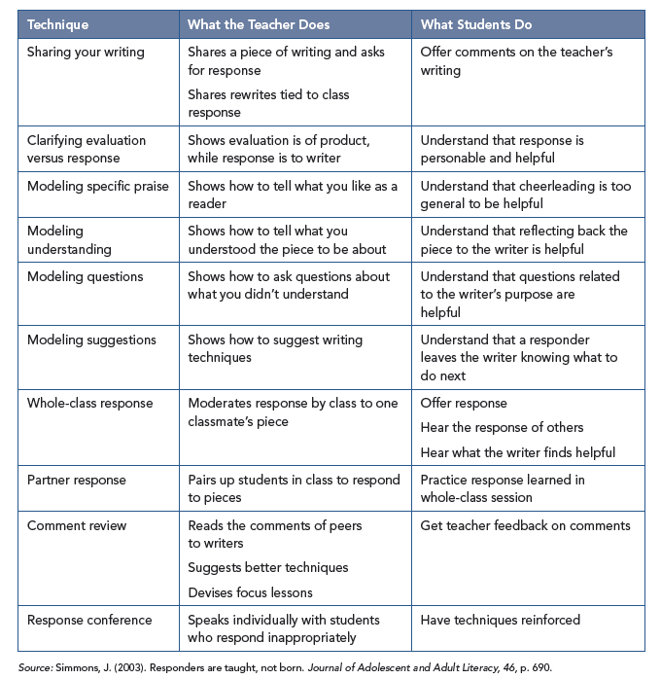
Tasks That Involve Struggle: Peer Critique
Teachers teach students productive ways to offer peer critiques using an array of effective techniques for peer responding.

Slide 14
Tasks That Involve Struggle: Close Reading
Close reading is an instructional routine that allows students to carefully read texts using strategic thinking, rereading, and metacognitive questioning.
Some examples include
Reading short passages
Reading excerpts from longer texts
Reading to answer text-dependent questions
Annotating texts to chronicle insights and observations

Slide 15
Tasks That Involve Struggle: Project-Based Learning
Project-based learning is an extended process that offers learners ways to build knowledge and expertise through inquiry-based approaches.
Students apply goal-setting, monitoring, reflecting, and strategic thinking to arrive at solutions during a project, promoting stamina and transfer of learning.

Slide 16
Difficulty and Complexity

